Slide 1
Advanced c++
- P. Sathya

Slide 2
About C++
If you're an experienced C++ programmer and are anything like me, you initially approached C++11 thinking, "Yes, yes, I get it. It's C++, only more so." But as you learned more, you were surprised by the scope of the changes. auto declarations, range-based for loops, lambda expressions, and rvalue references change the face of C++, to say nothing of the new concurrency features. And then there are the idiomatic changes. 0 and typedefs are out, nullptr and alias declarations are in. Enums should now be scoped. Smart pointers are now preferable to built-in ones. Moving objects is normally better than copying them. - Effective Modern C++ by Scott Meyers

Slide 3
Birds eye view on data type alignment
CPU Keeps frequently used variables are housed in register for faster access instead of memory
#include <cstdint> // for fixed-width integers
#include <iostream>
int main()
{
std::cout << "least 8: " << sizeof(std::int_least8_t) * 8 << " bits\n";
std::cout << "least 16: " << sizeof(std::int_least16_t) * 8 << " bits\n";
std::cout << "least 32: " << sizeof(std::int_least32_t) * 8 << " bits\n";
std::cout << '\n';
std::cout << "fast 8: " << sizeof(std::int_fast8_t) * 8 << " bits\n"; // check for the use case
std::cout << "fast 16: " << sizeof(std::int_fast16_t) * 8 << " bits\n";
std::cout << "fast 32: " << sizeof(std::int_fast32_t) * 8 << " bits\n";
return 0;
}

Slide 4
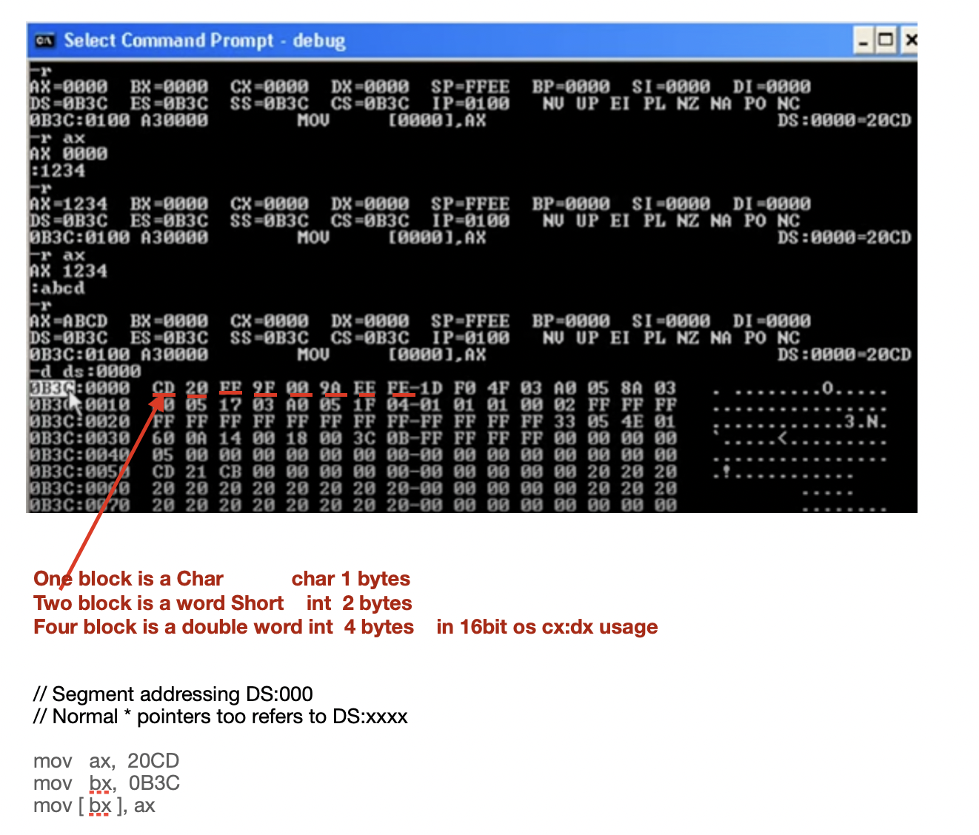
Birds eye view on data type alignment
/

Slide 5
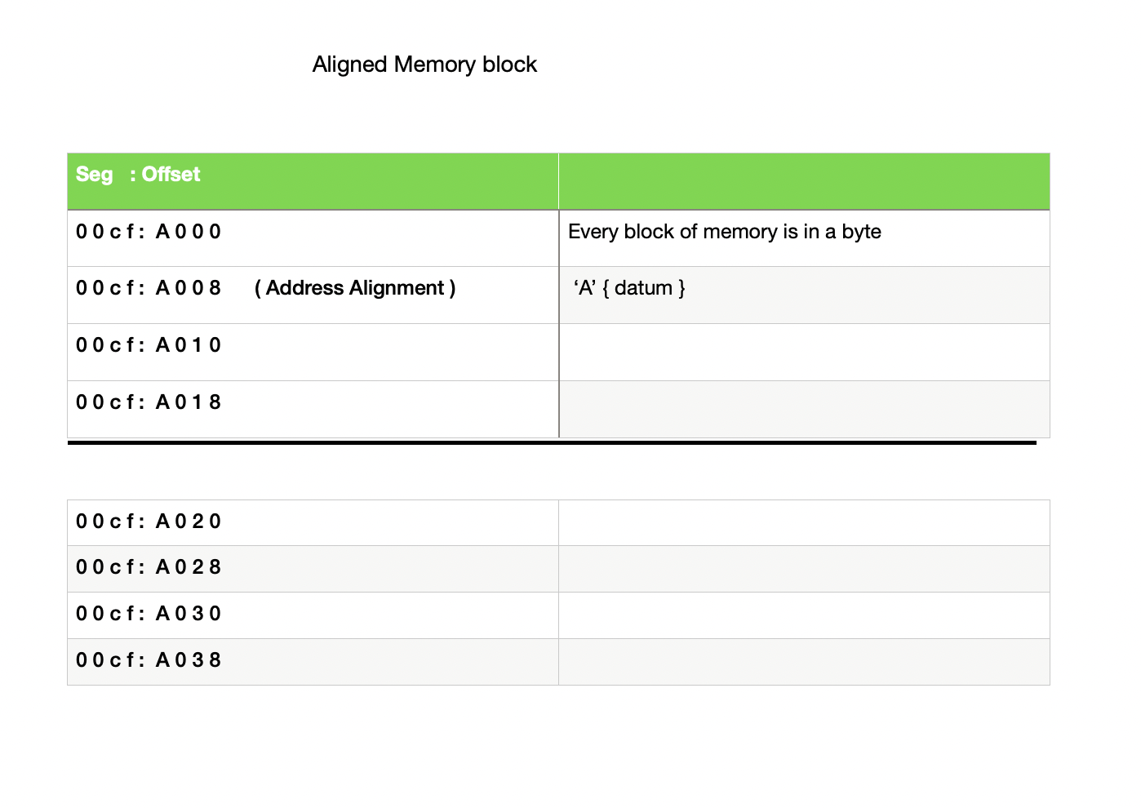
Birds eye view on data type alignment
/

Slide 6
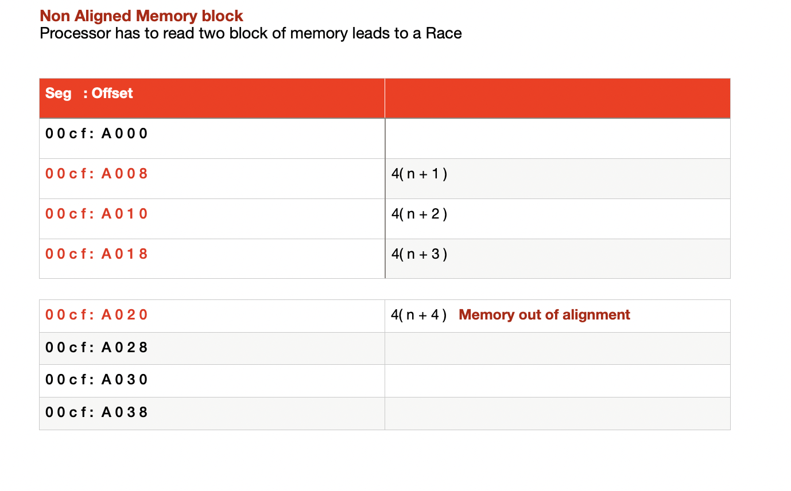
Birds eye view on data type alignment
/

Slide 7
Birds eye view on data type alignment
struct nonAligned{
char c1 ;
// 1 byte paddding with or withot the following line it allocates same mempry!!!
// char Padding1[1]; // 1 byte for the following 'short' to be aligned on a 2 byte boundary
short s1 ;
int i1 ;
char c2 ;
// 3 byte padding compiler does as folllows
// char Padding2[3]; /* 3 bytes to make total size of the structure 12 bytes */
};
std::cout << "non alignerd struct size align: " << sizeof(nonAligned) << std::endl;
non aligned struct size align: 12
std::cout << " aligining nonAlinged struct struct size again : " << alignof(nonAligned) << std::endl;
——————————————————————————————————————————————————————————————-
struct Aligned_{
int i1;
short s1 ;
char c1 ;
char c2 ;
};
std::cout << " aligned struct size align: " << sizeof(Aligned_) << std::endl;
aligned struct size align: 8

Slide 8
Value category expression gValue rValue lValue xValue prValue
An lvalue has an address that your program can access. Examples of lvalue expressions include variable , const variables, array elements, function calls that return an lvalue reference, bit-fields, unions, and class members.
A xvalue expression has no address but can be used to initialize an rvalue reference, which provides access to the expression. Examples include function calls that return an rvalue reference, the array subscript, etc.
A glvalue (“generalized” lvalue) is an lvalue or an xvalue.
An rvalue ( rvalues could appear on the right-hand side of an assignment expression) is an xvalue, a temporary object or subobject thereof, or a value that is not associated with an object.
A prvalue expression has no address that is accessible by your program. ie, of prvalue expressions include literals, function calls that return a non-reference type
/

Slide 9
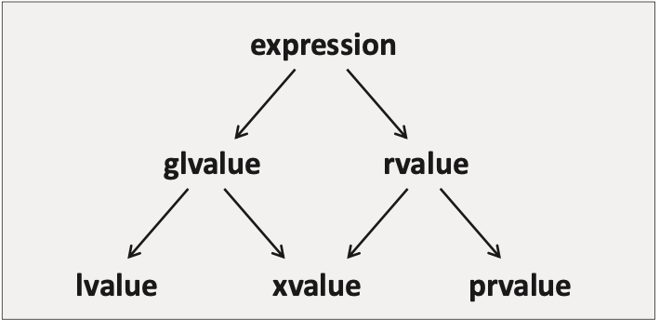
value category since c++11

Slide 10
value category since c++11
gvalue
A glvalue expression is either lvalue or xvalue.
Properties:
A glvalue may be implicitly converted to a prvalue with lvalue-to-rvalue, array-to-pointer, or function-to-pointer implicit conversion.
A glvalue may be polymorphic: the dynamic type of the object it identifies is not necessarily the static type of the expression.
A glvalue can have incomplete type, where permitted by the expression.

Slide 11
value category since c++11
rvalue
An rvalue expression is either prvalue or xvalue.
Properties:
Address of an rvalue cannot be taken by built-in address-of operator: &int(), &i++^{[3]}, &42, and &std::move(x) are invalid.
An rvalue can't be used as the left-hand operand of the built-in assignment or compound assignment operators.
An rvalue may be used to initialize a const lvalue reference, in which case the lifetime of the object identified by the rvalue is extended until the scope of the reference ends.

Slide 12
value category since c++11
lvalues are:
An expression that is just the name of a variable, function, or member
An expression that is just a string literal
The result of the built-in unary * operator (i.e., what dereferencing a raw pointer yields)
The result of a function returned by lvalue reference (type&)
lvalue
The following expressions are lvalue expressions:
a = b, a += b, a %= b, and all other built-in assignment and compound assignment expressions;
++a and --a, the built-in pre-increment and pre-decrement expressions;
*p, the built-in indirection expression;
a[n] and p[n]
a function call or an overloaded operator expression, whose return type is lvalue reference, such as std::getline(std::cin, str), std::cout << 1, str1 = str2, or ++it;

Slide 13
value category since c++11
xvalue
The following expressions are xvalue expressions:
a function call or an overloaded operator expression, whose return type is rvalue reference to object, such as std::move(x);
a[n], the built-in subscript expression, where one operand is an array rvalue;
a.m, the member of object expression, where a is an rvalue and m is a non-static data member of non-reference type;
a.*mp, the pointer to member of object expression, where a is an rvalue and mp is a pointer to data member;
a ? b : c, the ternary conditional expression for certain b and c (see definition for detail);

Slide 14
value category since c++11
prvalues are:
Expressions that consist of a literal that is not a string literal (or a user-defined literal, where the return type of the associated literal operator defines the category)
The result of the built-in unary & operator (i.e., what taking the address of an expression yields)
The result of built-in arithmetic operators
The result of a function returned by value
A lambda expression
a literal (except for string literal), such as 42, true or nullptr;
a function call or an overloaded operator expression, whose return type is non-reference, such as str.substr(1, 2), str1 + str2, or it++;
a++ and a--, the built-in post-increment and post-decrement expressions;
a + b, a % b, a & b, a << b, and all other built-in arithmetic expressions;

Slide 15
value category since c++11
xvalue
The following expressions are xvalue expressions:
a function call or an overloaded operator expression, whose return type is rvalue reference to object, such as std::move(x);
a[n], the built-in subscript expression, where one operand is an array rvalue;
a.m, the member of object expression, where a is an rvalue and m is a non-static data member of non-reference type;
a.*mp, the pointer to member of object expression, where a is an rvalue and mp is a pointer to data member;
a ? b : c, the ternary conditional expression for certain b and c (see definition for detail);

Slide 16
C++ 14 features binary literals
#include <iostream>
using namespace std;
// Driver Code
int main()
{
// Hexadecimal number with
// prefix '0x'
int h = 0x13ac;
// Octal number with prefix '0'
int o = 0117;
// Print the number of the
// hexadecimal form
cout << h << endl;
// Print the number of the
// octal form
cout << o;
return 0;
}
Out Put : h : 5036 : O : 79

Slide 17
C++ 14 features binary literals
// Driver Code
int main()
{
// Binary literal with prefix '0b'
int a = 0b00001111;
cout << a << '\n';
// Binary literal with prefix '0B'
int b = 0B00001111;
cout << b;
return 0;
}
auto x = 0xa;
std::cout << " x = "<< x << " "<< sizeof(x);

Slide 18
Fixed int width
Why isn’t the size of the integer variables fixed?
The short answer is that this goes back to C, when computers were slow and performance was of the utmost concern. C opted to intentionally leave the size of an integer open so that the compiler implementers could
pick a size for int that performs best on the target computer architecture.
Consider the int type. The minimum size for int is 2 bytes, but it’s often 4 bytes on modern architectures. If you assume an int is 4 bytes because that’s most likely, then your program will probably misbehave on architectures where int is actually 2 bytes
(since you will probably be storing values that require 4 bytes in a 2 byte variable, which will cause overflow or undefined behavior). If you assume an int is only 2 bytes to ensure maximum compatibility, then on systems where int is 4 bytes,
you’re wasting 2 bytes per integer and doubling your memory usage!

Slide 19
Fixed int width
std::int8_t 1 byte signed 128 to 127
Treated like a signed char on many systems. See note below.
std::uint8_t 1 byte unsigned 0 to 255
Treated like an unsigned char on many systems. See note below.
std::int16_t 2 byte signed -32,768 to 32,767
std::uint16_t 2 byte unsigned 0 to 65,535
std::int32_t 4 byte signed -2,147,483,648 to 2,147,483,647
std::uint32_t 4 byte unsigned 0 to 4,294,967,295
std::int64_t 8 byte signed -9,223,372,036,854,775,808 to 9,223,372,036,854,775,807
std::uint64_t 8 byte unsigned 0 to 18,446,744,073,709,551,615

Slide 20
Fixed int width
C++ officially adopted these fixed-width integers as part of C++11. They can be accessed by including the <cstdint> header,
where they are defined inside the std namespace. Here’s an example:
#include <cstdint> // for fixed-width integers
#include <iostream>
int main()
{
std::int16_t i{5};
std::cout << i;
return 0;
}
The fixed-width integers have two downsides that are typically raised.
First, the fixed-width integers are not guaranteed to be defined on all architectures. They only exist on systems where there are fundamental types matching their widths and following a certain binary representation.
Your program will fail to compile on any such architecture that does not support a fixed-width integer that your program is using. However, given that most modern architectures have standardized around 8/16/32/64-bit variables,
this is unlikely to be a problem unless your program needs to be portable to some exotic mainframe or embedded architectures.

Slide 21
Fixed int width
Second, if you use a fixed-width integer, it may be slower than a wider type on some architectures. For example, if you need an integer that is guaranteed to be 32-bits, you might decide to use std::int32_t, but your CPU might actually be faster at processing 64-bit integers. However, just because your CPU can process a given type faster doesn’t mean your program will be faster overall -- modern programs are often constrained by memory usage rather than CPU, and the larger memory footprint may slow your program more than the faster CPU processing accelerates it. It’s hard to know without actually measuring.

Slide 22
Fixed int width
#include <cstdint> // for fixed-width integers
#include <iostream>
int main()
{
std::cout << "least 8: " << sizeof(std::int_least8_t) * 8 << " bits\n";
std::cout << "least 16: " << sizeof(std::int_least16_t) * 8 << " bits\n";
std::cout << "least 32: " << sizeof(std::int_least32_t) * 8 << " bits\n";
std::cout << '\n';
std::cout << "fast 8: " << sizeof(std::int_fast8_t) * 8 << " bits\n";
std::cout << "fast 16: " << sizeof(std::int_fast16_t) * 8 << " bits\n";
std::cout << "fast 32: " << sizeof(std::int_fast32_t) * 8 << " bits\n";
return 0;
}
least 8: 8 bits : int_fast16_t is most efficient type in speed with at least the range of a 16 bit int.
least 16: 16 bits In a 64-bit machine, where one would expect to have int as 64-bit, a compiler may use a mode with
32-bit int compilation for compatibility. In this mode, int_fast16_t could be 64-bit as that is natively
the fastest width for it avoids alignment issues, etc.
least 32: 32 bits
fast 8: 8 bits
fast 16: 32 bits
fast 32: 32 bits

Slide 23
Fixed int width
#include <cstdint>
#include <iostream>
int main()
{
std::int8_t myint{65};
std::cout << myint;
return 0;
}
On most systems, this program will print ‘A’ (treating myint as a char). However, on some systems, this may print 65 as expected.

Slide 24
Fixed int width
#include <iostream>
int main()
{
std::cout << sizeof(int) << '\n';
return 0;
}
4
#include <cstddef> // std::size_t
#include <iostream>
int main()
{
std::cout << sizeof(std::size_t) << '\n';
return 0;
}
4

Slide 25
Fixed int width
#include <cstdint> // for fixed-width integers
#include <iostream>
int main()
{
std::uint_fast16_t sometype { 0 };
--sometype; // intentionally overflow to invoke wraparound behavior
std::cout << sometype; // 65556
return 0;
}

Slide 26
User defined literals
// Examples of classical long double Weight = 2.3; // pounds? kilograms? grams?
// With UDL, we attach units to the values which has
// following advantages
// 1) The code becomes readable.
// 2) Conversion computations are // literals (UDLs)
#include<iostream>
#include<iomanip>
using namespace std;
// user defined literals
// KiloGram
long double operator"" _kg( long double x )
{
return x*1000;
}
// Gram
long double operator"" _g( long double x )
{
return x;
}
// MiliGram
long double operator"" _mg( long double x )
{
return x / 1000;
}
// Driver code
int main()
{
long double weight = 3.6_kg;
cout << weight << endl;
cout << setprecision(8) << ( weight + 2.3_mg ) << endl;
cout << ( 32.3_kg / 2.0_g ) << endl;
cout << ( 32.3_mg *2.0_g ) << endl;
return 0;
}
done at compile time.
weight = 2.3kg;
ratio = 2.3kg/1.2lb;
literals for // Examples of classical literals for built-in types.
42 // int
2.4 // double
3.2F // float
'w' // char
32ULL // Unsigned long long
0xD0 // Hexadecimal unsigned
"cd" // C-style string(const char[3]")
// Examples of classical literals for built-in types.
42 // int
2.4 // double
3.2F // float
'w' // char
32ULL // Unsigned long long
0xD0 // Hexadecimal unsigned
"cd" // C-style string(const char[3]")
built-in types.
42 // int
2.4 // double
3.2F // float
'w' // char
32ULL // Unsigned long long
0xD0 // Hexadecimal unsigned
"cd" // C-style string(const char[3]")
// Examples of classical literals for built-in types.
42 // int
2.4 // double
3.2F // float
'w' // char
32ULL // Unsigned long lon
0xD0 // Hexadecimal unsigned
"cd" // C-style string(const char[3]")

Slide 27
decltype (auto)
C++14
The special form decltype(auto) deduces the type of a variable from its initializer or the return type of a function from the return statements in its definition, using the type deduction rules of decltype rather than those of auto.
const int x = 123;
auto y = x; // y has type int
decltype(auto) z = x; // z has type const int, the declared type of x

Slide 28
auto depreciated to Unique_ptr()
#include <iostream>
#include <memory>
using namespace std;
int main () {
std::unique_ptr<int> p1 (new int);
*p1.get()=10;
// std::unique_ptr<int> p2 (p1);
std::cout << "p1 points to " << *p1<< '\n';
// std::cout << "p2 points to " << *p2<< '\n';
// (p1 is now null-pointer auto_ptr)
return 0;
}

Slide 29
auto decltype()
#include <iostream>
#include <string>
const std::string message = " I'm here...\n ";
const std::string& foo(){
return message;
}
int main(int argc, const char * argv[]) {
// const ff = foo();
const auto f1 = foo();
decltype(foo()) f2 = foo();
decltype(auto) f3 = foo();
std::cout<< f1;
std::cout<< f2;
std::cout<< f3;
return EXIT_SUCCESS;
}

Slide 30
functions
int sum(int a, int b)
{
return a + b;
}
int main()
{
int i = sum(10, 32);
int j = sum(i, 66);
cout << "The value of j is" << j << endl; // 108
}
constexpr float exp(float x, int n)
{
return n == 0 ? 1 :
n % 2 == 0 ? exp(x * x, n / 2) :
exp(x * x, (n - 1) / 2) * x;
};
//Declare printf with C linkage.
extern "C" int printf( const char *fmt, ... );
inline double Account::GetBalance()
{
return balance;
}

Slide 31
functions
A noexcept expression, which specifies whether or not the function can throw an exception. In the following example, the function does not throw an exception if the is_pod expression evaluates to true.
#include <type_traits>
template <typename T>
T copy_object(T& obj) noexcept(std::is_pod<T>) {…}
MyClass& boom(int i, std::string s)
{
int value {i};
MyClass mc;
mc.Initialize(i,s);
return mc;
Function templates
template<typename Lhs, typename Rhs>
auto Add2(const Lhs& lhs, const Rhs& rhs)
{
return lhs + rhs;
}
auto a = Add2(3.13, 2.895); // a is a double
auto b = Add2(string{ "Hello" }, string{ " World" }); // b is a std::string

Slide 32
functions
template<typename Lhs, typename Rhs>
auto Add(const Lhs& lhs, const Rhs& rhs) -> decltype(lhs + rhs)
{
return lhs + rhs;
}
Lets peek into Returning multiple values from a function
Encapsulate the values in a named class or struct object. Requires the class or struct definition to be visible to the caller:
#include <string>
#include <iostream>
using namespace std;
struct S
{
string name;
int num;
};
S g()
{
string t{ "hello" };
int u{ 42 };
return { t, u };
}
int main()
{
S s = g();
cout << s.name << " " << s.num << endl;
return 0;
}

Slide 33
tuples
/Basic Operations
//There are three core functions for the use of tuples:
//1. std::make_tuple: construct tuple
//2. std::get: Get the value of a position in the tuple 3. std::tie: tuple unpacking
#include <tuple>
#include <iostream>
auto get_student(int id)
{
if (id == 0)
return std::make_tuple(3.8, 'A', "Sharan");
if (id == 1)
return std::make_tuple(2.9, 'C', "Sathya");
if (id == 2)
return std::make_tuple(1.7, 'D', "Suresh");
// it is not allowed to return 0 directly
// return type is std::tuple<double, char, std::string> return std::make_tuple(0.0, 'D', "null");
return std::make_tuple(0.0, 'D', "null");
}
int main() {
auto student = get_student(0); std::cout << "ID: 0, "
<< "GPA: " << std::get<0>(student) << ", "
<< "Grade: " << std::get<1>(student) << ", "
<< "Name: " << std::get<2>(student) << '\n';
double gpa;
char grade;
std::string name;
std::tie(gpa, grade, name) = get_student(1);
std::cout << "ID: 1, "
<<"GPA:" <<gpa<<","
<< "Grade: " << grade << ", "
<< "Name: " << name << '\n';
}

Slide 34
functions return tuple
#include <tuple>
#include <string>
#include <iostream>
using namespace std;
tuple<int, string, double> f()
{
int i{ 108 };
string s{ "Some text" };
double d{ .01 };
return { i,s,d };
}
int main()
{
auto t = f();
cout << get<0>(t) << " " << get<1>(t) << " " << get<2>(t) << endl;
// --or--
int myval;
string myname;
double mydecimal;
tie(myval, myname, mydecimal) = f();
cout << myval << " " << myname << " " << mydecimal << endl;
return 0;
}

Slide 35
functions tuple & POD
#include <tuple>
#include <string>
#include <iostream>
using namespace std;
tuple<int, string, double> f()
{
int i{ 108 };
string s{ "Some text" };
double d{ .01 };
return { i,s,d };
}
struct S
{
string name;
int num;
};
S g()
{
string t{ "hello" };
int u{ 42 };
return { t, u };
}
int main()
{
auto[x, y, z] = f(); // init from tuple
cout << x << " " << y << " " << z << endl; // 108 Some text 0.01
auto[a, b] = g(); // init from POD struct // hello 42
cout << a << " " << b << endl;
return 0;
}

Slide 36
variadic
#include <iostream>
using namespace std;
void print() {
cout << endl;
}
template <typename T> void print(const T& t) {
cout << t << endl;
}
template <typename First, typename... Rest> void print(const First& first, const Rest&... rest) {
cout << first << ", ";
print(rest...); // recursive call using pack expansion syntax
}
int main()
{
print(); // calls first overload, outputting only a newline
print(1); // calls second overload
// these call the third overload, the variadic template,
// which uses recursion as needed.
print(10, 20);
print(100, 200, 300);
print("first", 2, "third", 3.14159);
}

Slide 37
Variadic
#include <iostream>
void tprintf(const char* format) // base function
{
std::cout << format;
}
template<typename T, typename... Targs>
void tprintf(const char* format, T value, Targs... Fargs) // recursive variadic function
{
for ( ; *format != '\0'; format++ ) {
if ( *format == '%' ) {
std::cout << value;
tprintf(format+1, Fargs...); // recursive call
return;
}
// std::cout << *format;
}
}
// Hello world! 123
int main()
{
tprintf("% world% %\n","Hello",'!',123);
}

Slide 38
emplace_callBack
#include <iostream>
#include <vector>
int main ()
{
std::vector<int> myvector = {10,20,30};
myvector.emplace_back (100);
myvector.emplace_back (200);
myvector.emplace_back (123);
std::cout << "myvector contains:";
for (auto& x: myvector)
std::cout << ' ' << x;
std::cout << '\n';
return 0;
}

Slide 39
functions

Slide 40
functions

Slide 41
functions

Slide 42
functions
(*)()
typedef int (*fp)(int);
fp myFunction(char* s); // function returning function pointer
nt (*myFunction(char* s))(int);

Slide 43
functions default arguments
// Prototype three print functions.
int print( char *s ); // Print a string.
int print( double dvalue ); // Print a double.
int print( double dvalue, int prec ); // Print a double with a
// given precision.

Slide 44
functions macro
Inline functions are similar to macros, because the function code is expanded at the point of the call at compile time. However, inline functions are parsed by the compiler, and macros are expanded by the preprocessor. As a result, there are several important differences:
#include <iostream>
using namespace std;
#define TOUPPER(a) ((a) >= 'a' && ((a) <= 'z') ? ((a)-('a'-'A')):(a))
int main() {
char ch;
cout << " Enter a char : " ;
cin >> ch;
cout << " Result : " << (char) TOUPPER(ch) << endl;
}

Slide 45
functions inline
#include <iostream>
//#include <conio>
using namespace std;
inline char toupper( char a ) {
return ((a >= 'a' && a <= 'z') ? a-('a'-'A') : a );
}
int main() {
cout << " Enter a char : " ;
char ch;
cin >> ch;
cout << " Result : " << toupper(ch) << endl;
}

Slide 46
functions

Slide 47
For loop range based
#include <iostream>
#include <vector>
#include <algorithm>
int main() {
std::vector<int> vec = {1, 2, 3, 4};
if (auto itr = std::find(vec.begin(), vec.end(), 3); itr != vec.end()) *itr = 4;
for (auto element : vec)
std::cout << element << std::endl;
//Writable
for (auto &element : vec) {
element += 1; // writeable
}
for (auto element : vec)
std::cout << element << std::endl; // read only
}

Slide 48
Return type deduction
// type deduction using auto&
#include <iostream>
using namespace std;
// Function to increment the value
// of a and return the updated value
auto& increase(int& a)
{
a++;
return a;
}
// Driver Code
int main()
{
int b = 10;
// Function Call
int& c = increase(b);
cout << b << '\n'
<< c;
return 0;
}

Slide 49
Return type deduction
// type deduction using decltype()
#include <iostream>
using namespace std;
// Function that increments the value
// of a and return the updated value
decltype(auto) increase(int& a)
{
a++;
return a;
}
// Driver Code
int main()
{
int b = 10;
// Function Call
int& c = increase(b);
cout << b << '\n'
<< c;
return 0;
}

Slide 50
Return type deduction
/ C++ program to demonstrate use of decltype
#include <bits/stdc++.h>
using namespace std;
int fun1() { return 10; }
char fun2() { return 'g'; }
int main()
{
// When data type is unknown of its ambiguities
// Data type of x is same as return type of fun1()
// and type of y is same as return type of fun2()
decltype(fun1()) x; // Declare x as fun1() data type
decltype(fun2()) y;
cout << typeid(x).name() << endl;
cout << typeid(y).name() << endl;
return 0;
}

Slide 51
Alias
//typedef float f ;
using f = float ;
#include <iostream>
using namespace std;
int main(int argc, const char * argv[]) {
f variable = 12.3;
cout << variable << endl;
return 0;
}

Slide 52
Template Alias declaration
typedef void(*FP)(int);
// vs
using FP = void(*)(int);
// FP can be used to declare a function pointer
void foo(FP callback);

Slide 53
Member function
A member function of a class is a function that has its definition or its prototype within the class definition like any other variable. It operates on any object of the class of which it is a member, and has access to all the members of a class for that object.

Slide 54
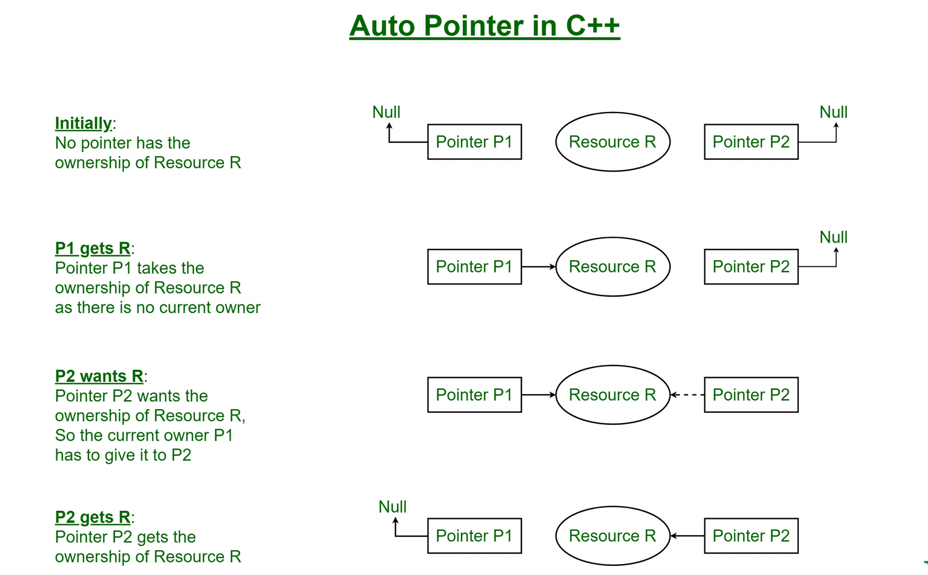
Auto pointer

Slide 55
Auto ptr DEPRICIATED
// C++ program to illustrate the use of auto_ptr
#include <iostream>
#include <memory>
using namespace std;
class A {
public:
void show() { cout << "A::show()" << endl; }
};
int main()
{
// p1 is an auto_ptr of type A
auto_ptr<A> p1(new A);
p1->show();
// returns the memory address of p1
cout << p1.get() << endl;
// copy constructor called, this makes p1 empty.
auto_ptr<A> p2(p1);
p2->show();
// p1 is empty now
cout << p1.get() << endl;
// p1 gets copied in p2
cout << p2.get() << endl;
return 0;
}

Slide 56
Auto ptr
A::show()A::
A::show()
0
0x1b42c20
0x1b42c20
A::show()
0
0x1b42c20
show()
0x1b42c20
A::show()
0
0x1b42c20
A::show()
Why is auto_ptr deprecated? It takes ownership of the pointer in a way that no two pointers should contain the same object. Assignment transfers ownership and resets the rvalue auto pointer to a null pointer. Thus, they can’t be used within STL containers due to the aforementioned inability to be copied.

Slide 57
Unique _ptr replacement for auto_ptr
unique_ptr<A> ptr1( new A ); (new A);
// Error: can't copy unique_ptr
unique_ptr<A> ptr2 = ptr1;
using std::move() function to transfer ownership of the contained pointer to another unique_ptr.
// Works, resource now stored in ptr2
unique_ptr<A> ptr2 = move(ptr1);
So, it’s best to use unique_ptr when we want a single pointer to an object that will be reclaimed when that single pointer is destroyed.

Slide 58
shared ptr
A shared_ptr is a container for raw pointers. It is a reference counting ownership model i.e. it maintains the reference count of its contained pointer in cooperation with all copies of the shared_ptr. So, the counter is incremented each time a new pointer points to the resource and decremented when the destructor of the object is called.
Reference Counting: It is a technique of storing the number of references, pointers or handles to a resource such as an object, block of memory, disk space or other resources.
An object referenced by the contained raw pointer will not be destroyed until reference count is greater than zero i.e. until all copies of shared_ptr have been deleted. So, we should use shared_ptr when we want to assign one raw pointer to multiple owners.

Slide 59
Shared_ptr
#include <iostream>
#include <memory>
using namespace std;
class A {
public:
void show()
{
cout << "A::show()" << endl;
}
};
int main()
{
shared_ptr<A> p1(new A);
cout << p1.get() << endl;
p1->show();
shared_ptr<A> p2(p1);
p2->show();
cout << p1.get() << endl;
cout << p2.get() << endl;
// Returns the number of shared_ptr objects
// referring to the same managed object.
cout << p1.use_count() << endl;
cout << p2.use_count() << endl;
// Relinquishes ownership of p1 on the object
// and pointer becomes NULL
p1.reset();
cout << p1.get() << endl;
cout << p2.use_count() << endl;
cout << p2.get() << endl;
return 0;
}

Slide 60
Shared_ptr
Output :
0x1006ba8c0
A::show()
A::show()
0x1006ba8c0
0x1006ba8c0
2
2
0x0
1
0x1006ba8c0

Slide 61
Weak_ptr

Slide 62
Weak_ptr
A weak_ptr is created as a copy of shared_ptr. It provides access to an object that is owned by one or more shared_ptr instances but does not participate in reference counting. The existence or destruction of weak_ptr has no effect on the shared_ptr or its other copies. It is required in some cases to break circular references between shared_ptr instances.
Cyclic Dependency (Problems with shared_ptr): Let’s consider a scenario where we have two classes A and B, both have pointers to other classes. So, it’s always like A is pointing to B and B is pointing to A. Hence, use_count will never reach zero and they never get deleted.

Slide 63
Weak_ptr
So, in case of shared_ptr because of cyclic dependency use_count never reaches zero which is prevented using weak_ptr, which removes this problem by declaring A_ptr as weak_ptr, thus class A does not own it, only have access to it and we also need to check the validity of object as it may go out of scope. In general, it is a design issue.
When to use weak_ptr? When you do want to refer to your object from multiple places – for those references for which it’s ok to ignore and deallocate (so they’ll just note the object is gone when you try to dereference).

Slide 64
Scope resolution operation
int count = 0;
int main(void) {
int count = 0;
::count = 1; // set global count to 1
count = 2; // set local count to 2
return 0;
}

Slide 65
Scope resolution operation
#include <iostream>
using namespace std;
class X
{
public:
static int count;
};
int X::count = 10; // define static data member
int main ()
{
int X = 0; // hides class type X
cout << X::count << endl; // use static member of class X
}

Slide 66
Const expression
constexpr, which indicates that the return value of the function is a constant value can be computed at compile time.
difference between const and constexpr variables is that the initialization of a const variable can be deferred until run time. A constexpr variable must be initialized at compile time.
The constexpr member function GetValue() is a run-time call because the value isn't required to be known at compile time.
constexpr float x = 42.0;
constexpr float y{108};
constexpr float z = exp(5, 3);
constexpr int i; // Error! Not initialized
int j = 0;
constexpr int k = j + 1; //Error! j not a constant expression

Slide 67
ConstExpression
// constexpr.cpp
// Compile with: cl /EHsc /W4 constexpr.cpp
#include <iostream>
using namespace std;
// Pass by value
constexpr float exp(float x, int n)
{
return n == 0 ? 1 :
n % 2 == 0 ? exp(x * x, n / 2) :
exp(x * x, (n - 1) / 2) * x;
}
// Pass by reference
constexpr float exp2(const float& x, const int& n)
{
return n == 0 ? 1 :
n % 2 == 0 ? exp2(x * x, n / 2) :
exp2(x * x, (n - 1) / 2) * x;
}
// Compile-time computation of array length
template<typename T, int N>
constexpr int length(const T(&)[N])
{
return N;
}

Slide 68
Const expression
// Recursive constexpr function
constexpr int fac(int n)
{
return n == 1 ? 1 : n * fac(n - 1);
}
// User-defined type
class Foo
{
public:
constexpr explicit Foo(int i) : _i(i) {}
constexpr int GetValue() const
{
return _i;
}
private:
int _i;
};

Slide 69
Const expression
int main()
{
// foo is const:
constexpr Foo foo(5);
// foo = Foo(6); //Error!
// Compile time:
constexpr float x = exp(5, 3);
constexpr float y { exp(2, 5) };
constexpr int val = foo.GetValue();
constexpr int f5 = fac(5);
const int nums[] { 1, 2, 3, 4 };
const int nums2[length(nums) * 2] { 1, 2, 3, 4, 5, 6, 7, 8 };
// Run time:
cout << "The value of foo is " << foo.GetValue() << endl;
}

Slide 70
Const
// constant_values4.cpp
#include <stdio.h>
int main() {
const char *mybuf = "test";
char *yourbuf = "test2";
printf_s("%s\n", mybuf);
const char *bptr = mybuf; // Pointer to constant data
printf_s("%s\n", bptr);
// *bptr = 'a'; // Error
}

Slide 71
Const
// constant_member_function.cpp
class Date
{
public:
Date( int mn, int dy, int yr );
int getMonth() const; // A read-only function
void setMonth( int mn ); // A write function; can't be const
private:
int month;
};
int Date::getMonth() const
{
return month; // Doesn't modify anything
}
void Date::setMonth( int mn )
{
month = mn; // Modifies data member
}
int main()
{
Date MyDate( 7, 4, 1998 );
const Date BirthDate( 1, 18, 1953 );
MyDate.setMonth( 4 ); // Okay
BirthDate.getMonth(); // Okay
BirthDate.setMonth( 4 ); // C2662 Error
}

Slide 72
Const expression
constexpr auto sum = [](const auto &a, const auto &b) { return a + b; };
2
/*
3
is equivalent to
4
constexpr struct anonymous
5
{
6
template <class T1, class T2>
7
constexpr auto operator()(T1 a, T2 b) const
8
{
9
return a + b;
10
}
11
};
12
*/
13
constexpr int answer = sum(10, 10);

Slide 73
Const expression
#include<iostream>
using namespace std;
class Anonymous
{
public :
template <class T1, class T2>
constexpr auto operator()(T1 a, T2 b) { return a + b; }
};
auto sum = [] (int a, int b) { return a + b; };
int main()
{
Anonymous an;
auto res = an(10,20);
cout << " res : "<< res << endl;
cout<<"Sum of two integers:"<< sum(5, 6) << endl;
return 0;
}

Slide 74
lambda
#include <iostream>
#include <string>
using namespace std;
int main()
{
auto sum = [](int a, int b) {
return a + b;
};
cout <<"Sum of two integers:"<< sum(5, 6) << endl;
return 0;
}
Output:
Sum of two integers:11

Slide 75
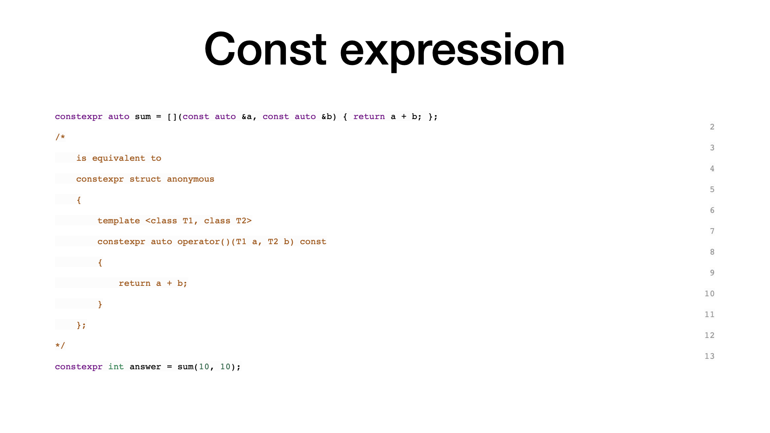
Const expression
#include<iostream>
using namespace std;
class Anonymous
{
public :
template <class T1, class T2>
constexpr auto operator()(T1 a, T2 b)
{
return a + b;
}
};
int main()
{
Anonymous an;
auto res = an(10,20);
cout << " res : "<< res << endl;
return 0;
}2
3
is equivalent to
4
constexpr struct anonymous
5
{
6
template <class T1, class T2>
7
constexpr auto operator()(T1 a, T2 b) const
8
{
9
return a + b;
10
}
11
};
12
*/
13
constexpr int answer = sum(10, 10);

Slide 76
Const expression
constexpr auto sum = [](const auto &a, const auto &b) { return a + b; };
constexpr int answer = sum(10, 10);
2
/*
3
is equivalent to
4
constexpr struct anonymous
5
{
6
template <class T1, class T2>
7
constexpr auto operator()(T1 a, T2 b) const
8
{
9
return a + b;
10
}
11
};
12
*/
13

Slide 77
static_assert
Static assert is used to make assertions at compile time. When the static assertion fails, the program simply doesn't compile. This is useful in different situations, like,
class Foo
{
public:
static const int bar = 3;
};
static_assert(Foo::bar > 4, "Foo::bar is too small :(");
int main()
{
return Foo::bar;
}
error: static assertion failed: "Foo::bar is too small :("

Slide 78
static_assert
#include "SomeLibrary.h"
static_assert(SomeLibrary::Version > 2,
"Old versions of SomeLibrary are missing the foo functionality. Cannot proceed!");
class UsingSomeLibrary {
// ...
};

Slide 79
Range-based for loop
#include <iostream>
#include <vector>
int main() {
std::vector<int> v = {0, 1, 2, 3, 4, 5};
for (const int& i : v) // access by const reference
std::cout << i << ' ';
std::cout << '\n';
for (auto i : v) // access by value, the type of i is int
std::cout << i << ' ';
std::cout << ‘\n';
std::cout << '\n';
// the initializer may be a braced-init-list
for (int n : {0, 1, 2, 3, 4, 5})
std::cout << n << ' ';
std::cout << '\n';
// Iterating over array
int a[] = {0, 1, 2, 3, 4, 5};
for (int n : a)
std::cout << n << ' ';
std::cout << '\n';
// Just running a loop for every array
// element
for (int n : a)
std::cout << "In loop" << ' ';
std::cout << '\n';
}

Slide 80
Range-based for loop
// Printing string characters
std::string str = “Sathya";
for (char c : str)
std::cout << c << ' ';
std::cout << '\n';
// Printing keys and values of a map
std::map <int, int> MAP({{1, 1}, {2, 2}, {3, 3}});
for (auto i : MAP)
std::cout << '{' << i.first << ", "
<< i.second << "}\n";

Slide 81
nullptr
nullptr is a keyword that can be used at all places where NULL is expected. Like NULL, nullptr is implicitly convertible and comparable to any pointer type. Unlike NULL, it is not implicitly convertible or comparable to integral types.

Slide 82
nullptr
// This program compiles
#include<iostream>
using namespace std;
int main()
{
int *ptr = nullptr;
// Below line compiles
if (ptr) { cout << "true"; }
else { cout << "false"; }
}

Slide 83
nullptr
// This program does NOT compile
#include<stdio.h>
int main()
{
int x = nullptr;
}
// function with integer argument
void fun(int N) { cout << "fun(int)"; return;}
// Overloaded function with char pointer argument
void fun(char* s) { cout << "fun(char *)"; return;}
int main()
{
// Ideally, it should have called fun(char *),
// but it causes compiler error.
fun(NULL);
}

Slide 84
nullptr
// C++ program to show comparisons with nullptr
#include <bits/stdc++.h>
using namespace std;
// Driver program to test behavior of nullptr
int main()
{
// creating two variables of nullptr_t type
// i.e., with value equal to nullptr
nullptr_t np1, np2;
// <= and >= comparison always return true
if (np1 >= np2)
cout << "can compare" << endl;
else
cout << "can not compare" << endl;
// Initialize a pointer with value equal to np1
char *x = np1; // same as x = nullptr (or x = NULL
// will also work)
if (x == nullptr)
cout << "x is null" << endl;
else
cout << "x is not null" << endl;
return 0;
}

Slide 85
scoped enums
enum Color {
Bronze,
Silver,
Gold
};
enum Bullion
{
Silver, //conflicts with Color’s Silver
Gold, //conflicts with Color’s Gold Platinum
};

Slide 86
scoped enums
The enumerators Silver and Gold belong to different enum types and have different values. However, they clash because they’re visible from their enclosing scope (unlike, say, members of a class). The common workaround, namely appending the enum name to every enumerator, evokes memories from the pre-namespace era:
enum Color
{
BronzeColor,
SilverColor,
GoldColor
};
enum Bullion
{
SilverBullion,
GoldBullion,
PlatinumBullion
};

Slide 87
scoped enums
Enter Scoped Enums
C++11 solves the scoping problem with a new category called scoped enums. A scoped enum looks exactly as a traditional enum except that the keyword class (or struct – the two keywords are interchangeable in this context) appears between the keyword enum and the enum name, as shown in the following example:
enum class Color //C++11 scoped enum
{
Bronze,
Silver,
Gold
};
enum struct Bullion //C++11 scoped enum
{
Silver, //doesn’t conflict with Color’s Silver
Gold, //ditto
Platinum
};
Enumerators of a scoped enum require a qualified name when referred to from an enclosing scope:
Color col1=Bronze; //error, Bronze not in scope
Color col2=Color::Bronze; //OK

Slide 88
decltype (auto)
C++14
The special form decltype(auto) deduces the type of a variable from its initializer or the return type of a function from the return statements in its definition, using the type deduction rules of decltype rather than those of auto.
const int x = 123;
auto y = x; // y has type int
decltype(auto) z = x; // z has type const int, the declared type of x

Slide 89
Uniform initialization
Initialization of dynamically allocated arrays:int *pi = new int[5]{1, 2, 3, 4, 5};
Initialization of an array member variable:class A {
int arr[3];
public:
A(int x, int y, int z) : arr{x, y, z} { };
};
Initialization of a STL container: std::vector v1{1, 2};

Slide 90
new delete
#include <iostream>
using namespace std;
class Student {
int age;
public:
// constructor initializes age to 12
Student() : age(12) {}
void getAge() {
cout << "Age = " << age << endl;
}
};
int main() {
// dynamically declare Student object
Student* ptr = new Student();
// call getAge() function
ptr->getAge();
// ptr memory is released
delete ptr;
return 0;
}

Slide 91
make_unique pointer
How to use make_unique()?
Instead of using new, you can use make_unique() to create a new object.
It is recommended to use “make_unique()” instead of new to create an object.
Now we shall modify the function “fun” as below:
unique_ptr<MyClass> fun()
{
unique_ptr<MyClass> p = make_unique<MyClass> ();
return p;
}

Slide 92
new delete
#include <iostream>
using namespace std;
class Student {
int age;
public:
// constructor initializes age to 12
Student() : age(12) {}
void getAge() {
cout << "Age = " << age << endl;
}
};
int main() {
// dynamically declare Student object
auto ptr = new Student();
// call getAge() function
ptr->getAge();
// ptr memory is released
delete ptr;
return 0;
}

Slide 93
Unique pointer
Points on unique_ptr:
1. unique_ptr as the same suggests, it is unique and cannot be shared. 2. It cannot ne copied to another unique_ptr by using assignement operator. 3. The owner ship can only be moved from one to another. 4. It means that, when an object ownership is transffered, the original owner will no longer owns the object, 5. We use “unique_ptr” when we want to limit the ownership of the objects. Thereby simplyfying the program logic.

Slide 94
Unique pointer
#include <iostream>
#include <memory>
//for more C++ tutorial visit www.ProDeveloperTutorial.com
using namespace std;
class MyClass
{
public:
MyClass()
{
cout<<"In constructor"<<endl;
}
~MyClass()
{
cout<<"In destructor"<<endl;
}
};
int main()
{
unique_ptr<MyClass> p (new MyClass);
return 0;
}

Slide 95
Unique pointer
int main()
{
unique_ptr<MyClass> p (new MyClass);
unique_ptr<MyClass> p1 = p; // new statement added
return 0;
}
You will recieve an error as below:
Main.cpp:27:25: error: call to deleted constructor of 'unique_ptr'
unique_ptr<MyClass> p1 = p;
^ ~
/usr/bin/../lib/gcc/x86_64-linux-gnu/7.4.0/../../../../include/c++/7.4.0/bits/unique_ptr.h:388:7: note: 'unique_ptr' has been explicitly marked deleted here
unique_ptr(const unique_ptr&) = delete;
^
1 error generated.
This is because, unique_ptr pointers are unique.

Slide 96
Unique pointer
Now we create a function that will return “unique_ptr” created:
#include <iostream>
#include <memory>
//for more C++ tutorial visit www.ProDeveloperTutorial.com
using namespace std;
class MyClass
{
public:
MyClass()
{
cout<<"In constructor"<<endl;
}
~MyClass()
{
cout<<"In destructor"<<endl;
}
};

Slide 97
Unique pointer
unique_ptr<MyClass> fun()
{
unique_ptr<MyClass> p (new MyClass);
return p;
}
int main()
{
cout<<"Entered main()"<<endl;
unique_ptr<MyClass> p2 = fun();
cout<<"Exited main()"<<endl;
return 0;
}
Output:
Entered main()
In constructor
Exited main()
In destructor

Slide 98
Unique pointer
Now you can think what is the difference between “p2 = p” and “p2 = fun()”?
Both are same, but you an achieve this by using move semantics.
i.e unique_ptr<MyClass> p1 = move(p);
Now the ownership is transffered from pointer p to pointer p2.
Here the ownership is not sharedm but rather moved.

Slide 99
Unique pointer
Implicit type conversion will be used where necessary. If no conversion exists, or only a narrowing conversion exists, the program is ill-formed. The initialization of b invokes the constructor.
If a class has an initializer list constructor, then it takes priority over other forms of construction.

Slide 100
differences in terms of priorities,
there are differences in terms of priorities, it's set in this order:
initializer_list
regular constructor
aggregate initialization

Slide 101
initialiser_list
#include <iostream>
#include <vector>
class A
{
public:
int mx;
double my;
};
class B
{
public:
B(int x, double y) : mx{ x }, my{ y } {}
int mx;
double my;
};
class C
{
public:
C(int x, double y) : mx{ x }, my{ y } {}
C(const std::initializer_list<int>& v) {
mx = *(v.begin());
my = *(v.begin() + 1);
}
int mx;
double my;
};

Slide 102
initialiser_list
int main()
{
// Aggregate initialization
A a{ 1, 3.7 };
// Regular constructor
B b{ 2, 9.8 };
// Initializer_list
C c{ 3, 7 };
std::cout << a.mx << " " << a.my << std::endl;
std::cout << b.mx << " " << b.my << std::endl;
std::cout << c.mx << " " << c.my << std::endl;
return 0;
}

Slide 103
C++ classes and structs
#include <iostream>
using namespace std;
struct X {
int a;
int b;
};
class X obj_X;
int main() {
obj_X.a = 0;
obj_X.b = 1;
cout << "Here are a and b: " << obj_X.a << " " << obj_X.b << endl;
}
Here are a and b: 0 1

Slide 104
C++ classes and structs
class X {
// private by default
int a;
public:
// public member function
int f() { return a = 5; };
};
struct Y {
// public by default
int f() { return a = 5; };
private:
// private data member
int a;
};

Slide 105
Components of a class

Slide 106
Components of a class
// accessing of data members
#include <bits/stdc++.h>
using namespace std;
class names
{
// Access specifier
public:
// Data Members
string name;
// Member Functions()
void printname()
{
cout << "name is: " << name;
}
};
int main() {
// Declare an object of class geeks
names obj1;
// accessing data member
obj1.name = "Abhi";
// accessing member function
obj1.printname();
return 0;
}

Slide 107
Declaring fun using :: Scope resolution
// declaration outside class
#include <bits/stdc++.h>
using namespace std;
class Names
{
public:
string name;
int id;
// printname is not defined inside class definition
void printname();
// printid is defined inside class definition
void printid()
{
cout << "id is: " << id;
}
};
// Definition of printname using scope resolution operator ::
void Names::printname()
{
cout << "name is: " << geekname;
}
int main() {
Names obj1;
obj1.name = "xyz";
obj1.id=15;
// call printname()
obj1.printname();
cout << endl;
// call printid()
obj1.printid();
return 0;
}

Slide 108
Constructor
// C++ program to demonstrate constructors
#include <bits/stdc++.h>
using namespace std;
class Names
{
public:
int id;
//Default Constructor
Names()
{
cout << "Default Constructor called" << endl;
id=-1;
}
//Parameterized Constructor
Names(int x)
{
cout << "Parameterized Constructor called" << endl;
id=x;
}
};
int main() {
// obj1 will call Default Constructor
Names obj1;
cout << “Name id is: " <<obj1.id << endl;
// obj1 will call Parameterized Constructor
Names obj2(21);
cout << “Name id is: " <<obj2.id << endl;
return 0;
}

Slide 109
Destructor
// C++ program to explain destructors
#include <bits/stdc++.h>
using namespace std;
class Names
{
public:
int id;
//Definition for Destructor
~Names()
{
cout << "Destructor called for id: " << id <<endl;
}
};
int main()
{
Names obj1;
obj1.id=7;
int i = 0;
while ( i < 5 )
{
Names obj2;
obj2.id=i;
i++;
} // Scope for obj2 ends here
return 0;
} // Scope for obj1 ends here
Output:
Destructor called for id: 0
…..
Destructor called for id: 7
Destructor called for id: 0Destructor called for id: 0
Destructor called for id: 1
Destructor called for id: 1
Destructor called for id: 0
Destructor called for id: 1
Destructor called for id: 2

Slide 110
Constructor
#include <iostream>
using std::cout;
using std::endl;
class complexNumbers {
double real, img;
public:
complexNumbers() : real(0), img(0) { }
complexNumbers(const complexNumbers& c) { real = c.real; img = c.img; }
complexNumbers( double r, double i = 0.0) { real = r; img = i; }
friend void display(complexNumbers cx);
};
void display(complexNumbers cx){
cout<<"Real Part: " << cx.real<< " Imag Part: " << cx.img<<endl;
}
int main() {
complexNumbers one(1);
complexNumbers five = 5;
display(one);
display(five);
return 0;
}
/

Slide 111
Implicit Constructor
/
#include <iostream>
using std::cout;
using std::endl;
class complexNumbers {
double real, img;
public:
complexNumbers() : real(0), img(0) { }
complexNumbers(const complexNumbers& c) { real = c.real; img = c.img; }
complexNumbers( double r, double i = 0.0) { real = r; img = i; }
friend void display(complexNumbers cx);
};
void display(complexNumbers cx){
cout<<"Real Part: " << cx.real<< " Imag Part: " << cx.img<<endl;
}
int main() {
complexNumbers one(1);
complexNumbers five = 5;
display(one);
display(5000); // Surprise prints 5000 via object!!!
return 0;
}
/*
Surprise :
when we pass a decimal value of 5000, an implicit conversion happens in-place, which in-turn transfers the decimal value of 5000 to a temporary object of class complexNumbers (and thereby assigns the value 300 to the real part of that temporary object).
*/

Slide 112
Explicit Constructor
/
#include <iostream>
using std::cout;
using std::endl;
class complexNumbers {
double real, img;
public:
complexNumbers() : real(0), img(0) { }
complexNumbers(const complexNumbers& c) { real = c.real; img = c.img; }
complexNumbers( double r, double i = 0.0) { real = r; img = i; }
friend void display(complexNumbers cx);
};
void display(complexNumbers cx){
cout<<"Real Part: " << cx.real<< " Imag Part: " << cx.img<<endl;
}
int main() {
complexNumbers one(1);
complexNumbers five = 5;
display(one);
display(five);
return 0;
}

Slide 113
Explicit conversion constructors
class A
{ public:
A();
A(int);
A(const char*, int = 0);
};
A c = 1;
A d = “Venditti”;
If you declare the constructor of the class with the explicit keyword, the previous declarations would be illegal.
class A
{ public:
explicit A();
explicit A(int);
explicit A(const char*, int = 0);
};
You can only assign values that match the values of the class type.
A a1;
A a2 = A(1);
A a3(1);
A a4 = A("Venditti");
A* p = new A(1);
A a5 = (A)1;
A a6 = static_cast<A>(1);

Slide 114
Explicit Constructor
#include <iostream>
using namespace std;
struct A
{
A(int) { } // converting constructor
A(int, int) { } // converting constructor (C++11)
operator bool() const { return true; }
};
struct B
{
explicit B(int) { }
explicit B(int, int) { }
explicit operator bool() const { return true; }
};
int main()
{
A a1 = 1; // OK: copy-initialization selects A::A(int)
A a2(2); // OK: direct-initialization selects A::A(int)
A a3 {4, 5}; // OK: direct-list-initialization selects A::A(int, int)
A a4 = {4, 5}; // OK: copy-list-initialization selects A::A(int, int)
A a5 = (A)1; // OK: explicit cast performs static_cast
if (a1) ; // OK: A::operator bool()
bool na1 = a1; // OK: copy-initialization selects A::operator bool()
bool na2 = static_cast<bool>(a1); // OK: static_cast performs direct-initialization
// B b1 = 1; // error: copy-initialization does not consider B::B(int)
B b2(2); // OK: direct-initialization selects B::B(int)
B b3 {4, 5}; // OK: direct-list-initialization selects B::B(int, int)
// B b4 = {4, 5}; // error: copy-list-initialization does not consider B::B(int,int)
B b5 = (B)1; // OK: explicit cast performs static_cast
if (b2) ; // OK: B::operator bool()
// bool nb1 = b2; // error: copy-initialization does not consider B::operator bool()
bool nb2 = static_cast<bool>(b2); // OK: static_cast performs direct-initialization
}

Slide 115
function explicit constructor
#include <algorithm>
#include <iostream>
#include <vector>
using namespace std;
class FunctorClass
{
public:
// The required constructor for this example.
explicit FunctorClass(int& evenCount)
: m_evenCount(evenCount) { }
// The function-call operator prints whether the number is
// even or odd. If the number is even, this method updates
// the counter.
void operator()(int n) const {
cout << n;
if (n % 2 == 0) {
cout << " is even " << endl;
++m_evenCount;
} else {
cout << " is odd " << endl;
}
}
private:
// Default assignment operator to silence warning C4512.
FunctorClass& operator=(const FunctorClass&);
int& m_evenCount; // the number of even variables in the vector.
};
int main()
{
// Create a vector object that contains 9 elements.
vector<int> v;
for (int i = 1; i < 10; ++i) {
v.push_back(i);
}
// Count the number of even numbers in the vector by
// using the for_each function and a function object.
int evenCount = 0;
for_each(v.begin(), v.end(), FunctorClass(evenCount));
// Print the count of even numbers to the console.
cout << "There are " << evenCount
<< " even numbers in the vector." << endl;
}

Slide 116
Inheritance
// access_specifiers_for_base_classes.cpp
class BaseClass
{
public:
int PublicFunc(); // Declare a public member.
protected:
int ProtectedFunc(); // Declare a protected member.
private:
int PrivateFunc(); // Declare a private member.
};
// Declare two classes derived from BaseClass.
class DerivedClass1 : public BaseClass
{
void foo()
{
PublicFunc();
ProtectedFunc();
PrivateFunc(); // function is inaccessible
}
};

Slide 117
Inheritance
class DerivedClass2 : private BaseClass
{
void foo()
{
PublicFunc();
ProtectedFunc();
PrivateFunc(); // function is inaccessible
}
};
int main()
{
DerivedClass1 derived_class1;
DerivedClass2 derived_class2;
derived_class1.PublicFunc();
derived_class2.PublicFunc(); // function is inaccessible
}

Slide 118
Inheritance private
// access_control.cpp
class Base
{
public:
int Print(); // Nonstatic member.
static int CountOf(); // Static member.
};
// Derived1 declares Base as a private base class.
class Derived1 : private Base
{
};
// Derived2 declares Derived1 as a public base class.
class Derived2 : public Derived1
{
int ShowCount(); // Nonstatic member.
};

Slide 119
Inheritance
// Define ShowCount function for Derived2.
int Derived2::ShowCount()
{
// Call static member function CountOf explicitly.
int cCount = ::Base::CountOf(); // OK.
// Call static member function CountOf using pointer.
cCount = this->CountOf(); // C2247: 'Base::CountOf'
// not accessible because
// 'Derived1' uses 'private'
// to inherit from 'Base'
return cCount;
}

Slide 120
Null
traditional C++ treats NULL and 0 as the same thing,
some compilers define NULL as
((void*)0) Some will define it directly as 0.
compiler tries to define NULL as ((void*)0), then in the following code: char *ch = NULL;
void foo(char*);
void foo(int);
Then the foo(NULL); statement will call foo(int), which will cause the code to be counterintuitive.
The type of nullptr is nullptr_t, which can be implicitly converted to any pointer or member pointer type

Slide 121
Null ptr
#include <iostream>
#include <type_traits>
void foo(char *);
void foo(int);
int main() { if (std::is_same<decltype(NULL), decltype(0)>::value)
std::cout << "NULL == 0" << std::endl; if (std::is_same<decltype(NULL), decltype((void*)0)>::value)
std::cout << "NULL == (void *)0" << std::endl; if (std::is_same<decltype(NULL), std::nullptr_t>::value)
std::cout << "NULL == nullptr" << std::endl;
foo(0); // foo(NULL); foo(nullptr); return 0;
}
void foo(char *) {
// will call foo(int)
// doesn't compile
// will call foo(char*)
std::cout << "foo(char*) is called" << std::endl;
}
void foo(int i) {
std::cout << "foo(int) is called" << std::endl;
}

Slide 122
Constexpr
In the above example, char arr_4[len_2] may be confusing because len_2 has been defined as a constant. Why is char arr_4[len_2] still illegal? This is because the length of the array in the C++ standard must be a constant expression, and for len_2, this is a const constant, not a constant expression, so even if this behavior is supported by most compilers, but it is an illegal behavior, we need to use the constexpr feature introduced in C++11, which will be introduced next, to solve this problem; for arr_5, before C++98 The compiler cannot know that len_foo() actually returns a constant at runtime, which causes illegal production.

Slide 123
Constexpr
/*
If the compiler can directly optimize and embed these expressions into the program at compile-time, it will increase the performance of the program.
*/
#include <iostream>
#define LEN 10
int len_foo() {
int i = 2;
return i; }
constexpr int len_foo_constexpr() { return 5; }
constexpr int fibonacci(const int n) { return n == 1 || n == 2 ? 1 : fibonacci(n-1) + fibonacci(n-2);
}
int main() { char arr_1[10]; // legal char arr_2[LEN]; // legal
int len = 10; // char arr_3[len]; // illegal
const int len_2 = len + 1;
constexpr int len_2_constexpr = 1 + 2 + 3;
// char arr_4[len_2];
char arr_4[len_2_constexpr]; // char arr_5[len_foo()+5];
// illegal, but ok for most of the compilers
// legal
// illegal char arr_6[len_foo_constexpr() + 1]; // legal
// 1, 1, 2, 3, 5, 8, 13, 21, 34, 55
std::cout << fibonacci(10) << std::endl; return 0;
}

Slide 124
Lambda

Slide 125
Generic lambda
The general syntax of defining lambdas is as follows:
(Capture clause) (parameter_list) mutable exception ->return_type
{
Method definition;
}
Capture list will become a constructor argument in the closure. If you capture argument as a value, then the corresponding type data member is created within the closure.
The capture closure [&] means the variables are captured by reference.
The capture closure [=] indicates that the variables are captured by value.

Slide 126
Lambda
capture clause (Also known as the lambda-introducer in the C++ specification.)
parameter list Optional. (Also known as the lambda declarator)
mutable specification Optional.
exception-specification Optional.
trailing-return-type Optional.
lambda body.

Slide 127
Lambda Capture List
Lambda Capture List
The following table shows different use cases for the same:
[ ] ( ) { }
no captures
[=] ( ) { }
captures everything by copy(not recommendded)
[&] ( ) { }
captures everything by reference(not recommendded)
[x] ( ) { }
captures x by copy
[&x] ( ) { }
captures x by reference
[&, x] ( ) { }
captures x by copy, everything else by reference
[=, &x] ( ) { }
captures x by reference, everything else by copy

Slide 128
Const expression
constexpr auto sum = [](const auto &a, const auto &b) { return a + b; };
2
/*
3
is equivalent to
4
constexpr struct anonymous
5
{
6
template <class T1, class T2>
7
constexpr auto operator()(T1 a, T2 b) const
8
{
9
return a + b;
10
}
11
};
12
*/
13
constexpr int answer = sum(10, 10);

Slide 129
Lambda Functions Work
[&i] ( ) { std::cout << i; }
2
// is equivalent to
3
struct anonymous
4
{
5
int &m_i;
6
anonymous(int &i) : m_i(i) {}
7
inline auto operator()() const
8
{
9
std::cout << i;
10
}
11
};

Slide 130
Generic lambda
Is it based on C++ templates where for each different argument type compiler generates a new function with the same body but replaced types (compile-time polymorphism) or is it more similar to Java's generics
auto glambda = [] (auto a) { return a; };
class /* unnamed */
{
public:
template<typename T>
T operator () (T a) const { return a; }
};

Slide 131
lambda
#include <iostream>
#include <string>
using namespace std;
int main()
{
auto sum = [](int a, int b) {
return a + b;
};
cout <<"Sum of two integers:"<< sum(5, 6) << endl;
return 0;
}
Output:
Sum of two integers:11

Slide 132
lambda
#include <iostream>
#include <string>
using namespace std;
int main()
{
// generalized lambda
auto sum = [](auto a, auto b) {
return a + b;
};
cout <<"Sum(5,6) = "<< sum(5, 6) << endl; // sum of two integers
cout <<"Sum(2.0,6.5) = "<<sum(2.0, 6.5) << endl; // sum of two float numbers
cout <<"Sum((string(\"SoftwareTesting\"), string(\"help.com\")) =
"<<sum(string("SoftwareTesting"), string("help.com")) << endl; // sum of two strings
return 0;
}
Output:
Sum(5,6) = 11 Sum(2.0,6.5) = 8.5 Sum((string(“SoftwareTesting”), string(“help.com”)) = SoftwareTestinghelp.com

Slide 133
HigherOrder function
auto makeDeveloper(const std::string& name)
{
// Capture name by reference and return the lambda.
return [&]() {
std::cout << "I am a Developer , my name is " << name << '\n'; // Undefined behavior
};
}
int main()
{
// auto sayName{ makeDeveloper("Sathya") };
// Call the lambda function that makeWalrus returned.
sayName();
return 0;
}

Slide 134
Generic lambda capture by ref
int main()
2
{
3
int x = 100, y = 200;
4
auto print = [&] { // Capturing object by reference
5
std::cout << __PRETTY_FUNCTION__ << " : " << x << " , " << y << std::endl;
6
};
7
print();
8
return 0;
9
}
In the above example, I have mentioned & in the capture list. This captures variable x and y as a reference. Similarly, = denotes captured by value, which will create data member of the same type within the closure and copy assignment will take place.
Note that the parameter list is optional; you can omit the empty parentheses if you do not pass arguments to the lambda expression.

Slide 135
lambda
class Example
2
{
3
public:
4
Example() : m_var(10) {}
5
void func()
6
{
7
[=]() { std::cout << m_var << std::endl; }(); // IIFE
8
}
9
private:
10
int m_var;
11
};
12
13
int main()
14
{
15
Example e;
16
e.func();
17
}

Slide 136
Lambda Variadic
#include <iostream>
void print() {}
template <typename First, typename... Rest>
void print(const First &first, Rest &&... args)
{
std::cout << first << std::endl;
print(args...);
}
int main()
{
// [ capture list ] (parameters) -> return-type
auto variadic_generic_lambda = [](auto... param) { print(param...); };
variadic_generic_lambda(1, "LOL🤣", 17.1,"Sathya",999);
}

Slide 137
Lambda Function ptr static_assert is_same<decltype
#include <iostream>
#include <type_traits>
int main()
{
/*
You can force the compiler to generate lambda as a function pointer rather than closure by adding + in front of it, as shown above.
The + triggers a conversion to a plain old function pointer for the lambda.
When operator + is applied to the closure object, the set of overloaded built-in candidates contains a conversion-to-any-pointer and the closure type contains exactly one candidate: The conversion to the function pointer of the lambda.
Not work without +
*/
auto funcPtr = +[] {std::cout << " hello "<< std::endl;};
static_assert(std::is_same<decltype(funcPtr), void (*)() > ::value);
funcPtr();
}

Slide 138
lambda
// even_lambda.cpp
// compile with: cl /EHsc /nologo /W4 /MTd
#include <algorithm>
#include <iostream>
#include <vector>
using namespace std;
int main()
{
// Create a vector object that contains 9 elements.
vector<int> v;
for (int i = 1; i < 10; ++i) {
v.push_back(i);
}
// Count the number of even numbers in the vector by
// using the for_each function and a lambda.
int evenCount = 0;
for_each(v.begin(), v.end(), [&evenCount] (int n) {
cout << n;
if (n % 2 == 0) {
cout << " is even " << endl;
++evenCount;
} else {
cout << " is odd " << endl;
}
});
// Print the count of even numbers to the console.
cout << "There are " << evenCount
<< " even numbers in the vector." << endl;
}

Slide 139
Iterator_if
#include <iostream>
#include <vector>
#include <algorithm>
int main() {
std::vector<int> vec = {1, 2, 3, 4};
// since c++17, can be simplified by using `auto`
const std::vector<int>::iterator itr = std::find(vec.begin(), vec.end(), 2);
if (itr != vec.end()) {*itr = 3; }
if (const std::vector<int>::iterator itr = std::find(vec.begin(), vec.end(), 3);
itr != vec.end()) {
*itr = 4;
}
// should output: 1, 4, 3, 4. can be simplified using `auto`
for (std::vector<int>::iterator element = vec.begin(); element != vec.end(); ++element) std::cout << *element << std::endl;
}

Slide 140
Array to Vector Initializer list
#include <iostream>
#include <iostream>
#include <vector>
class Foo { public:
int value_a;
int value_b;
Foo(int a, int b) : value_a(a), value_b(b) {}
};
int main() {
// before C++11
int arr[3] = {1, 2, 3};
Foo foo(1, 2);
std::vector<int> vec = {1, 2, 3, 4, 5};
std::cout << "arr[0]: " << arr[0] << std::endl;
std::cout << "foo:" << foo.value_a << ", " << foo.value_b << std::endl;
for (std::vector<int>::iterator it = vec.begin(); it != vec.end(); ++it) {
std::cout << *it << std::endl;
}
return 0;
}

Slide 141
Initializer list - Bridges Obj and variables
it std::initializer_list, allowing the constructor or other function to use the initialization list like a parameter, which is the initialization of class objects provides a unified bridge between normal arrays and POD initialization methods
This constructor is called the initialize list constructor, and the type with this constructor will be specially taken care of during initialization.
In addition to the object construction, the initialization list can also be used as a formal parameter of a normal function, for example:

Slide 142
Initializer list - Bridges Obj and variables
#include <iostream>
#include <initializer_list>
#include <vector>
class MagicFoo {
public:
std::vector<int> vec;
MagicFoo(std::initializer_list<int> list)
{
for (std::initializer_list<int>::iterator it = list.begin(); it != list.end(); ++it)
vec.push_back(*it);
} };
int main() {
// after C++11
MagicFoo magicFoo = {1, 2, 3, 4, 5};
std::cout << "magicFoo: ";
for (std::vector<int>::iterator it = magicFoo.vec.begin(); it != magicFoo.vec.end(); ++it)
std::cout << *it << std::endl;
}// main

Slide 143
Template Recurssion
#include <iostream>
template<typename T0> void printf1(T0 value) {
std::cout << "Sathya"<< std::endl;
std::cout << value << std::endl;
}
template<typename T, typename... Ts> void printf1(T value, Ts... args) {
std::cout << value << std::endl;
std::cout << "Starts here and goes on... "<< std::endl;
printf1(args...);
}
int main() {
printf1(198);
printf1(1, 2, "123", 11.8);
return 0;
}

Slide 144
Unique

Slide 145
Fold Expression
#include <iostream>
template<typename ... T>
auto sum(T ... t) {
return (t + ...);
}
int main() {
std::cout << sum(1, 2, 3, 4, 5, 6, 7, 8, 9, 10) << std::endl;
}

Slide 146
UNon-type template parameter deduction
// Old Style
template <typename T, int BufSize>
class buffer_t {
public:
T& alloc();
void free(T& item); private:
T data[BufSize];
};
// buffer_t<int, 100> buf; // 100 as template parameter
#include <iostream>
template <auto value>
void foo() { std::cout << value << std::endl; return; }
int main() {
foo<10>(); // value as int
}

Slide 147
Base Class
#include <iostream>
class Base {
public:
int value1;
int value2;
Base() {
value1 = 1; }
Base(int value) : Base() { // delegate Base() constructor value2 = value;
} };
int main() {
Base b(2);
std::cout << b.value1 << std::endl;
std::cout << b.value2 << std::endl;
}

Slide 148
Base Class
#include <iostream>
class Base { public:
int value1;
int value2;
Base() {
value1 = 1; }
Base(int value) : Base() { // delegate Base() constructor value2 = value;
}
};
class Subclass : public Base { public:
using Base::Base; // inheritance constructor };
int main() {
Subclass s(3);
std::cout << s.value1 << std::endl;
std::cout << s.value2 << std::endl;
}

Slide 149
Final
/*
Requirement :
1. We need one class which will make our class as final class
Lets name that calss as class Final
Soluton :
1. Make default constructor of final class as private.
2. Inherit final calss as virtual in our class which we want to make non-inheritable
3. Make our class as friend class as friend inside final class
So that obly our class can call the constructor of Final calss not the derived class
*/
#include <iostream>
using namespace std;
class Final{
private :
Final() { cout << "In final... .";}
friend class Base;
};
class Base : virtual public Final{
public:
Base() {}
};
//phase II remark
//class Derived : public Base{
//public:
// Derived() {} // Error Inherited virtual base class 'Final' has private default
// // without virtual it compiles virtual public Final{
//};
int main(int argc, const char * argv[]) {
// insert code here...
// Derived d ;
Base b; // phase II works
std::cout << "Hello, World!\n";
return 0;
}

Slide 150
Final
struct Base { virtual void foo() final;
}; struct SubClass1 final: Base { }; // legal
struct SubClass2 : SubClass1 { }; // illegal, SubClass1 has final
struct SubClass3: Base { void foo(); // illegal, foo has final
};

Slide 151
Explicit delete default
class Magic { public:
Magic() = default; // explicit let compiler use default constructor Magic& operator=(const Magic&) = delete; // explicit declare refuse constructor Magic(int magic_number);
}

Slide 152
Binder
#include <iostream>
using namespace std;
void foo(int a, int b, int c) {
cout << " a "<< a;
cout << " b "<< b;
cout << " c "<< c;
}
int main() {
// bind parameter 1, 2 on function foo, and use std::placeholders::_1 as placeholder // for the first parameter.
auto bindFoo = std::bind(foo, std::placeholders::_1, 1,2);
// when call bindFoo, we only need one param left
bindFoo(10);
}

Slide 153
UnOrdered Map
#include <iostream>
#include <string>
#include <unordered_map>
#include <map>
//using namespace std;
int main() {
// initialized in same order
std::unordered_map<int, std::string> u = {
{1, "100"},
{3, "300"},
{2, "200"}
};
std::map<int, std::string> v = {
{1, "101"},
{3, "301"},
{2, "201"}
};
// iterates in the same way
std::cout << "std::unordered_map" << std::endl;
for( const auto & n : u)
std::cout << "Key:[" << n.first << "] Value:[" << n.second << "]\n";
std::cout << std::endl;
std::cout << "std::map" << std::endl;
for( const auto & n : v)
std::cout << "Key:[" << n.first << "] Value:[" << n.second << "]\n";
}

Slide 154
Tuples
//Basic Operations
//There are three core functions for the use of tuples:
//1. std::make_tuple: construct tuple
//2. std::get: Get the value of a position in the tuple 3. std::tie: tuple unpacking
#include <tuple>
#include <iostream>
auto get_student(int id)
{
if (id == 0)
return std::make_tuple(3.8, 'A', "Sharan");
if (id == 1)
return std::make_tuple(2.9, 'C', "Sathya");
if (id == 2)
return std::make_tuple(1.7, 'D', "Suresh");
// it is not allowed to return 0 directly
// return type is std::tuple<double, char, std::string> return std::make_tuple(0.0, 'D', "null");
return std::make_tuple(0.0, 'D', "null");
}
int main() {
auto student = get_student(0); std::cout << "ID: 0, "
<< "GPA: " << std::get<0>(student) << ", "
<< "Grade: " << std::get<1>(student) << ", "
<< "Name: " << std::get<2>(student) << '\n';
double gpa;
char grade;
std::string name;
// unpack tuples
std::tie(gpa, grade, name) = get_student(1);
std::cout << "ID: 1, "
<<"GPA:" <<gpa<<","
<< "Grade: " << grade << ", "
<< "Name: " << name << '\n';
}
//std::get In addition to using constants to get tuple objects, C++14 adds usage types to get objects

Slide 155
Shared Pointer
#include <iostream>
#include <memory>
void foo(std::shared_ptr<int> i) {
(*i)++; }
int main() {
// auto pointer = new int(10); // illegal, no direct assignment // Constructed a std::shared_ptr
auto pointer = std::make_shared<int>(10);
foo(pointer);
std::cout << *pointer << std::endl; // 11
// The shared_ptr will be destructed before leaving the scope return 0;
}

Slide 156
Unique_Ptr
std::unique_ptr is an exclusive smart pointer that prohibits other smart pointers from sharing
the same object, thus keeping the code safe:
std::unique_ptr<int> pointer = std::make_unique<int>(10); // make_unique was introduced in C++14 std::unique_ptr<int> pointer2 = pointer; // illegal
Since it is monopolized, in other words, it cannot be copied. However, we can use std::move to
transfer it to other unique_ptr, for example:

Slide 157
Unique_Ptr
#include <iostream>
#include <memory>
struct Foo { Foo() { std::cout << "Foo::Foo" << std::endl; } ~Foo() { std::cout << "Foo::~Foo" << std::endl; } void foo() { std::cout << "Foo::foo" << std::endl; }
};
void f(const Foo &) {
std::cout << "f(const Foo&)" << std::endl;
}
int main() {
std::unique_ptr<Foo> p1(std::make_unique<Foo>());
// p1 is not empty, prints
if (p1) p1->foo(); {
std::unique_ptr<Foo> p2(std::move(p1));
// p2 is not empty, prints
f(*p2);
// p2 is not empty, prints
if(p2) p2->foo(); // p1 is empty, no prints
if(p1) p1->foo();
p1 = std::move(p2);
// p2 is empty, no prints
if(p2) p2->foo();
std::cout << "p2 was destroyed" << std::endl;
}
// p1 is not empty, prints
if (p1) p1->foo();
}

Slide 158
Weak_ptr
The result is that A and B will not be destroyed. This is because the pointer inside a, b also references a, b, which makes the reference count of a, b becomes 2, leaving the scope. When the a, b smart pointer is destructed, it can only cause the reference count of this area to be decremented by one. This causes the memory area reference count pointed to by the a, b object to be non-zero, but the external has no way to find this area, it also caused a memory leak, as shown in Figure 5.1:
The solution to this problem is to use the weak reference pointer std::weak_ptr, which is a weak reference (compared to std::shared_ptr is a strong reference). A weak reference does not cause an increase in the reference count. When a weak reference is used, the final release process is shown in Figure 5.2:
In the above figure, only B is left in the last step, and B does not have any smart pointers to reference it, so this memory resource will also be released.
std::weak_ptr has no * operator and -> operator, so it can’t operate on resources. Its only function is to check if std::shared_ptr exists, its expired() method can return false when the resource is not released, otherwise, it returns true.

Slide 159
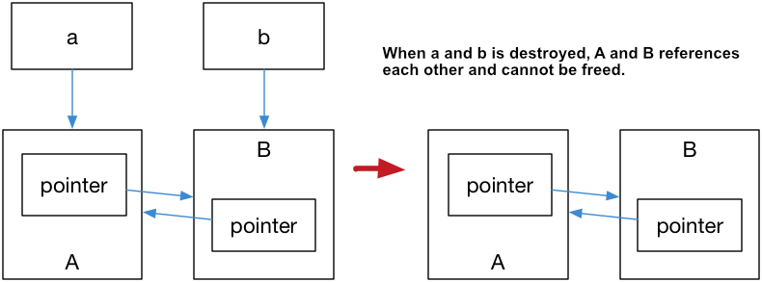
Weak_ptr

Slide 160
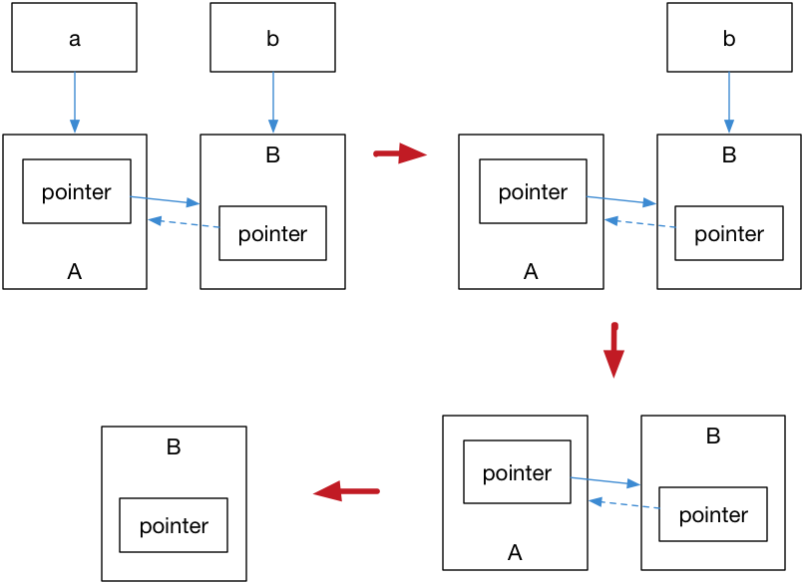
Weak_Ptr Diagram two

Slide 161
Weak_ptr Working demo
#include <iostream>
#include <memory>
std::weak_ptr<int> gw;
void observe()
{
std::cout << "gw.use_count() == " << gw.use_count() << "; ";
// we have to make a copy of shared pointer before usage:
if (std::shared_ptr<int> spt = gw.lock()) {
std::cout << "*spt == " << *spt << '\n';
}
else {
std::cout << "gw is expired\n";
}
}
int main()
{
{
auto sp = std::make_shared<int>(42);
gw = sp;
observe();
}
observe();
}

Slide 162
Weak_ptr Working demo
#include <iostream>
#include <memory>
class A; class B;
class A { public:
std::shared_ptr<B> pointer;
~A() {
std::cout << "A was destroyed" << std::endl;
}
}; class B { public:
std::shared_ptr<A> pointer;
~B() {
std::cout << "B was destroyed" << std::endl;
}
};
int main() {
std::shared_ptr<A> a = std::make_shared<A>();
std::shared_ptr<B> b = std::make_shared<B>();
a->pointer = b;
b->pointer = a;
return 0; }

Slide 163
Weak_pointer 2
#include <iostream>
#include <memory>
int main(){
std::cout << std::boolalpha << std::endl;
auto sharedPtr=std::make_shared<int>(2011);
std::weak_ptr<int> weakPtr(sharedPtr);
std::cout << "weakPtr.use_count(): " << weakPtr.use_count() << std::endl;
std::cout << "sharedPtr.use_count(): " << sharedPtr.use_count() << std::endl;
std::cout << "weakPtr.expired(): " << weakPtr.expired() << std::endl;
if( std::shared_ptr<int> sharedPtr1 = weakPtr.lock() ) {
std::cout << "*sharedPtr: " << *sharedPtr << std::endl;
std::cout << "sharedPtr1.use_count(): " << sharedPtr1.use_count() << std::endl;
}
else{
std::cout << "Don't get the resource!" << std::endl;
}
weakPtr.reset();
if( std::shared_ptr<int> sharedPtr1 = weakPtr.lock() ) {
std::cout << "*sharedPtr: " << *sharedPtr << std::endl;
std::cout << "sharedPtr1.use_count(): " << sharedPtr1.use_count() << std::endl;
}
else{
std::cout << "Don't get the resource!" << std::endl;
}
std::cout << std::endl;
}

Slide 164
Weak_pointer 2
// weak_ptr::reset example
#include <iostream>
#include <memory>
int main () {
std::shared_ptr<int> sp (new int(10));
std::weak_ptr<int> wp(sp);
std::cout << "1. wp " << (wp.expired()?"is":"is not") << " expired\n";
wp.reset();
std::cout << "2. wp " << (wp.expired()?"is":"is not") << " expired\n";
return 0;
}
Edit & Run
Output:
1. wp is not expired
2. wp is expired

Slide 165
Weak_pointer

Slide 166
Weak_pointer 3
#include <iostream>
#include <memory>
struct Son;
struct Daughter;
struct Mother{
~Mother(){
std::cout << "Mother gone" << std::endl;
}
void setSon(const std::shared_ptr<Son> s ){
mySon=s;
}
void setDaughter(const std::shared_ptr<Daughter> d ){
myDaughter=d;
}
std::shared_ptr<const Son> mySon;
std::weak_ptr<const Daughter> myDaughter;
};
struct Son{
Son(std::shared_ptr<Mother> m):myMother(m){}
~Son(){
std::cout << "Son gone" << std::endl;
}
std::shared_ptr<const Mother> myMother;
};
struct Daughter{
Daughter(std::shared_ptr<Mother> m):myMother(m){}
~Daughter(){
std::cout << "Daughter gone" << std::endl;
}
std::shared_ptr<const Mother> myMother;
};
int main(){
std::cout << std::endl;
{
std::shared_ptr<Mother> mother= std::shared_ptr<Mother>( new Mother);
std::shared_ptr<Son> son= std::shared_ptr<Son>( new Son(mother) );
std::shared_ptr<Daughter> daughter= std::shared_ptr<Daughter>( new Daughter(mother) );
mother->setSon(son);
mother->setDaughter(daughter);
}
std::cout << std::endl;
}

Slide 167
Thread Basic
#include <iostream>
#include <thread>
int main() {
std::thread t([](){
std::cout << "hello world." << std::endl;
});
t.join(); // Without this line code will crash
return EXIT_SUCCESS;
}

Slide 168
Mutex
std::mutex is the most basic mutex class in C++11, and you can create a mutex by instantiating std::mutex. It can be locked by its member function lock(), and unlock() can be unlocked. But in the process of actually writing the code, it is best not to directly call the member function, Because calling member functions, you need to call unlock() at the exit of each critical section, and of course, exceptions.

Slide 169
Mutex
#include <iostream>
#include <thread>
int v = 1;
void critical_section(int change_v) {
static std::mutex mtx;
std::lock_guard<std::mutex> lock(mtx);
// execute contention works
v = change_v;
// mtx will be released after leaving the scope
}
int main() {
// keep executing to check on Schedulear scheduling t1,t2,t3 randomly
std::thread t1(critical_section, 2), t2(critical_section, 3),t3(critical_section, 4);;
t1.join();
t2.join();
t3.join();
std::cout << v << std::endl; return 0;
}

Slide 170
Critical Section
Because C++ guarantees that all stack objects will be destroyed at the end of the declaration period, such code is also extremely safe. Whether critical_section() returns normally or if an exception is thrown in the middle, a stack rollback is thrown, and unlock() is automatically called.
And std::unique_lock is more flexible than std::lock_guard, std::unique_lock is more flexible. Objects of std::unique_lock manage the locking and unlocking operations on the mutex object with exclusive ownership (no other unique_lock objects owning the ownership of a mutex object). So in concurrent programming, it is recommended to use std::unique_lock.
std::lock_guard cannot explicitly call lock and unlock, and std::unique_lock can be called anywhere after the declaration. It can reduce the scope of the lock and provide higher concurrency.
If you use the condition variable std::condition_variable::wait you must use std::unique_lock as a parameter.

Slide 171
Critical Section
#include <iostream>
#include <thread>
int v = 1;
void critical_section(int change_v)
{
static std::mutex mtx; std::unique_lock<std::mutex> lock(mtx); // do contention operations
v = change_v;
std::cout << v << std::endl; // release the lock lock.unlock();
// during this period,
// others are allowed to acquire v
// start another group of contention operations // lock again
lock.lock();
v += 1;
std::cout << v << std::endl;
}
int main() {
std::thread t1(critical_section, 2), t2(critical_section, 3); t1.join();
t2.join();
return 0;
}

Slide 172
Thread Coroutine Future
#include <iostream>
#include <thread>
#include <future>
int main() {
// pack a lambda expression that returns 7 into a std::packaged_task
std::packaged_task<int()> task([](){return 7;});
// get the future of task
std::future<int> result = task.get_future();
std::thread(std::move(task)).detach();
std::cout << "waiting...";
result.wait(); // block until future has arrived
// output result
std::cout << "done!" << std:: endl << "future result is " << result.get() << std::endl; return 0;
}

Slide 173
Thread Conditional Var
The condition variable std::condition_variable was born to solve the deadlock and was intro- duced when the mutex operation was not enough. For example, a thread may need to wait for a condition to be true to continue execution. A dead wait loop can cause all other threads to fail to enter the criti- cal section so that when the condition is true, a deadlock occurs. Therefore, the condition_variable instance is created primarily to wake up the waiting thread and avoid deadlocks. notify_one() of std::condition_variable is used to wake up a thread; notify_all() is to notify all threads. Below is an example of a producer and consumer model:
It is worth mentioning that although we can use notify_one() in the producer, it is not recom- mended to use it here. Because in the case of multiple consumers, our consumer implementation simply gives up the lock holding, which makes it possible for other consumers to compete for this lock, to bet- ter utilize the concurrency between multiple consumers. Having said that, but in fact because of the exclusivity of std::mutex, We simply can’t expect multiple consumers to be able to produce content in a parallel consumer queue, and we still need a more granular approach.

Slide 174
Thread Conditional var Notify
#include <iostream>
#include <thread>
#include <mutex>
#include <condition_variable>
using namespace std;
std::condition_variable cv;
std::mutex muteex ;
long balance = 0 ;
void addMoney( int money ) {
lock_guard<mutex> lg( muteex);
balance += money ;
cout << "Ammount added Current balance : " << balance << endl ;
cv.notify_one();
}
void withdrawMoney( int money ) {
unique_lock<mutex> ul(muteex);
cv.wait(ul, [] { return (balance != 0) ? true : false ;});
if( balance >= money ){
balance -= money ;
cout << "Ammount Deducted : " << money << endl ;
} else{
cout << "Ammount cant be Deducted , Current balance is less than : " << money
<< endl;
}
cout << "Current balance is : " << balance << endl ;
}
int main(int argc, const char * argv[]) {
thread t1(withdrawMoney,500);
std::this_thread::sleep_for(std::chrono::milliseconds(500));
thread t2(addMoney,5000);
t1.join();
t2.join();
return 0;
}

Slide 175
Thread Conditional var Producer consumer3
#include <queue>
#include <chrono>
#include <mutex>
#include <thread>
#include <iostream>
#include <condition_variable>
int main() {
std::queue<int> produced_nums;
std::mutex mtx;
std::condition_variable cv;
bool notified = false; // notification sign
auto producer = [&]() {
for (int i = 0; ; i++) {
std::this_thread::sleep_for(std::chrono::milliseconds(500));
std::unique_lock<std::mutex> lock(mtx);
std::cout << "producing " << i << std::endl;
produced_nums.push(i);
notified = true;
cv.notify_all();
}
};
auto consumer = [&]() {
while (true) {
std::unique_lock<std::mutex> lock(mtx); while (!notified) { // avoid spurious wakeup
cv.wait(lock);
}
// temporal unlock to allow producer produces more rather than
// let consumer hold the lock until its consumed.
lock.unlock();
std::this_thread::sleep_for(std::chrono::milliseconds(1000)); // consumer is slower lock.lock();
if (!produced_nums.empty()) {
std::cout << "consuming " << produced_nums.front() << std::endl; produced_nums.pop();
}
notified = false; }
};
std::thread p(producer); std::thread cs[2];
for (int i = 0; i < 2; ++i) {
cs[i] = std::thread(consumer);
}
p.join();
for (int i = 0; i < 2; ++i) {
cs[i].join();
}
return 0; }

Slide 176
User defined littorals

Slide 177
Compile-time integer sequences
during compilation, generate a sequence [0, N] given an integer N. So for example, the following mappings can be generated
int_seq<3> -> { 0, 1, 2, 3 }
int_seq<2> -> { 0, 1, 2 }
int_seq<1> -> { 0, 1 }
int_seq<0> -> { 0 }

Slide 178
Higher-Order-Before
#include <algorithm>
#include <iostream>
#include <vector>
// Find the even numbers among 10
bool is_even(int i) {
return i % 2 == 0;
}
int main(int argc, char *argv[]) {
std::vector<int> v;
for (int i = 0; i < 10; ++i) {
v.push_back(i);
}
std::cout
<< "count = "
<< std::count_if(v.begin(), v.end(), &is_even)
<< std::endl;
return 0;
}

Slide 179
Higher-Order-After
#include <algorithm>
#include <iostream>
#include <vector>
// Find the even numbers among V
int main(int argc, char *argv[]) {
std::vector<int> v = { 0, 1, 2, 3, 4, 5 };
std::cout
<< "count = "
<< std::count_if(v.begin(),
v.end(),
[](int i) -> bool { return i % 2 == 0; }) // replaced is_even with a lambda expression.
<< std::endl;
return 0;
}

Slide 180
final classes prevents inheritance
class X final
{
// ...
};
class Base
{
public:
virtual void f()
{
std::cout << "Base class default behaviour\n";
}
};
class Derived : public Base
{
public:
void f() final
{
std::cout << "Derived class overridden behaviour\n";
}
};
This prevents any derived class of Derived to override the member function f.

Slide 181
Concurrency in C++11
Threads
Shared memory parallelization
Threads
Race conditions
Mutexes
Atomicity
Asynchronous tasks
Condition variables
Producer-consumer problem

Slide 182
Threads
#include <iostream>
#include <thread>
using namespace std;
void func(int x) {
cout << "Inside thread " << x << endl;
}
int main() {
thread th(&func, 100);
th.join();
cout << "Outside thread" << endl;
return 0;
}

Slide 183
Threads Race Condition
Race conditions
Let us imagine that x * x is a very costly operation (it's not, but use your imagination) and we want to calculate the sum of squares up to a certain number. It would make sense to parallelize the calulation of each square across threads. We can do something like this:
#include <iostream>
#include <vector>
#include <thread>
using namespace std;
int accum = 0;
void square(int x) {
accum += x * x;
}
int main() {
vector<thread> ths;
for (int i = 1; i <= 20; i++) {
ths.push_back(thread(&square, i));
}
for (auto& th : ths) {
th.join();
}
cout << "accum = " << accum << endl;
return 0;
}

Slide 184
Threads Mutex
A mutex (mutual exlusion) allows us to encapsulate blocks of code that should only be executed in one thread at a time. Keeping the main function the same:
int accum = 0;
mutex accum_mutex;
void square(int x) {
int temp = x * x;
accum_mutex.lock();
accum += temp;
accum_mutex.unlock();
}

Slide 185
Threads Atomic
C++11 offers even nicer abstractions to solve this problem. For instance, the atomic container:
#include <atomic>
atomic<int> accum(0);
void square(int x) {
accum += x * x;
}
We don't need to introduce temp here, since x * x will be evaluated before handed off to accum, so it will be outside the atomic event.

Slide 186
Threads Tasks
Tasks
An even higher level of abstraction avoids the concept of threads altogether and talks in terms of tasks instead. Consider the following example:
#include <iostream>
#include <future>
#include <chrono>
using namespace std;
int square(int x) {
return x * x;
}
int main() {
auto a = async(&square, 10);
int v = a.get();
cout << "The thread returned " << v << endl;
return 0;
}
The async construct uses an object pair called a promise and a future. The former has made a promise to eventually provide a value. The future is linked to the promise and can at any time try to retrieve the value by get(). If the promise hasn't been fulfilled yet, it will simply wait until the value is ready. The async hides most of this for us, except that it returns in this case a future<int> object. Again, since the compiler knows what this call to async returns, we can use auto to declare the future.

Slide 187
Threads Condition
#include <iostream>
#include <thread>
#include <condition_variable>
#include <mutex>
#include <chrono>
#include <queue>
using namespace std;
condition_variable cond_var;
mutex m;
int main() {
int value = 100;
bool notified = false;
thread reporter([&]() {
/*
unique_lock<mutex> lock(m);
while (!notified) {
cond_var.wait(lock);
}
*/
cout << "The value is " << value << endl;
});
thread assigner([&]() {
value = 20;
/*
notified = true;
cond_var.notify_one();
*/
});
reporter.join();
assigner.join();
return 0;
}

Slide 188
Containers with Big Oh complexity
Rules of Thumb
use sequential containers to access elements by positions and associative when access by key
use vector as default sequential containers
if the size is immutable choose std::array
use std::list for remove and add elements at middle o sequence
use std::unordered_map or std::unordered_set unless order matters and use std::map or std::set
associative containers have logarithmic access time

Slide 189
Containers with Big Oh complexity

Slide 190
Bubble Sort
/

Slide 191
#include<stdio.h>
void main ()
{
int i, j,temp;
int a[10] = { 10, 9, 7, 101, 23, 44, 12, 78, 34, 23};
for(i = 0; i<10; i++)
{
for(j = i+1; j<10; j++)
{
if(a[j] > a[i])
{
temp = a[i];
a[i] = a[j];
a[j] = temp;
}
}
}
printf("Printing Sorted Element List ...\n");
for(i = 0; i<10; i++)
{
printf("%d\n",a[i]);
}
}
Bubble sort o(n2) complicity

Slide 192
Stl containers
The Standard Template Library (STL) is a collection of C++ container classes and template algorithms that work together to produce a variety of useful functionalities. The STL was designed to combine different data structures with different algorithms while achieving the best performance; this guarantees the interoperability between all built-in and user-built components. To benefit from the powerful framework and great performance of the STL, you must know the concepts and apply them carefully.

Slide 193
Stl - Time Complexity and Big-O Notation
Time Complexity and Big-O Notation
There are various solutions to a problem, but not all of them are the best. Generally, we tend to use the most efficient solution. In programming, we can't leave the mechanism of finding the best solution; we need a clear standard to evaluate their efficiency. This is where the notion of time complexity enter the equation.
The Big-O notation describes the runtime of an algorithm and defines the upper bound of any algorithm (i.e, algorithm should not take more than this time). Big-O notation is the most used notation for the time complexity of an algorithm for a given input of size n. For example, if the runtime grows linearly with the number of elements n, then the complexity is O(n) and if the runtime is independent of the input, the complexity is O(1).
There are different types of time complexities used; the below table lists the typical values of complexity and their Big-O notation.

Slide 194
Stl - Time Complexity and Big-O Notation
Type Notation Description
Constant O(1) The runtime is independent of the number of elements
Linear O(n) The runtime grows linearly as the number of elements grows
Logarithmic O(log(n)) The runtime grows logarithmically with respect to the number of elements
n-log-n O(n ∗ log(n)) The runtime grows as a product of linear and logarithmic complexity
Quadratic O(n²) The runtime grows quadratically with respect to the number of elements

Slide 195
Stl containers
In the graph, the x axis represents the size of n (or algorithm input) and y represents the amount of time it would take to execute that algorithm.

Slide 196
Stl containers
O(1) solution
int findSum(int n) // input "n"
{
return n * (n+1) / 2; // this will take some constant time c1
}
O(n) solution
In this solution, we will run a loop from 1 to n and we will add these values to a variable named sum.
int findSum(int n) // input "n"
{
int sum = 0; // -----------------> it takes some constant time "c1"
for(int i = 1; i <= n; ++i) // --> here the comparison and increment will take place n times(c2*n)
sum = sum + i; // -----------> this statement will be executed n times i.e. c3*n
return sum; // ------------------> it takes some constant time "c4"
}
/*
* Total time taken = time taken by all the statements to execute
* i.e, total time taken = c2*n + c3*n + c1 + c4, if the expression c2*n + c3*n constitute to c0*n and another expression c1 + c4 constitute to c then
* total time taken = c0*n + c, which constitute to O(n) complexity
*/
The big O notation of the above code is O(c0*n) + O(c), where c and c0 are constants. So, the overall time complexity can be written as O(n)

Slide 197
Stl containers
O(n²) solution
In this solution, we will increment the value of sum variable i times i.e. for i = 1, the sum variable will be incremented once i.e. sum = 1. For i = 2, the sum variable will be incremented twice. So, let's see the solution.
int findSum(int n) // input "n"
{
int sum = 0; // ---------------------> constant time c1
for(int i = 1; i <= n; ++i)
for(int j = 1; j <= i; ++j)
sum++; // -------------------> this will run [(n * (n + 1) / 2)] times
return sum; // ----------------------> constant time c3
}
/*
* Total time taken = time taken by all the statements to execute
* total time taken = c1 + c2*n² + c2*n + c3
* which constitutes to c2*n² + c2*n + c3
*/
The big O notation of the above algorithm is O(c1*n²) + O(c2*n) + O(c3). Since we take the higher order of growth in big O. So, our expression will be reduced to O(n²).

Slide 198
Stl containers
The C++ containers library categorized as
Sequence containers - ordered collections in which every element has a certain position.
Associative containers - sorted collections in which the position of an element depends on its key due to a certain sorting criterion
Unordered associative containers - unordered collections in which the position of an element doesn’t matter.
Container Adapter - provide a different interface for sequential containers
Sequence Containers
In sequence containers, the position of an element depends on the time and place of the insertion, but it is independent of the value of the element. For example, if you put 5 elements into the a container by appending each element at the end of the actual collection, these elements are in the exact order in which you put them (Hence the name Sequence Containers). The STL contains three predefined sequence container classes: vector, deque, and list.

Slide 199
Stl containers
std::vector
The std::vector comes into play when array-like storage is needed, but with varying sizes. It uses memory from the heap to store objects and hence is a dynamic array. It enables random access, which means you can access each element directly with the corresponding index. Sequence containers are usually implemented as arrays or linked lists
Some Important pointers on std::vector
Appending and removing elements at the end of the array is very fast using push_back() and pop_back() respectively (O(1) in complexity notation).
However, inserting an element in the middle or at the beginning of the array takes time because all the following elements have to be moved to make room for it while maintaining the order (O(n) in complexity notation for n vector elements).
Vector reallocation occurs when vector size increases beyond its current storage capacity, it will automatically move all items to a larger chunk of newly allocated memory and delete the old chunk.
In such cases. iterators or references that point at altered portions of the sequence become invalid.
The following example defines a vector for integer values, inserts six elements, and prints the elements of the vector:

Slide 200
Stl Vector
#include <iostream>
#include <vector> // header for vector
int main()
{
std::vector<int> vec; //vector container for integer elements
// append elements with values 1 to 6
for (int i = 1; i <= 6; ++i)
{
vec.push_back(i);
}
//print all elements followed by a space
for (const auto &ele : vec)
{
std::cout << ele << ' ';
}
std::cout << std::endl;
}

Slide 201
Stl duque
std::deque
Deque is an abbreviation for double ended queue. it is a dynamic array that is implemented so that it can grow in both directions.
Some Important pointers on std::deque
Inserting elements at the end and at the beginning is fast (O(1) in complexity notation).
However, inserting elements in the middle takes time because elements must be moved (O(n) in complexity notation for n deque elements).
If an element is inserted into an empty sequence, or if an element is erased to leave an empty sequence, then iterators earlier returned by begin() and end() become invalid.
If an element is inserted at the first position of the deque, then all iterators that designate existing elements become invalid.
If an element is inserted at the end of the deque, then end() and all iterators that designate existing elements become invalid.
Allocating deque contents from the center of the underlying array, and resizing the underlying array when either end is reached leads to frequent resizing and waste more space, particularly when elements are only inserted at one end.
It is important to note that, deque allocator allocates block of memory in a single allocation and hence frequent push_back() or push_front() has less memory allocation overhead compared to vector. In vector the memory is allocated in smaller chunks, hence frequent insertion of elements leads to frequent allocation of memory, slowing down the container.
The following general deque example declares a deque for floating-point values:

Slide 202
Stl containers
#include <iostream>
#include <deque>
int main()
{
std::deque<float> dq; //deque container for floating-point elements
for (int i = 1; i <= 6; ++i)
{
dq.push_front(i * 2.2); //insert at the front
}
//print all elements followed by a space
for (const auto &ele : dq)
{
std::cout << ele << ' ';
}
std::cout << std::endl;
}

Slide 203
Stl containers
std::list
A list is implemented as a doubly linked list of elements. This means each element in a list has its own segment of memory and refers to its predecessor and its successor.
Some Important pointers on std::list
Unlike vectors and deques, fast random access to list elements is not supported, to access the tenth element, you must navigate the first nine elements by following the chain of their links (O(n) complexity because the average distance is proportional to the number of elements).
list supports bidirectional iterators and allows constant time insert and erase operations anywhere within the sequence, with storage management handled automatically. (O(1) complexity).
If only uni-directional list traversal is needed, std::forward_list may be more performant in both space and maintenance complexity, because it maintains only list item pointers in one direction.

Slide 204
Stl list
#include <algorithm>
#include <iostream>
#include <list>
int main()
{
// Create a list containing integers
std::list<int> l = {17, 55, 16, 3};
// Insert an integer before 16 by searching
auto it = std::find(l.begin(), l.end(), 16);
if (it != l.end())
{
l.insert(it, 77);
}
//print all elements followed by a space
for (const auto &ele : l)
{
std::cout << ele << ' ';
}
std::cout << std::endl;
}
/*OUTPUT
17 55 77 16 3
*/

Slide 205
Stl containers
The STL contains four predefined associative container classes: set, multiset, map, multimap.
std::set
A set is a collection in which elements are sorted according to their own values. Each element may occur only once, thus duplicates are not allowed.
Some pointers on std::set
Insert and erase is O(log n) complexity.
Initialize with unsorted sequence is O(n log n) complexity.
Initialize with sorted sequence is O(n) complexity.
lower_bound and upper_bound can be used with set.
NOTE: lower_bound(st.begin(), st.end(), x) will compile but is O(n) for std::set

Slide 206
Stl containers
#include <iostream>
#include <set>
int main()
{
std::set<int> st; //set container for int values
/** insert elements in arbitrary order
* value 1 gets inserted twice
*/
st.insert(8);
st.insert(1);
st.insert(5);
st.insert(7);
st.insert(1);
st.insert(6);
st.insert(11);
// print all elements
for (const auto &ele : st)
{
std::cout << ele << ' ';
}
std::cout << std::endl;
}
/*OUTPUT
1 5 6 7 8 11
*/

Slide 207
STL -multiset
std::multiset
A multiset is the same as a set except that duplicates are allowed. Thus, a multiset may contain multiple elements that have the same value.
The time complexity of count() is additionally linear (O(n)) to the number of elements having the key.

Slide 208
Stl multiset
#include <iostream>
#include <set>
int main()
{
std::multiset<int> st; //multiset container for int values
/** insert elements in arbitrary order
* value 1 gets inserted twice
*/
st.insert(8);
st.insert(1);
st.insert(5);
st.insert(7);
st.insert(1);
st.insert(6);
st.insert(11);
// print all elements
for (const auto &ele : st)
{
std::cout << ele << ' ';
}
std::cout << std::endl;
}
// A multiset allows duplicates, so it would contain two elements that have value 1
/* OUTPUT
1 1 5 6 7 8 11
*/

Slide 209
Stl map
std::map
A map contains elements that are key/value pairs. Each element has a key that is the basis for the sorting criterion and a value. Each key may occur only once, thus duplicate keys are not allowed. A map can also be used as an associative array, which is an array that has an arbitrary index type.
Some important pointers on std::map
Since multiset count() could be slow, we can use map to store the frequency of a key instead of inserting multiple copies of they same key into a multiset .
Insertion, deletion and lookup has logarithmic complexity O(log n), when n is the number of entries.
If the index operator is called with a non-existing number, it stores this number in the map and uses the default constructor for generating the data. This ensures that the index operator never returns an invalid reference.
In order to prevent above case, find() should be called beforehand.

Slide 210
Stl map
#include <iostream>
#include <map>
#include <string>
int main()
{
std::map<int, std::string> mp; //set container for int/string values
//insert some elements in arbitrary order
// a value with key 1 gets inserted twice
mp.insert(std::make_pair(5, "map"));
/**
* The elements are key/value pairs, so you must create such a pair to insert it into the
* collection. The auxiliary function make_pair() is provided for this purpose.
*/
mp.insert(std::make_pair(2, "is a"));
mp.insert(std::make_pair(1, "sorted"));
mp.insert(std::make_pair(4, "associative"));
mp.insert(std::make_pair(6, "container"));
mp.insert(std::make_pair(1, "key"));
mp.insert(std::make_pair(3, "value"));
// print key value pairs
for (const auto &ele : mp)
{
/**
* you must access the members of the pair structure, which are called first and second
*/
std::cout << ele.first << " : " << ele.second << std::endl;
}
}
/*OUTPUT
1 : sorted
2 : is a
3 : value
4 : associative
5 : map
6 : container
*/

Slide 211
Stl multimap
std::multimap
multimap differs from map in the same way as multiset differs from set: multiple entries of elements with identical keys are possible.
#include <iostream>
#include <map>
#include <string>
int main()
{
std::multimap<int, std::string> mp; //set container for int/string values
//insert some elements in arbitrary order
// a value with key 1 gets inserted twice
mp.insert(std::make_pair(5, "map"));
mp.insert(std::make_pair(2, "is a"));
mp.insert(std::make_pair(1, "sorted"));
mp.insert(std::make_pair(4, "associative"));
mp.insert(std::make_pair(6, "container"));
mp.insert(std::make_pair(1, "key"));
mp.insert(std::make_pair(3, "value"));
// print key value pairs
for (const auto &ele : mp)
{
std::cout << ele.first << " : " << ele.second << std::endl;
}
}
/*OUTPUT
1 : sorted
1 : key
2 : is a
3 : value
4 : associative
5 : map
6 : container
*/

Slide 212
Stl Custom compare for associative containers
Container have a predefined comparison function, Sometimes we may want to supply alternative comparison function. The complete declaration for std::set is
template <class T, class Compare = less<T>, class Alloc = allocator<T> >
class set;
Where,
T is the type of elements that will be held
Alloc is the memory allocator, with the default being allocator<T>
Compare is the type of the comparison used, with the default being std::less<T>
we can provide our desired comparison function object for the template parameter.

Slide 213
compare for associative containers less greater emu
#include <iostream>
#include <set>
template <typename T>
int printContainer(T con)
{
for (const auto &ele : con)
{
std::cout << ele << ' ';
}
std::cout << std::endl;
}
int main()
{
auto comp = [](int a, int b)
{ return a > b; };
std::initializer_list<int> lst{34, 45, 1, 77, 98, 15};
std::set<int> st(lst); // default std::less<int>
std::set<int, std::greater<int>> st1(lst); // changed compare to std::greater<int>
std::set<int, decltype(comp)> st2(lst, comp); // custom compare same as std::greater<int>
std::cout << "With default std::less<int>: ";
printContainer(st);
std::cout << "With std::greater<int>: ";
printContainer(st1);
std::cout << "With custom compare comp: ";
printContainer(st2);
return EXIT_SUCCESS;
}
/*OUTPUT
With default std::less<int>: 1 15 34 45 77 98
With std::greater<int>: 98 77 45 34 15 1
With custom compare comp: 98 77 45 34 15 1
*/

Slide 214
Unordered associative containers
Unordered associative containers
Binary search tree is not the only way of implementing associative containers. With hash tables, items can be found in O(1) time. The size of the hash table can be manipulated by the user, and the hash function can also be chosen individually, which is important, because the performance versus space consumption characteristics depend on that.
Some important pointers
These containers has Hash table implementation
Since elements are unordered, you cannot perform binary search
Also, begin() does not return the smallest element
In order to use unordered_set/map, classes must have hash function implemented

Slide 215
Unordered associative containers
struct hasher
{
size_t operator()(std::pair<int, int> x) const
{
return x.first ^ x.second;
}
};
int main()
{
std::unordered_set<std::pair<int, int>, hasher> us;
us.insert({5, 2});
us.insert({6, 1});
us.insert({1, 7});
us.insert({4, 9});
us.insert({0, 6});
std::cout << us.bucket_size(6) << std::endl; // prints 2 becz there are 2 containers with hash code 6
return EXIT_SUCCESS;
}

Slide 216
Adapter Containers
Adapter Containers
Container adapters are a special type of container class. They are not full container classes on their own, but wrappers around other container types (such as a vector, deque, or list). These container adapters encapsulate the underlying container type and limit the user interfaces accordingly.
There are three standard container adapters: stacks, queues, and priority queues.
Constructor adapters allow you to pass a specific allocator to their constructors.
Container adapters provide the emplace() feature, which internally creates a new element initialized by the passed arguments
std::stack
A stack is a container which allows insertion, retrieving, and deletion only at one end (LIFO data structure). Objects inserted first are removed last. Any one of the sequence container could be used as a stack, if those containers supports the following operation.
Insertion at one end (push, with push_back()).
Deletion from the same end (pop, with pop_back()).
Retrieving the value at that end (top, with back()).
Testing the stack being empty (with empty()).
The std::stack<T> is a stack of T with a default implementation using a deque.

Slide 217
Stack
nt main()
{
std::stack<int> s;
s.push(10);
s.push(20);
s.push(30);
s.push(40);
s.push(50);
std::cout << "Size: " << s.size() << std::endl;
std::cout << "Top: " << s.top() << std::endl;
std::cout << "Elements of stack: ";
while(!s.empty())
{
std::cout << s.top() << ' ';
s.pop();
}
std::cout << std::endl;
return EXIT_SUCCESS;
}
/*OUTPUT
Size: 5
Top: 50
Elements of stack: 50 40 30 20 10
*/

Slide 218
Queue
std::queue
A queue allows you to insert objects at one end and to remove them from the opposite end (FIFO data structure). The objects at both ends of the queue can be read without being removed.
list and deque are suitable data types for queue implementation.
The std::queue<T> is a queue of T with a default implementation using a list.
push() inserts any number f elements.
pop() removes the elements in the same order in which they are inserted.
front() returns the first element in the queue.
back() returns the last element in the queue.

Slide 219
queue
int main()
{
std::queue<int> q;
q.push(10);
q.push(20);
q.push(30);
q.push(40);
q.push(50);
std::cout << "Size: " << q.size() << std::endl;
std::cout << "Front: " << q.front() << std::endl;
std::cout << "Back: " << q.back() << std::endl;
std::cout << "Elements of queue: ";
while(!q.empty())
{
std::cout << q.front() << ' ';
q.pop();
}
std::cout << std::endl;
return EXIT_SUCCESS;
}
/*OUTPUT
Size: 5
Front: 10
Back: 50
Elements of queue: 10 20 30 40 50
*/

Slide 220
Priority queue
std::priority_queue
A priority queue always returns the element with the highest priority. The priority criterion must be specified when creating the queue. In the simplest case, it is the greatest (or smallest) number in the queue. We can also write our own custom compare to describe the priority of an element in the queue (default compare is std::less<int>).

Slide 221
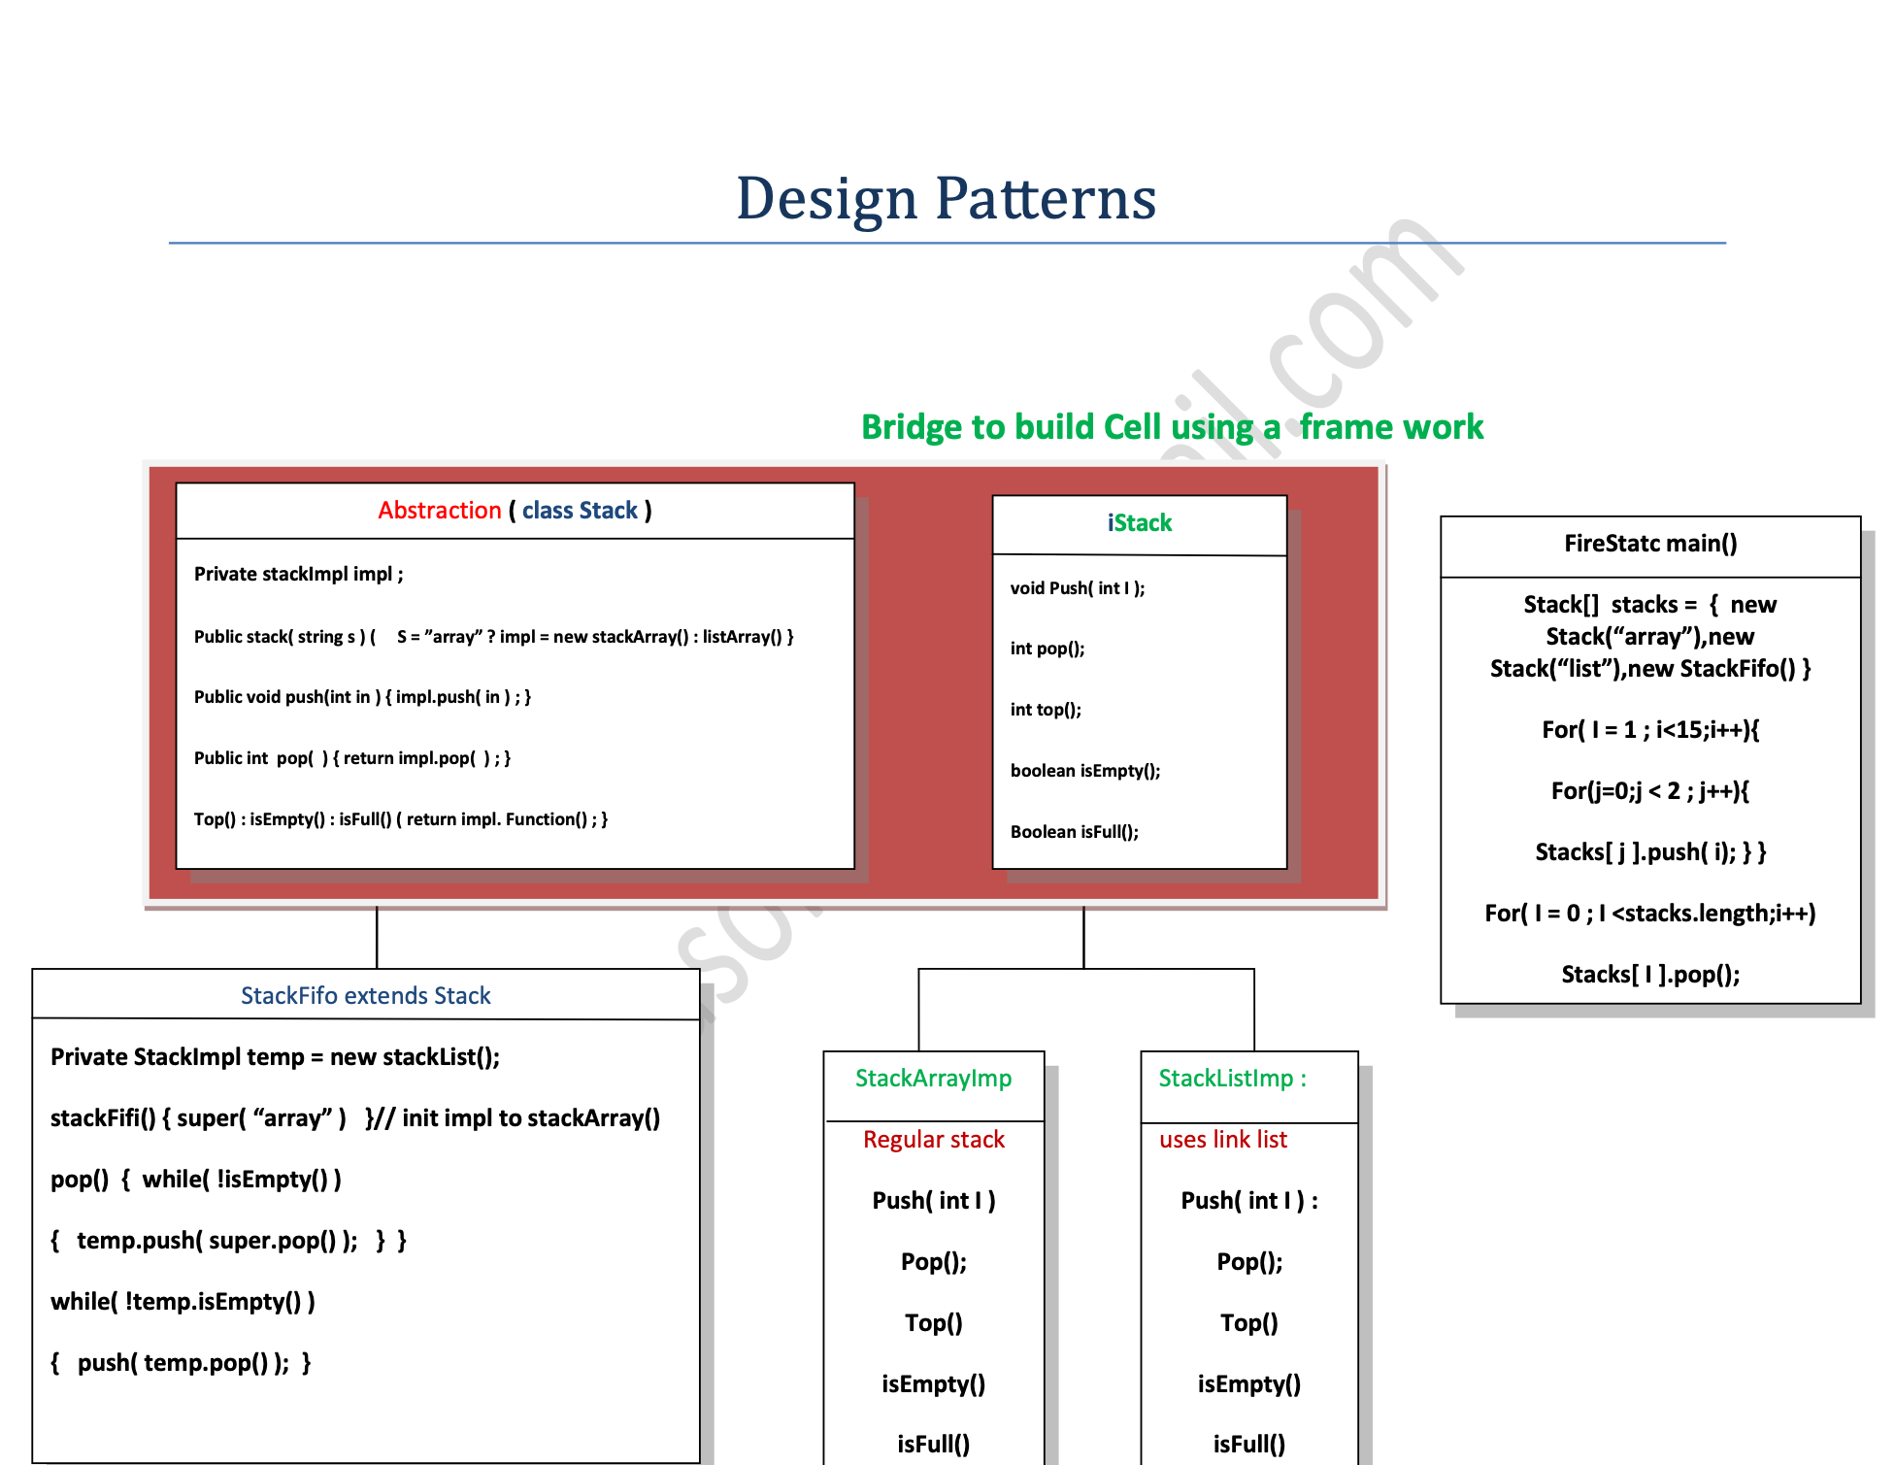
Bridge

Slide 222
Priority queue
int main()
{
std::priority_queue<int, std::vector<int>, std::greater<int>> pq;
pq.push(10);
pq.push(20);
pq.push(30);
pq.push(40);
pq.push(50);
std::cout << "Size: " << pq.size() << std::endl;
std::cout << "Top: " << pq.top() << std::endl;
std::cout << "Elements of queue: ";
while (!pq.empty())
{
std::cout << pq.top() << ' ';
pq.pop();
}
std::cout << std::endl;
// using lambda to compare elements.
auto compare = [](int a, int b)
{
return a < b;
};
std::priority_queue<int, std::vector<int>, decltype(compare)> q(compare);
for (int n : {1, 8, 5, 6, 3, 4, 0, 9, 7, 2})
q.push(n);
std::cout << "Elements of queue for custom compare: ";
while (!q.empty())
{
std::cout << q.top() << ' ';
q.pop();
}
std::cout << std::endl;
return EXIT_SUCCESS;
}
/*OUTPUT
Size: 5
Top: 10
Elements of queue: 10 20 30 40 50
Elements of queue for custom compare: 9 8 7 6 5 4 3 2 1 0
*/

Slide 223
Choosing your containers - reusing the same

Slide 224
Choosing your containers - reusing the same
Do you need to be able to insert a new element at an arbitrary position in the container? - if so, you need a sequence containers.
Do you care how elements are ordered in the container? - if not, hashed containers becomes workable choice, otherwise use ordered containers.
Do you need to avoid movement of existing containers elements when insertions and erasures take place? - Avoid using contiguous containers
Does you code has frequent push_back()? - use deque instead of vector as deque allocates block of data.
If there are strict requirements on memory usage, additional memory overhead for storing hash table cannot be accepted.
If you are to traverse the map use ordered map instead of unordered map.
If the size is immutable choose std::array instead of vector.
If there are frequent insertion and remove of the elements in the middle of the sequence- use std::list instead of vector and deque.
In some use cases the containers in STL are not a great fit, in that case we can write our own containers. With the implementation of some basic core interfaces we can use adaptor interface efficiently.

Slide 225
Algorithms, interaction between algorithms and iterators
Stack vs Queue - dequeue

Slide 226
Base class for Iterator
// std::iterator example
#include <iostream> // std::cout
#include <iterator> // std::iterator, std::input_iterator_tag
class MyIterator : public std::iterator<std::input_iterator_tag, int>
{
int* p;
public:
MyIterator(int* x) :p(x) {}
MyIterator(const MyIterator& mit) : p(mit.p) {}
MyIterator& operator++() {++p;return *this;}
MyIterator operator++(int) {MyIterator tmp(*this); operator++(); return tmp;}
bool operator==(const MyIterator& rhs) const {return p==rhs.p;}
bool operator!=(const MyIterator& rhs) const {return p!=rhs.p;}
int& operator*() {return *p;}
};
int main () {
int numbers[]={10,20,30,40,50};
MyIterator from(numbers);
MyIterator until(numbers+5);
for (MyIterator it=from; it!=until; it++)
std::cout << *it << ' ';
std::cout << '\n';
return 0;
}

Slide 227
Iterator traits
Iterator traits
Traits class defining properties of iterators.
Standard algorithms determine certain properties of the iterators passed to them and the range they represent by using the members of the corresponding iterator_traits instantiation.
// iterator_traits example
#include <iostream> // std::cout
#include <iterator> // std::iterator_traits
#include <typeinfo> // typeid
int main() {
typedef std::iterator_traits<int*> traits;
if (typeid(traits::iterator_category)==typeid(std::random_access_iterator_tag))
std::cout << "int* is a random-access iterator";
return 0;
}

Slide 228
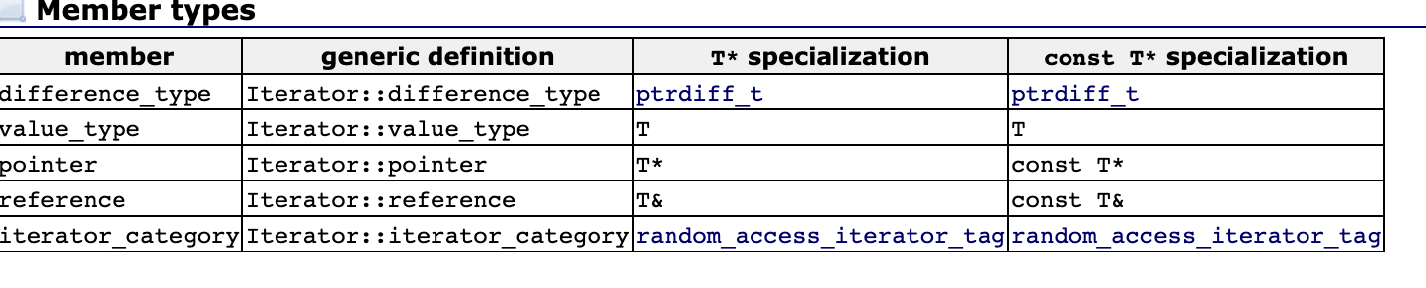
Unique

Slide 229
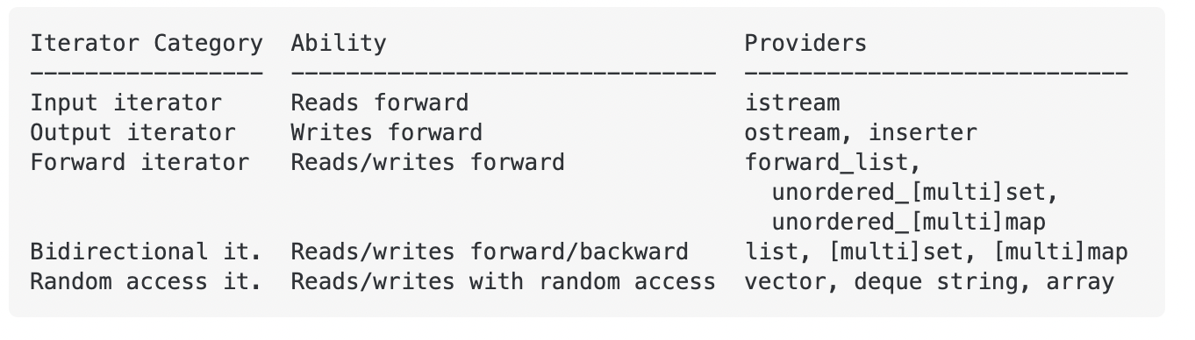
Iterators : input, output, forward, bi-directional & random iterators

Slide 230
Iterators
Iterators:
Iterators are used to point to the memory addresses of the STL containers. Apart from that, an iterator is also used to iterate over the data structures. It can access or assign values that a pointer is unable to do.

Slide 231
Iterator
Input iterator
Output iterator
Forward iterator
Bidirectional iterator
Random access iterator
Use of Iterators in C++
An iterator in C++ serves the following major purposes:
The primary objective of an iterator is to access the STL container elements and perform certain operations on them.
The internal structure of a container does not matter, since the iterators provide common usage for all of them.
Iterator algorithms are not dependent on the container type.
An iterator can be used to iterate over the container elements. It can also provide access to those elements to modify their values.
Iterators follow a generic approach for STL container classes. This way, the programmers don’t need to learn about different iterators for different containers.

Slide 232
Iterator
The following program illustrates the concept of iterators in C++:
#include <iostream>
#include <vector>
using namespace std;
int main()
{
// initialize a vector
vector<int> v1 = { 10, 20, 30, 40 };
// declare an iterator
vector<int>::iterator itr;
// access vector elements without iterator
cout << “Traversing without iterator : “;
for (int j = 0; j < 4; ++j) {
cout << v1[j] << ” “;
}
cout << “\n”;
// access vector elements using an iterator
cout << “Traversing using iterator “;
for (itr = v1.begin(); itr != v1.end(); ++itr) {
cout << *itr << ” “;
}

Slide 233
Iterator
cout << “\n\n”;
// insert an element into the vector
v1.push_back(50);
// access vector elements without iterator
cout << “Traversing without iterator : “;
for (int j = 0; j < 5; ++j) {
cout << v1[j] << ” “;
}
cout << “\n”;
// access vector elements using an iterator
cout << “Traversing using iterator “;
for (itr = v1.begin(); itr != v1.end(); ++itr) {
cout << *itr << ” “;
}
cout << “\n\n”;
return 0;
}

Slide 234
Iterator
Input Iterators in C++
The input iterator is the simplest and least used iterator among the five main iterators of C++. It sequentially uses this iterator for input operations. In other words, you can say that it is used to read the values from the container. It is a one-way iterator. Once you have read a value, you are only allowed to increment the iterator. You can not decrement the input iterator in any way.

Slide 235
Unique

Slide 236
Input Iterator
The input iterator is the simplest and least used iterator among the five main iterators of C++. It sequentially uses this iterator for input operations. In other words, you can say that it is used to read the values from the container. It is a one-way iterator. Once you have read a value, you are only allowed to increment the iterator. You can not decrement the input iterator in any way.

Slide 237
Operations of Iterator
#include<iostream>
#include<iterator>
#include<vector>
using namespace std;
int main()
{
// initialize a vector
vector<int> myVector = { 100, 200, 300, 400, 500 };
// declare an iterator
vector<int>::iterator itr;
// traverse the vector using the begin() and end()
cout << “The vector contains these elements: “;
// print the elements of the vector
for (itr = myVector.begin(); itr < myVector.end(); itr++) {
cout << *itr << ” “;
}
cout << “\n\n”;
return 0;
}

Slide 238
Operations of Iterator
advance():
The advance() method is used to increment the iterator from its current position. It takes an integer as its argument. The advance() method increments the pointer up to that integer position.
Syntax
advance(iterator i ,int distance)
The following program illustrates the advance() operation of iterators:

Slide 239
Operations of Iterator
#include<iostream> #include<iterator> #include<vector>
using namespace std;
int main()
{
// initialize a vector
vector<int> myVect = { 100, 200, 300, 400, 500 };
// declare iterators for the vector
vector<int>::iterator i1 = myVect.begin();
vector<int>::iterator i2 = myVect.end();
// store the pointer returned by next()
// after incrementing i1 by 3
auto nextptr = next(i1, 3);
// store the pointer returned by prev()
// after decrementing i2 by 3
auto prevptr = prev(i2, 3);
// Displaying iterator position

Slide 240
Operations of Iterator
// print the value of the new iterator returned by next()
cout << “The new pointer after using next() now points to : “;
cout << “\n”;
cout << *nextptr << ” “;
cout << “\n\n”;
// Displaying iterator position
// print the value of the new iterator returned by prev()
cout << “The new pointer after using prev() now points to : “;
cout << “\n”;
cout << *prevptr << ” “;
cout << “\n\n”;
return 0;
}

Slide 241
Operations of Iterator inserter
inserter():
The inserter() method is a special type of iterator method. It is used to insert elements at a specified position in a container. If there is already an element at the specified position, then it can also overwrite the elements in the container to insert the new elements.
Benefits of Iterators
Iterators prove to be highly beneficial in certain fields. Some of these benefits are listed below:
Convenience in programming: Iterators provide you with ease and convenience while writing the code. For instance, while using iterators, you do not have to worry about the size of the container. You can easily iterate through the container and get the last element using the end() method. You can even alter the container elements without shifting or doing all the labor.

Slide 242
Operations of Iterator
using namespace std;
int main () {
// initialize 2 vectors
vector<int> myVect1, myVect2;
// add elements into the vectors
for (int i = 1; i <= 5; i++) {
myVect1.push_back(i);
myVect2.push_back(i + 4);
}
// initialize an iterator itr pointing to
// the first element in vector myVect1
vector<int>::iterator itr = myVect1.begin();
// copy elements of myVect2 vector to myVect1 vector at
// the beginning
copy (myVect2.begin(), myVect2.end(), inserter(myVect1, itr));
// print the elements of the vector myVect1
cout<<“Elements of vector myVect1 after copying elements of myVect2 are :”<< endl;
for ( itr = myVect1.begin(); itr!= myVect1.end(); ++itr )
{
cout << ” ” << *itr;
}
cout << “\n\n”;
}

Slide 243
Operations of Iterator
#include <iostream>
#include <vector>
using namespace std;
int main()
{
// initialize a vector
vector<char> v1 = {‘a’, ‘b’, ‘c’, ‘d’ };
// declare an iterator
vector<char>::iterator itr;
// access vector elements without iterator
cout << “Traversing without iterator : “;
for (int j = 0; j < 4; ++j) {
cout << v1[j] << ” “;
}
cout << “\n”;
// access vector elements using an iterator
cout << “Traversing using iterator “;
for (itr = v1.begin(); itr != v1.end(); ++itr) {
cout << *itr << ” “;
}

Slide 244
Operations of Iterator
cout << “\n\n”;
// insert an element into the vector
v1.push_back(‘e’);
// access vector elements without iterator
cout << “Traversing without iterator : “;
for (int j = 0; j < 5; ++j) {
cout << v1[j] << ” “;
}
cout << “\n”;
// access vector elements using an iterator
cout << “Traversing using iterator “;
for (itr = v1.begin(); itr != v1.end(); ++itr) {
cout << *itr << ” “;
}
cout << “\n\n”;
return 0;
}

Slide 245
Operations of Iterator
In the code mentioned above, you did not store or calculate the initial size of the container. You simply iterated over the container with the help of an iterator. Then you added an element to the container. This time, you did not calculate the size either.
You simply iterated over the container. In both cases, you used the same loop and therefore the iterator eased out your work.
Code Reusability: Now, consider the above code. If you want to change the vector into a list without changing the code, this would not be possible without an iterator. But since you are using an iterator here, you can just change the declaration of the vector into a list and it will work fine. In this way, you can reuse your code.
Dynamic Processing: With the help of iterators, you can dynamically allocate as well as delete the memory. This dynamic processing of containers prevents the wastage of memory. And you can easily alter the size of the containers according to your needs and requirements.

Slide 246
Operations of Iterator
#include <iostream>
#include <vector>
using namespace std;
int main()
{
// initialize a vector
vector<int> v = { 10, 20, 30 };
// declare an iterator
vector<int>::iterator i;
// add elements into vector using the iterator
for (i = v.begin(); i != v.end(); ++i) {
if (i == v.begin()) {
// add 100 at the beginning
i = v.insert(i, 100);
}
}
// vect -> 100 10 20 30

Slide 247
Operations of Iterator
// delete an element using the iterator
for (i = v.begin(); i != v.end(); ++i) {
if (i == v.begin() + 1) {
// delete 2nd element, i.e. at index 1
i = v.erase(i);
}
}
cout << “Vector after performing all operations: “;
cout << “\n”;
// vect -> 100 20 30
// Traversing the vector using the iterator
for (i = v.begin(); i != v.end(); ++i) {
cout << *i << ” “;
}
cout << “\n\n”;
return 0;
}

Slide 248
Disadvantages of Iterator
In the above section, you saw how beneficial iterators are. But there are some drawbacks of using iterators too. Some of these disadvantages are mentioned below:
Iterators do not allow you to handle two data structures simultaneously, especially when the data of the first data structure decides your location in the other one.
You can not go back while iterating through a container, due to the working process of iterators.
The structure of the STL container cannot be updated while traversing it if you are using an iterator to iterate over it.

Slide 249
Providers of Iterator
The following table represents iterators along with their provider containers.
ITERATOR | PROVIDER
Input Iterator | istream
Output Iterator | ostream
Forward iterator | –
Bidirectional iterator | List, set, map, multimap, multiset
Random access iterator | Vector, array, deque

Slide 250
Operations of Iterator
next():
The next() method gives an iterator in return that points to the element you get after incrementing the iterator pointer from the current element.
Syntax
next(iterator i ,int n)
5. prev():
The prev() method is just the opposite of the next() method. It returns an iterator pointer that points to the element that you get after decrementing the iterator from the current element.

Slide 251
Operations of Iterator Advanced
#include<iostream>
#include<iterator>
#include<vector>
using namespace std;
int main()
{
// initialize a vector
vector<int> myVect = { 100, 200, 300, 400, 500 };
// declare an iterator
vector<int>::iterator itr;
// initialize the iterator
itr = myVect.begin();
// print the original value to
// which the iterator is pointing
cout << “The iterator originally points to: “;
cout << *itr << ” “;
cout << “\n\n”;
// update the iterator by incrementing it
// by a distance of 2
// using advance()
advance(itr,2); // iterator now points to 300
// print the current value to which the
// iterator is pointing
cout << “The iterator now points to : “;
cout << *itr << ” “;
cout << “\n\n”;
return 0;
}

Slide 252
END of Iterator

Slide 253
Operations of Iterator
begin():
The begin() function returns a pointer pointing to the first element of the container. This pointer can point in either direction of the container and hence it is bidirectional.
end():
The end() method returns a pointer pointing to the element that comes after the last element of the container. This element is not real, it is a virtual element that contains the address of the last element.
The following program illustrates the begin() and end() operations of iterators:

Slide 254
Input Iterator
Limitations
The following are some of the major limitations of the input iterators in C++:
Input iterators are read-only. They can only read the data of the location to which the pointer points, they can not be used to assign the values.
As mentioned earlier, these iterators are unidirectional. They can only move in a forward direction i.e., they can only be incremented. You can not decrement them.
You can not use these iterators in a multi-pass algorithm where you have to move in both directions inside a container.
Except for equality and inequality operators, you can not implement any other relational operator on these iterators.
Like relational operators, you cannot implement arithmetic operators on the input iterators.

Slide 255
Iterator input
#include<iostream>
#include<vector>
using namespace std;
int main()
{
vector<int> v{1, 2, 3, 4, 5};
// declare iterators
vector<int>::iterator it1, it2, temp;
// inititalize the iterators
it1 = v.begin(); // will point to the first element, i.e. 1
it2 = v.end() -1; // will point to the last element, i.e. 5
// dereference and print iterators before swapping them
cout << "Before Swapping" << endl;
cout << "Dereferenced iterator 1: " << *it1 << endl ;
cout << "\n";
cout << "Dereferenced iterator 2: "<< *it2;
cout << "\n\n";
// swap the iterators
temp = it1;
it1 = it2;
it2 = temp;
// dereference and print iterators after swapping them
cout << " After swaping " << endl;
cout << " Dereferenced iterator 1: "<< *it1 << endl ;
cout << "\n";
cout << " Dereferenced iterator 2: " << *it2;
cout << "\n\n";
return 0;
}

Slide 256
Iterator output
Output iterators serve exactly the opposite purpose as the input iterators. This iterator is sequentially used for output operations. In other words, you can say that it is used to assign the values. But it can not access the values. It is complementary to the input iterators where you can access the values, but can not assign them. Like the input iterator, it is a one-way iterator. Once you have assigned a value, you are only allowed to increment the iterator, and you can not decrement the output iterator in any way.

Slide 257
Iterator output
Salient Features
The output iterator in C++ has the following salient features:
Equality and Inequality operator: Just like the input iterators, you can compare the equality of two output iterators. Two iterators are said to be equal if both of them are pointing towards the same location. Otherwise, they are considered unequal.
In the expression shown below, consider it1 and it2 as two output iterators:
it1 == it2 // Using equality operator
it1 != it2 // Using inequality operator
Usability: Output iterators also work with single-pass algorithms where you can visit an element only once at most. You can assign the value only once.
Dereferencing: You can dereference an output iterator as an lvalue to get the position for storing the value. The method of dereferencing is the same as for the input iterators.
In the expression shown below, consider it as an output iterator:
*it // Dereferencing it using the asterisk(*)
Incrementable: Just like input iterators, output iterators are one-way iterators too, and you can increment them in the forward direction. These iterators can be incremented either in a pre-increment manner or post-increment manner.
In the expression shown below, consider it as an output iterator:
it++ // Using post increment operator
++it // Using pre increment operator
Swappable: The value of the two output iterators that are pointing to different positions can be easily swapped or exchanged with each other.

Slide 258
Iterator output
Limitations
The following are some of the major limitations of the output iterators in C++:
You can not access the values using output iterators. These iterators can only be used to assign the values.
As mentioned earlier, these iterators are unidirectional. They only move in a forward direction i.e., they can only be incremented. You can not decrement them.
You can not use these iterators in a multi-pass algorithm where you have to move in both directions inside a container.
Just like in input iterators, except for equality and inequality operators, you can not implement any other relational operator on output iterators.
Like relational operators, arithmetic operators can not be implemented on the output iterators.

Slide 259
Iterator Output
#include <iostream>
#include <vector>
using namespace std;
int main () {
// initialize 2 vectors
vector<int> v1, v2;
// add elements into the vectors
for (int i = 1; i <= 10; i++) {
v1.push_back(i);
v2.push_back(i + 2);
}
// initialize an iterator itr pointing to
// the first element in vector v1
vector<int>::iterator itr = v1.begin();
// copy elements of v2 vector to v1 vector at the beginning
copy (v2.begin(), v2.end(), inserter(v1, itr));
// print the elements of the vector v1
cout << "Elements of vector v1 after copying elements of v2 are :" << endl ;
for ( itr = v1.begin(); itr!= v1.end(); ++itr )
{
cout << " "<< *itr;
}
cout << "\n\n";
}

Slide 260
Iterator forward
Forward Iterators in C++
Forward iterators serve the purpose of both the input and output iterators. That’s why these iterators are said to be the combination of input and output operators. You can access the values (functionality of input iterators) as well as assign the values (functionality of output iterators). As the name suggests, these iterators are one-way iterators. You can only traverse in the forward direction. Also, Bidirectional and Random Access iterators are considered valid forward iterators.

Slide 261
Forward Iterator
Salient Features
The forward iterator in C++ has the following salient features:
Equality and Inequality operator: Just like the other two iterators mentioned above, you can compare the equality of two output iterators. Two iterators are said to be equal if both of them are pointing towards the same location. Otherwise, they are considered unequal.
In the expression shown below, consider it1 and it2 as two forward iterators:
it1 == it2 // Using equality operator
it1 != it2 // Using inequality operator
Usability: Forward iterator is the only iterator category that is used by every STL container class. It is the only iterator among the 5 types of iterators that provides the functionality of the simplest kind of loop through a container.
Dereferencing: Since input iterators are dereferenced as an rvalue and output iterators are dereferenced as an lvalue, and forward iterators are the combination of these iterators, you can use both rvalue and lvalue.
Incrementable: Forward iterators unidirectional iterators and you can increment them in the forward direction. These iterators can be incremented either in a pre-increment manner or post-increment manner.
In the expression shown below, consider it as a forward iterator:
it++ // Using post increment operator
++it // Using pre increment operator
Swappable: The value of the two forward iterators that are pointing to different positions can be easily swapped or exchanged with each other.

Slide 262
Forward Iterator
Limitations
The following are some of the major limitations of the forward iterators in C++:
The offset dereference operator ([]) is not supported by the forward iterators. So you can not use the offset operator to dereference a forward iterator.
As mentioned earlier, these iterators are unidirectional. They only move in a forward direction i.e., they can only be incremented. You can not decrement them.
Just like in input and output iterators, except for equality and inequality operators, you can not implement any other relational operator on the forward iterators.
Like relational operators, arithmetic operators can not be implemented on the forward iterators.

Slide 263
Iterator forward
#include <iostream>
#include<vector>
using namespace std;
template<class FIterator>
void forwardIterator(FIterator start, FIterator end)
{
while(start != end){
// dereference the iterator to print its value
cout << *start << " ";
start++;
}
}
int main()
{
vector<int> v1;
// add elements to the vector v1
for(int i = 1; i <= 10; i++){
v1.push_back(i + 2);
}
// call the forward Iterator function pass the vector v1
forwardIterator(v1.begin(),v1.end());
cout << "\n\n";
return 0;
}

Slide 264
Bidirectional Iterators
Bidirectional Iterators Bidirectional iterators can iterate in either direction. They are considered as the forward iterators with two decrement operators because they offer the same functionality as the forward iterators, except that they can move in both directions. The containers like list, set, and multimap supports bidirectional iterators. The random access iterators are also considered valid bidirectional iterators.

Slide 265
Bidirectional Iterators
Salient Features
The bidirectional iterator in C++ has the following salient features:
Equality and Inequality operator: Two bidirectional iterators can be compared as to whether they are equal or not. Two iterators are said to be equal if both of them are pointing towards the same location. Otherwise, they are considered unequal.
In the expression shown below, consider it1 and it2 as two bidirectional iterators:
it1 == it2 //Using equality operator
it1 != it2 //Using inequality operator
Usability: Forward iterators are used for multi-pass algorithms (the algorithms that may need the read and write operations multiple times). Therefore, bidirectional operators can also be used for multi-pass algorithms.
Dereferencing: Since input iterators are dereferenced as rvalue and output iterators are dereferenced as an lvalue and forward iterators are the combination of these iterators, you can use both rvalue and lvalue. So, bidirectional iterators can also be used for the same purpose.
Incrementable/Decrementable: Bidirectional iterators are valid forward iterators and forward iterators are unidirectional. But bidirectional iterators can move in either way. You can increment your iterator pointer as well as decrement it. That is why they are named bidirectional.
In the expression shown below, consider it as a bidirectional iterator:
//********Incrementing the iterator********//
it++ // Using post increment operator
++it // Using pre increment operator
//********Decrementing the iterator********//
it– // Using post decrement operator
–it // Using pre decrement operator
Swappable: The value of the two bidirectional iterators that are pointing to different positions can be easily swapped or exchanged with each other.

Slide 266
Bidirectional Iterators
Limitations
The following are some of the major limitations of the bidirectional iterators in C++:
The offset dereference operator ([]) is not supported by the bidirectional iterators. You can not use the offset operator to dereference a bidirectional iterator.
Just like in the forward iterators, except for equality and inequality operators, you can not implement any other relational operator on the bidirectional iterators.
Like relational operators, arithmetic operators can not be implemented on the bidirectional iterators.

Slide 267
Iterator BiDirectional
#include <iostream>
#include<vector>
using namespace std;
int main()
{ // initialize a vector
vector<int> v1{10, 20, 30, 40, 50, 60};
vector<int> ::iterator i1;
vector<int> :: reverse_iterator rItr;
// dereference and print i1 to print values in original order
cout << "values in orginal order" << "\n";
for(i1 = v1.begin(); i1 != v1.end(); i1++)
{
cout << *i1 << " ";
}
cout << "\n\n";
// dereference and print rItr to print values in reverse order
cout << "Values in reverse order"<< "\n";
for(rItr = v1.rbegin(); rItr != v1.rend(); rItr++)
{
cout << *rItr << " ";
}
cout << "\n\n";
return 0;
}
// Values in reverse order 60 50 40 30 20 10

Slide 268
Random-Access Iterators
Random Access iterators are considered to be the most completed iterators among all the five iterators. These iterators are also stated as bidirectional iterators with random access.

Slide 269
Random-Access Iterators
Salient Features
The random-access iterator in C++ has the following salient features:
Equality and Inequality operator: Two random access iterators can be compared to see whether they are equal or not. Two iterators are said to be equal if both of them are pointing towards the same location. Otherwise, they are considered unequal.
In the expression shown below, consider it1 and it2 as two random-access iterators:
it1 == it2 //Using equality operator
it1 != it2 //Using inequality operator
Usability: Just like bidirectional iterators, random access iterators can also be used in multi-pass algorithms.
Dereferencing: Bidirectional iterators are dereferenced as rvalue as well as an lvalue. Therefore, random access iterators can also be used for the same purpose.
Incremental/Decremental: Random access iterators can be incremented as well as decremented, as they are multi-directional.
In the expression shown below, consider it as a random access iterator:
//********Incrementing the iterator********//
it++ // Using post increment operator
++it // Using pre increment operator
//********Decrementing the iterator********//
it– // Using post decrement operator
–it // Using pre decrement operator
Swappable: The value of the two random-access iterators that are pointing to different positions can be easily swapped or exchanged with each other.
Relational Operators: Unlike other iterators, random access supports all the relational operators.
Arithmetic Operators: Just like relational operators, arithmetic operators can be implemented on the random access iterators.
Offset dereference operator: The offset dereference operator ([]) is supported by the random access iterators. You can use the offset operator to dereference a random-access iterator.

Slide 270
Random-Access Iterators
#include <iostream>
#include <vector>
using namespace std;
int main()
{
// initialize a vector
vector<int>vec1 = {10, 20, 30, 40, 50, 60};
vector<int>::iterator i1;
vector<int>::iterator i2;
i1 = vec1.begin();
i2 = vec1.end();
if ( i1 < i2)
{
cout << "Iterator i2 is greater than iterator i1.";
}
// computing the distance using the arithmetic operator
int difference = i2 – i1 ;
cout << "\nThe difference between i1 and i2 = " << difference;
cout << "\n\n";
return 0;
}

Slide 271
Template
#include <iostream>
using namespace std;
template <class T>
class Test
{
// Data members of test
public:
Test()
{
// Initialization of data members
cout << "General template object \n";
}
// Other methods of Test
};
template <>
class Test <int>
{
public:
Test()
{
// Initialization of data members
cout << "Specialized template object\n";
}
};
int main()
{
Test<int> a;
Test<char> b;
Test<float> c;
return 0;
}

Slide 272
Template
template<typename T>
struct A {
void f(int); // non-template member
template<typename T2> void f(T2); // member template
};
int main()
{
A<char> ac;
ac.f('c'); // calls template function A<char>::f<char>(int)
ac.f(1); // calls non-template function A<char>::f(int)
ac.f<>(1); // calls template function A<char>::f<int>(inf)
}

Slide 273
Template Member function
#include <iostream>
#include <vector>
#include <algorithm>
struct Printer { // generic functor
std::ostream& os;
Printer(std::ostream& os) : os(os) {}
template<typename T>
void operator()(const T& obj) { os << obj << ' '; } // member template
};
int main()
{
std::vector<int> v = {1,2,3};
std::for_each(v.begin(), v.end(), Printer(std::cout));
std::string s = "abc";
std::for_each(s.begin(), s.end(), Printer(std::cout));
}

Slide 274
Template Inheritance
#include <iostream>
class Base{
public:
void func(){ // (1)
std::cout << "func\n";
}
};
class Derived: public Base{
public:
void callBase(){
func(); // (2)
}
};
int main(){
std::cout << '\n';
Derived derived;
derived.callBase();
std::cout << '\n';
}

Slide 275
Template inheritance Error
template <typename T>
class Base{
public:
void func(){ // (1)
std::cout << "func\n";
}
};
template <typename T>
class Derived: public Base<T>{
public:
void callBase(){
func(); // (2)
}
};
int main(){
std::cout << '\n';
Derived<int> derived;
derived.callBase();
std::cout << '\n';
}

Slide 276
Template Inheritance
#include <iostream>
template <typename T>
class Base{
public:
void func1() const {
std::cout << "func1()\n";
}
void func2() const {
std::cout << "func2()\n";
}
void func3() const {
std::cout << "func3()\n";
}
};
template <typename T>
class Derived: public Base<T>{
public:
using Base<T>::func2; // (2)
void callAllBaseFunctions(){
this->func1(); // (1)
func2(); // (2)
Base<T>::func3(); // (3)
}
};
int main(){
std::cout << '\n';
Derived<int> derived;
derived.callAllBaseFunctions();
std::cout << '\n';
}

Slide 277
Template Inheritance Works
#include <iostream>
template <typename T>
class Base{
public:
void func1() const {
std::cout << "func1()\n";
}
void func2() const {
std::cout << "func2()\n";
}
void func3() const {
std::cout << "func3()\n";
}
};
template <typename T>
class Derived: public Base<T>{
public:
using Base<T>::func2; // (2)
void callAllBaseFunctions(){
this->func1(); // (1)
func2(); // (2)
Base<T>::func3(); // (3)
}
};
int main(){
std::cout << '\n';
Derived<int> derived;
derived.callAllBaseFunctions();
std::cout << '\n';
}

Slide 278
Template Inheritance
// lazy.cpp
#include <iostream>
template<class T>
struct Lazy{
void func() { std::cout << "func\n"; }
void func2(); // not defined (1)
};
int main(){
std::cout << '\n';
Lazy<int> lazy;
lazy.func();
std::cout << '\n';
}

Slide 279
Template Partial NOT ALLOWED
// classTemplatePartial.cpp
#include <iostream>
#include <vector>
template <typename T> // (1)
class Matrix {
public:
explicit Matrix(std::initializer_list<T> inList): data(inList) {}
void printAll() const { // (2)
for (const auto& d: data) std::cout << d << " ";
}
private:
std::vector<T> data;
};
int main() {
std::cout << '\n';
const Matrix<int> myMatrix1({1, 2, 3, 4, 5});
myMatrix1.printAll(); // (3)
std::cout << "\n\n";
const Matrix<int> myMatrix2({10, 11, 12, 13});
myMatrix2.printAll(); // (4)
std::cout << "\n\n";
const Matrix<Matrix<int>> myMatrix3({myMatrix1, myMatrix2});
// myMatrix3.printAll(); ERROR (5)
}

Slide 280
Template External
#include "TemplHeader.h"
extern template void f<T>(); //is this correct?
int main() {
f<char>();
return 0;
}

Slide 281
Template Alias declaration
#include <iostream>
using IntArray4 = int(&)[4];
// Use the array reference alias as parameter type
void foo(IntArray4 array) {
// range-based loop on the array
for(int i : array) std::cout << i << " ";
}
int main(int argc, const char * argv[]) {
// create an alias of reference to int[4];
// or with typedef
// typedef int(&IntArray4)[4];
// foo can be called on a int[4] as:
int arr[4] = {6,7,8,9};
foo(arr); // logs 6 7 8 9
return 0;
}

Slide 282
Template Alias declaration
// a template or generic alias
template<typename A>
using UserAccounts_t = std::map<UserId, std::vector<A>>;
using UserCheckingAccounts_t = UserAccounts_t<CheckingAccount>;
using UserSavingsAccounts_t = UserAccounts_t<SavingsAccount>;

Slide 283
Template Alias declaration
#include <stdlib.h>
#include <new>
template <typename T> struct MyAlloc {
typedef T value_type;
MyAlloc() { }
template <typename U> MyAlloc(const MyAlloc<U>&) { }
bool operator==(const MyAlloc&) const { return true; }
bool operator!=(const MyAlloc&) const { return false; }
T * allocate(const size_t n) const {
if (n == 0) {
return nullptr;
}
if (n > static_cast<size_t>(-1) / sizeof(T)) {
throw std::bad_array_new_length();
}
void * const pv = malloc(n * sizeof(T));
if (!pv) {
throw std::bad_alloc();
}
return static_cast<T *>(pv);
}
void deallocate(T * const p, size_t) const {
free(p);
}
};

Slide 284
Template Alias declaration
#include <vector>
using MyIntVector = std::vector<int, MyAlloc<int>>;
#include <iostream>
int main ()
{
MyIntVector foov = { 1701, 1764, 1664 };
for (auto a: foov) std::cout << a << " ";
std::cout << "\n";
return 0;
}
Output
1701 1764 1664

Slide 285
Non-move Constructor
Trying to move A
Before move, a1.s = "test" a1.k = -1
After move, a1.s = "" a1.k = 0
Trying to move B
Before move, b1.s = "test"
After move, b1.s = ""
Trying to move C
move failed!
Trying to move D

Slide 286
Exception Handling set terminate
// set_terminate example
#include <iostream> // std::cerr
#include <exception> // std::set_terminate
#include <cstdlib> // std::abort
void myterminate () {
std::cerr << "terminate handler called\n";
abort(); // forces abnormal termination
}
int main (void) {
std::set_terminate (myterminate);
throw 0; // unhandled exception: calls terminate handler
return 0;
}

Slide 287
Exception Handling set_unexpected
// set_unexpected example
#include <iostream> // std::cerr
#include <exception> // std::set_unexpected
void myunexpected () {
std::cerr << "unexpected called\n";
throw 0; // throws int (in exception-specification)
}
void myfunction () throw (int) {
throw 'x'; // throws char (not in exception-specification)
}
int main (void) {
std::set_unexpected (myunexpected);
try {
myfunction();
}
catch (int) { std::cerr << "caught int\n"; }
catch (...) { std::cerr << "caught some other exception type\n"; }
return 0;
}
/

Slide 288
Exception Handling set terminate
/

Slide 289
Exception Handling
#include <stdexcept>
#include <limits>
#include <iostream>
using namespace std;
void MyFunc(int c)
{
if (c > numeric_limits< char> ::max())
throw invalid_argument("MyFunc argument too large.");
//...
}
int main()
{
try
{
MyFunc(256); //cause an exception to throw
}
catch (invalid_argument& e)
{
cerr << e.what() << endl;
return -1;
}
//...
return 0;
}
/

Slide 290
Unhandled Exception
#include <iostream>
using namespace std;
void term_func() {
cout << "term_func was called by terminate." << endl;
exit( -1 );
}
int main() {
try
{
set_terminate( term_func );
throw "Out of memory!"; // No catch handler for this exception
}
catch( int )
{
cout << "Integer exception raised." << endl;
}
return 0;
}
/

Slide 291
Bubble Sort
/

Slide 292
Exception Handling
/

Slide 293
Exception Handling
/

Slide 294
Shallow Copy
#include <iostream>
using namespace std;
class Demo
{
int a;
int b;
int *p;
public:
Demo()
{
p=new int;
}
void setdata(int x,int y,int z)
{
a=x;
b=y;
*p=z;
}
void showdata()
{
std::cout << " a is : " <<a<< std::endl;
std::cout << " b is : " <<b<< std::endl;
std::cout << " *p is : " <<*p<< std::endl;
}
};
int main()
{
Demo d1;
d1.setdata(10,20,30);
Demo d2 = d1;
d2.showdata();
return 0;
}
/

Slide 295
Deep Copy
#include <iostream>
using namespace std;
class Line {
public:
int getLength( void );
Line( int len ); // simple constructor
Line( const Line &obj); // copy constructor
~Line(); // destructor
private:
int *ptr;
};
// Member functions definitions including constructor
Line::Line(int len) {
cout << "Normal constructor allocating ptr" << endl;
// allocate memory for the pointer;
ptr = new int;
*ptr = len;
}
Line::Line(const Line &obj) {
cout << "Copy constructor allocating ptr." << endl;
ptr = new int;
*ptr = *obj.ptr; // copy the value
}
Line::~Line(void) {
cout << "Freeing memory!.." << endl;
delete ptr;
}
/

Slide 296
Deep Copy
int Line::getLength( void ) {
return *ptr;
}
void display(Line obj) {
cout << "Length of line : " << obj.getLength() <<endl;
}
// Main function for the program
int main() {
Line line(10);
display(line);
return 0;
}
/*
Output:
Copy constructor allocating ptr.
Length of line : 10
Freeing memory!
Freeing memory!
Program ended with exit code: 0
*/
/

Slide 297
Exception Handling
/// throw_with_nested/rethrow_if_nested example
#include <iostream> // std::cerr
#include <exception> // std::exception, std::throw_with_nested, std::rethrow_if_nested
#include <stdexcept> // std::logic_error
// recursively print exception whats:
void print_what (const std::exception& e) {
std::cerr << e.what() << '\n';
try {
std::rethrow_if_nested(e);
} catch (const std::exception& nested) {
std::cerr << "nested: ";
print_what(nested);
}
}
// throws an exception nested in another:
void throw_nested() {
try {
throw std::logic_error ("first");
} catch (const std::exception& e) {
std::throw_with_nested(std::logic_error("second"));
}
}
int main () {
try {
throw_nested();
} catch (std::exception& e) {
print_what(e);
}
return 0;
}
Edit & Run

Slide 298
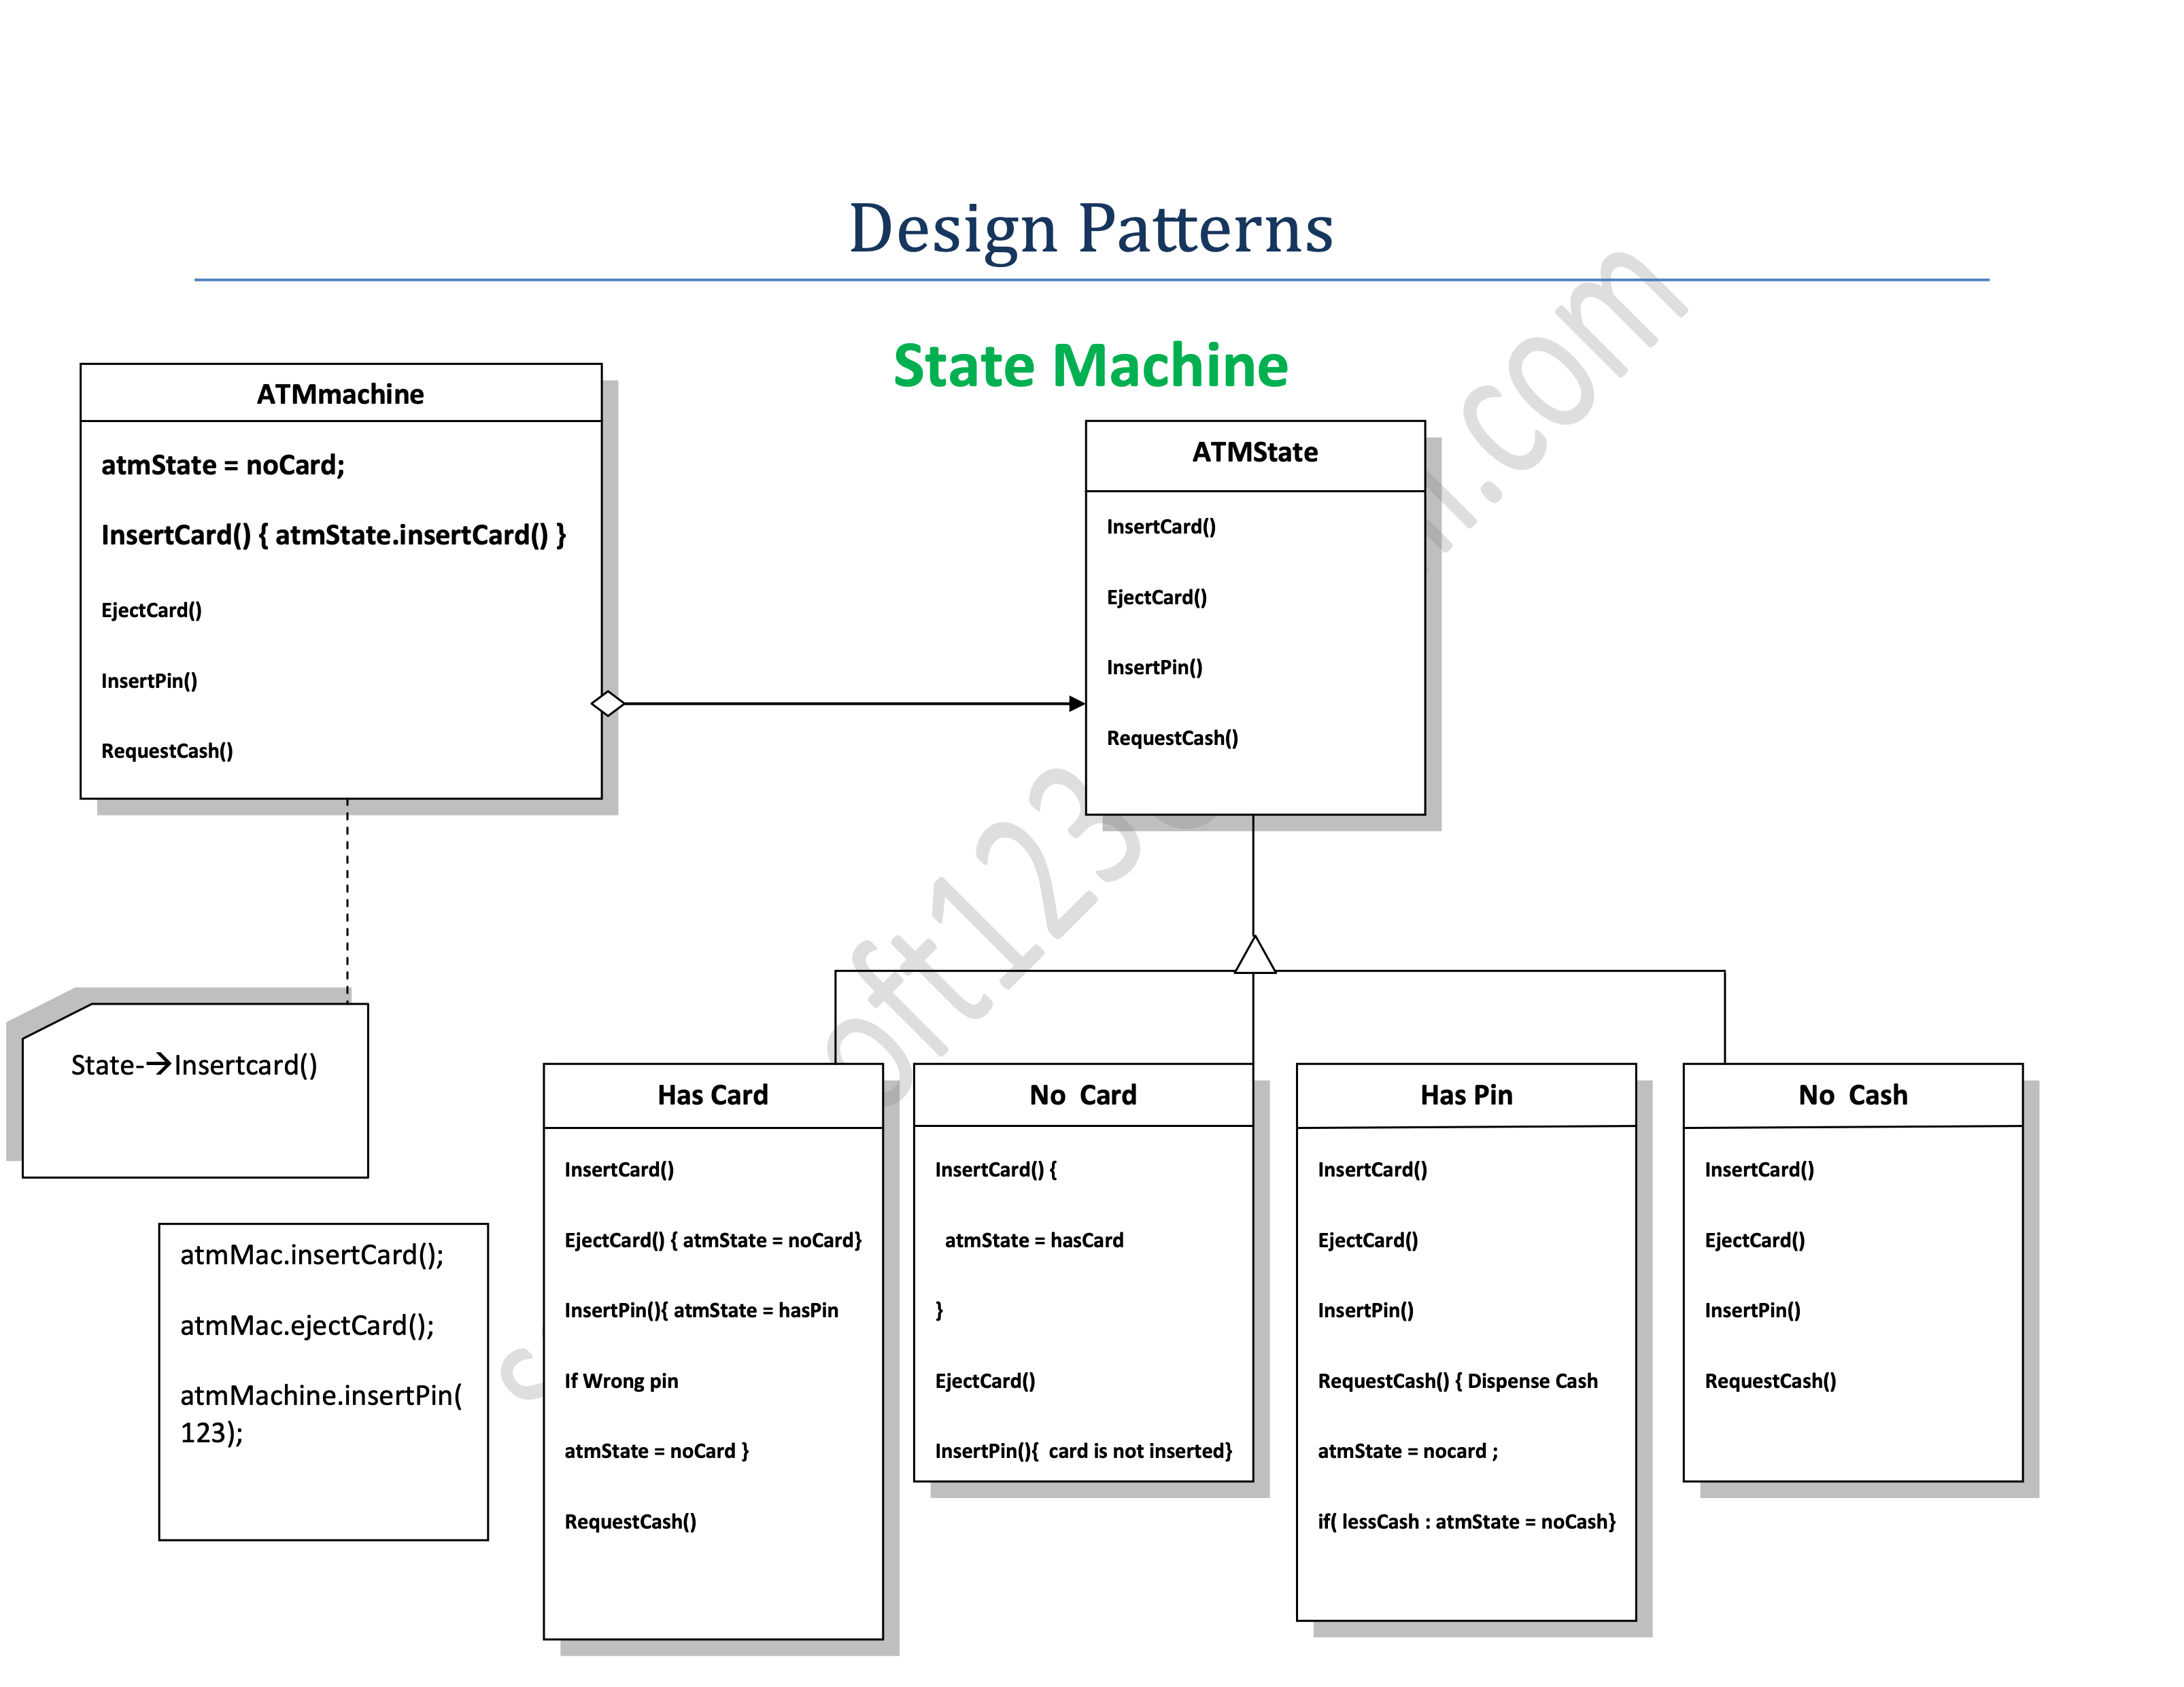
State
/

Slide 299
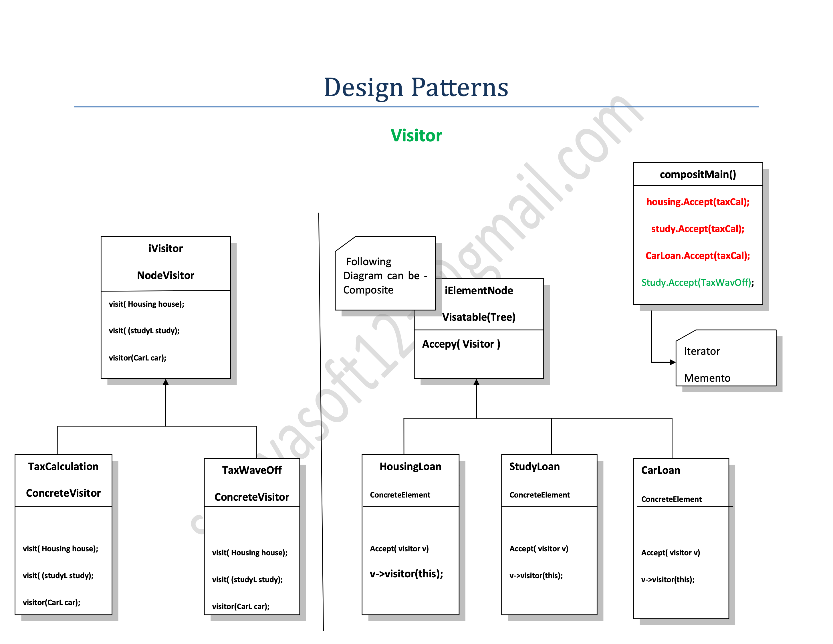
Visitor
/

Slide 300
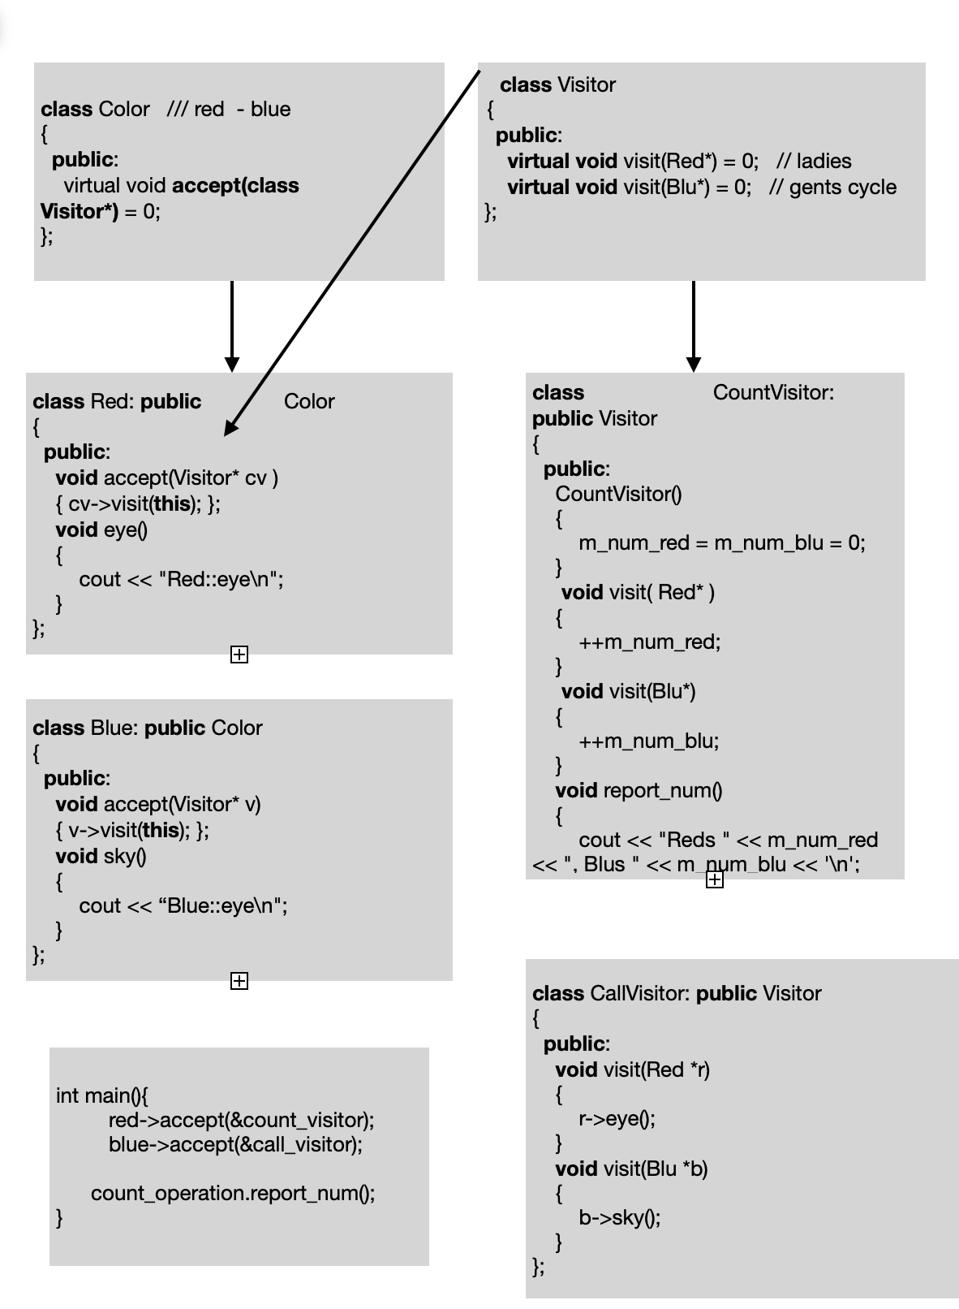
Visitor Legacy -Double dispatch
/

Slide 301
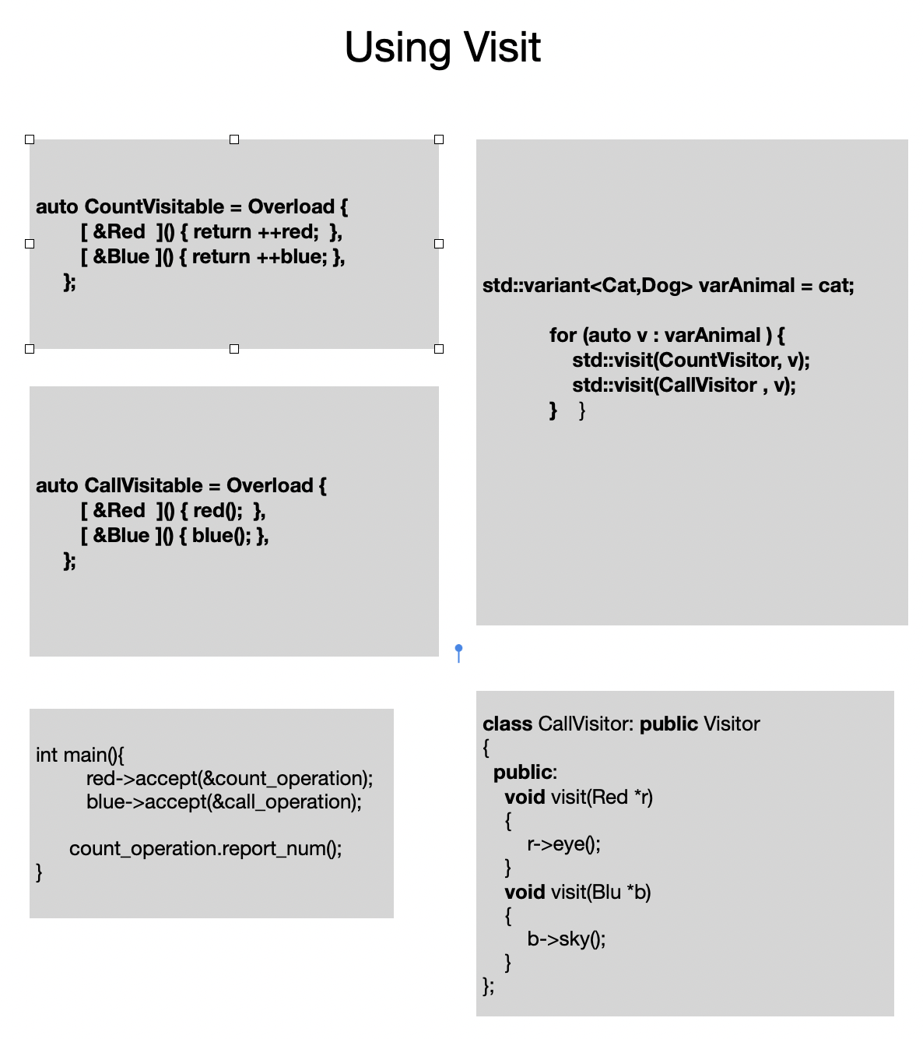
Visitor using Visit ,Variant, Lambda
/

Slide 302

Threads

Slide 303
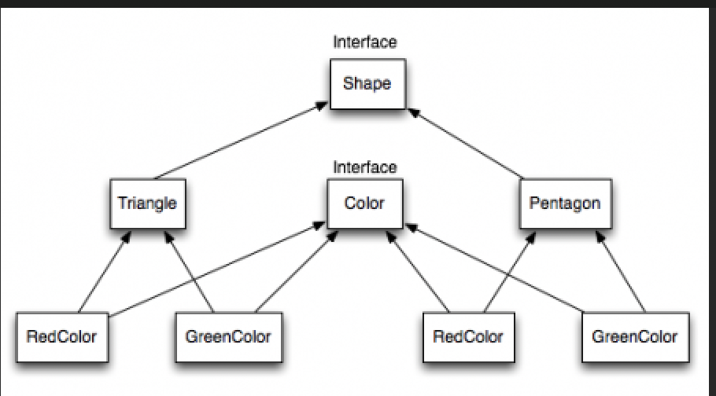
Bridge
/

Slide 304
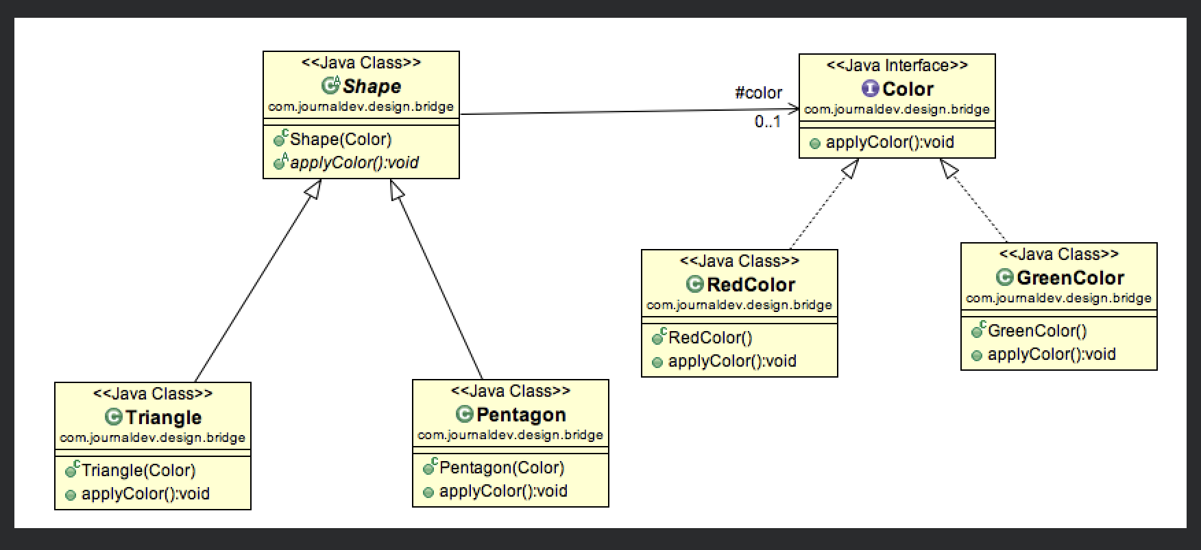
Bridge
/

Slide 305
Bridge

Slide 306
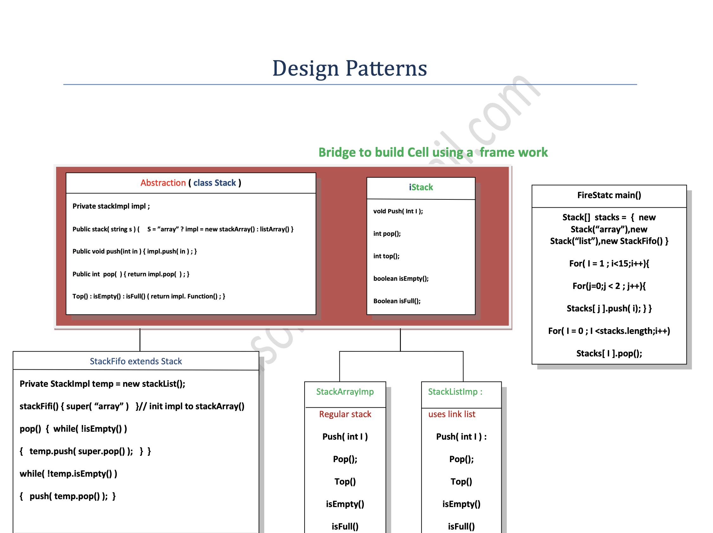
Bridge

Slide 307
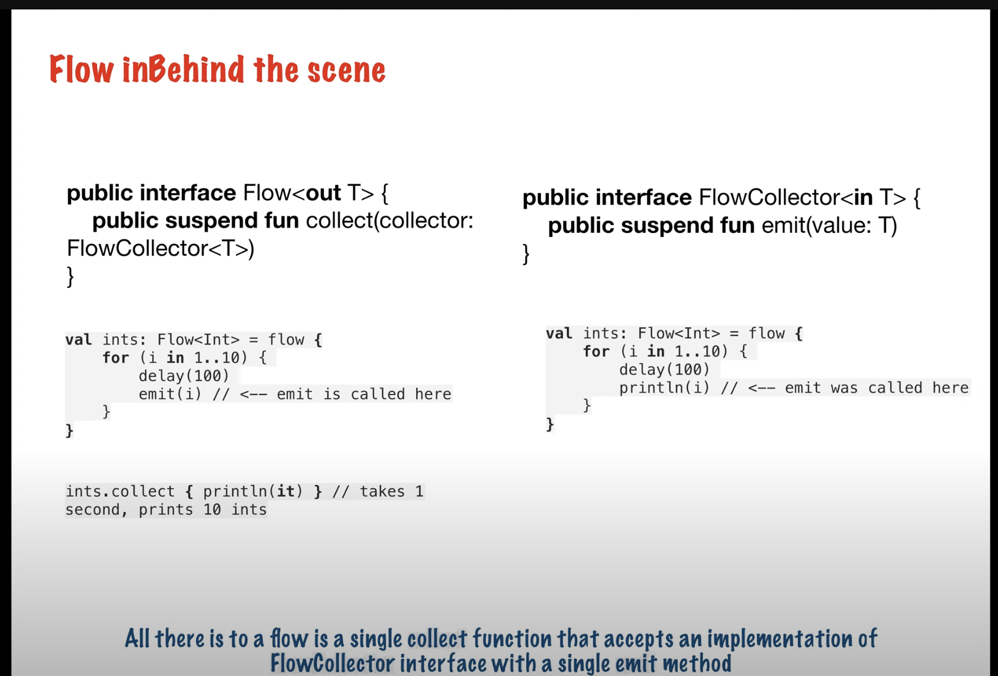
Flow Collector using lambda
/

Slide 308
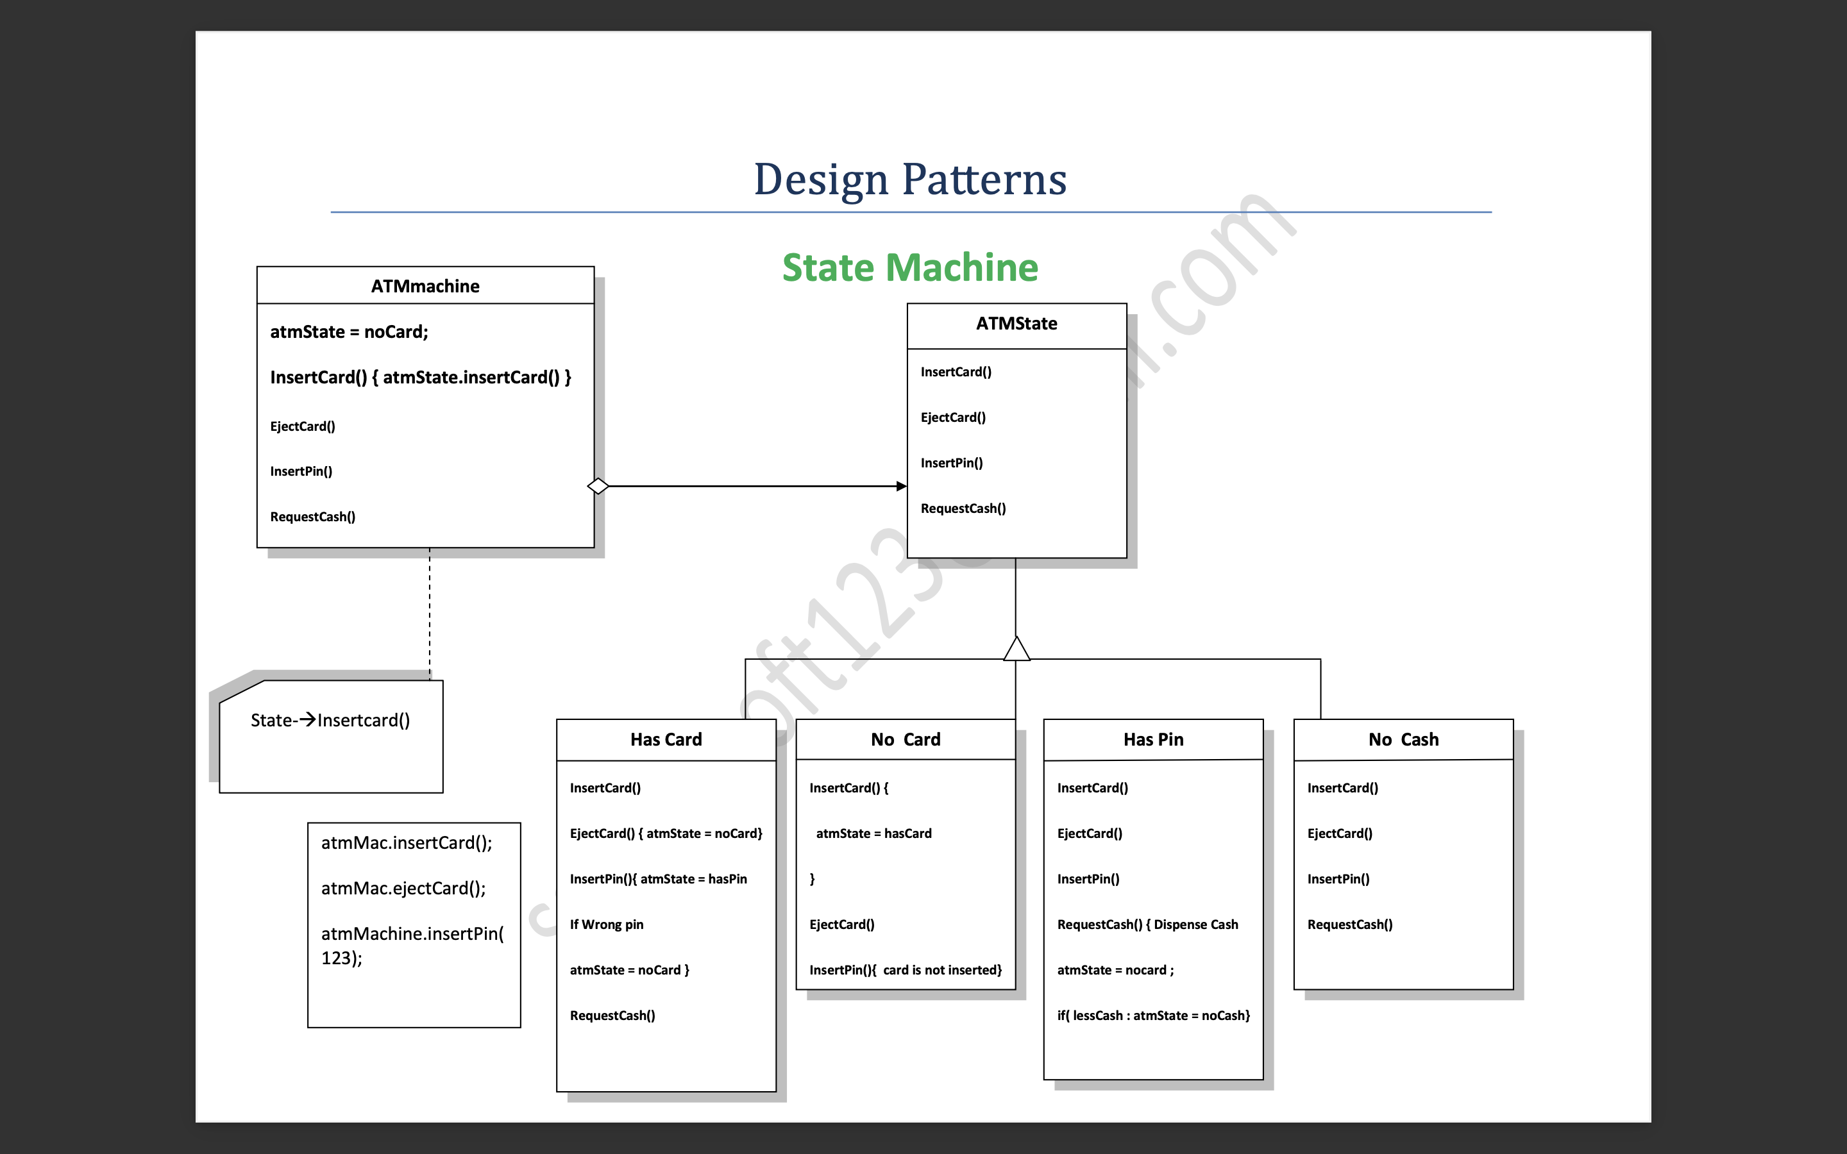
H
/

Slide 309
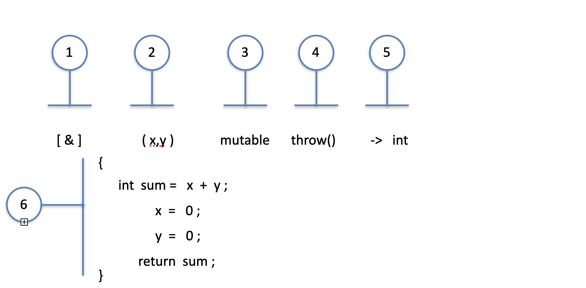
Lambda vs Function objects
- By P.Sathya

Slide 310
Const
Declaring a variable as `const` instead of a regular variable declaration
has several effects on the compiler in modern C++
1. Optimisation : The `const` qualifier perform optimizations like
constant folding : improves runtime performance int result = 2 + 7 * 3; int result = 23;
applied to arithmetic operations, logical operations, comparisons, bitwise operations…
reduces unnecessary computations and optimises the generated code.
dead code elimination :
to remove portions of code that are not reachable or have no effect on the program’s
output or behaviour.
This can include unused functions, variables, constants, branches, loops, and more.
1. Reduced Code Size: By removing unused code segments
if( auto res = 0 ; !res ) { // Its a dead code }
2. Improved Performance: unnecessary computations and branches are removed,
reducing the overall execution time.
3. Elimination of Potential Bugs: Dead code can sometimes contain bugs or logical errors
bugs causing issues in the program are mitigated.
eliminating the need for runtime evaluation.

Slide 311
Const
loop unrolling.
It involves duplicating loop iterations and combining multiple
iterations into a single iteration
When a loop is unrolled, the compiler replicates its body
multiple times,
void foo(const int n) {
for (int i = 0; i < n; i += 4) {
// loop body (iteration 0)
// loop body (iteration 1)
// loop body (iteration 2)
// loop body (iteration 3)
}
}

Slide 312
Const loop unrolling
#include <iostream>
int sum(int arr[], int size) {
int result = 0;
// Normal loop
for (int i = 0; i < size; i++) {
result += arr[i];
}
// Unrolled loop
for (int j = 0; j < size - 3; j += 4) {
result += arr[j];
result += arr[j + 1];
result += arr[j + 2];
result += arr[j + 3];
}
// Handle remaining elements if size is not a multiple of 4
for (int k = size - (size % 4); k < size; k++) {
result += arr[k];
}
return result;
}
int main() {
int arr[] = {1, 2, 3, 4, 5, 6, 7, 8, 9, 10};
int size = sizeof(arr) / sizeof(arr[0]);
int result = sum(arr, size);
std::cout << "Sum: " << result << std::endl;
return 0;
}

Slide 313
Const loop unrolling
sum(int*, int):
lea eax, [rdi+rsi*4]
lea ecx, [rdi+4]
add eax, rdi
xor edx, edx
cmp ecx, eax
je .L1
cmp ecx, 4
jbe .L2
; Loop with unrolled iterations
xor eax, eax
movsxd rcx, edx
add edx, 4
add eax, DWORD PTR [rdi+rcx*4]
add eax, DWORD PTR [rdi+rcx*4+4]
add eax, DWORD PTR [rdi+rcx*4+8]
add eax, DWORD PTR [rdi+rcx*4+12]
cmp edx, ecx
jb .L3
.L1:
ret
.L2:
; Handle remaining elements if size is not a multiple of 4
xor eax, eax
movsxd rcx, edx
add edx, 1
add eax, DWORD PTR [rdi+rcx*4]
cmp edx, ecx
jb .L2
.L3:
ret
main:
; ...
; assembly code for main function
; ...

Slide 314
Const
template< typename Type >
constexpr Type max_( Type a, Type b )
{
return a < b ? b : a;
}

Slide 315

Compose

Slide 316
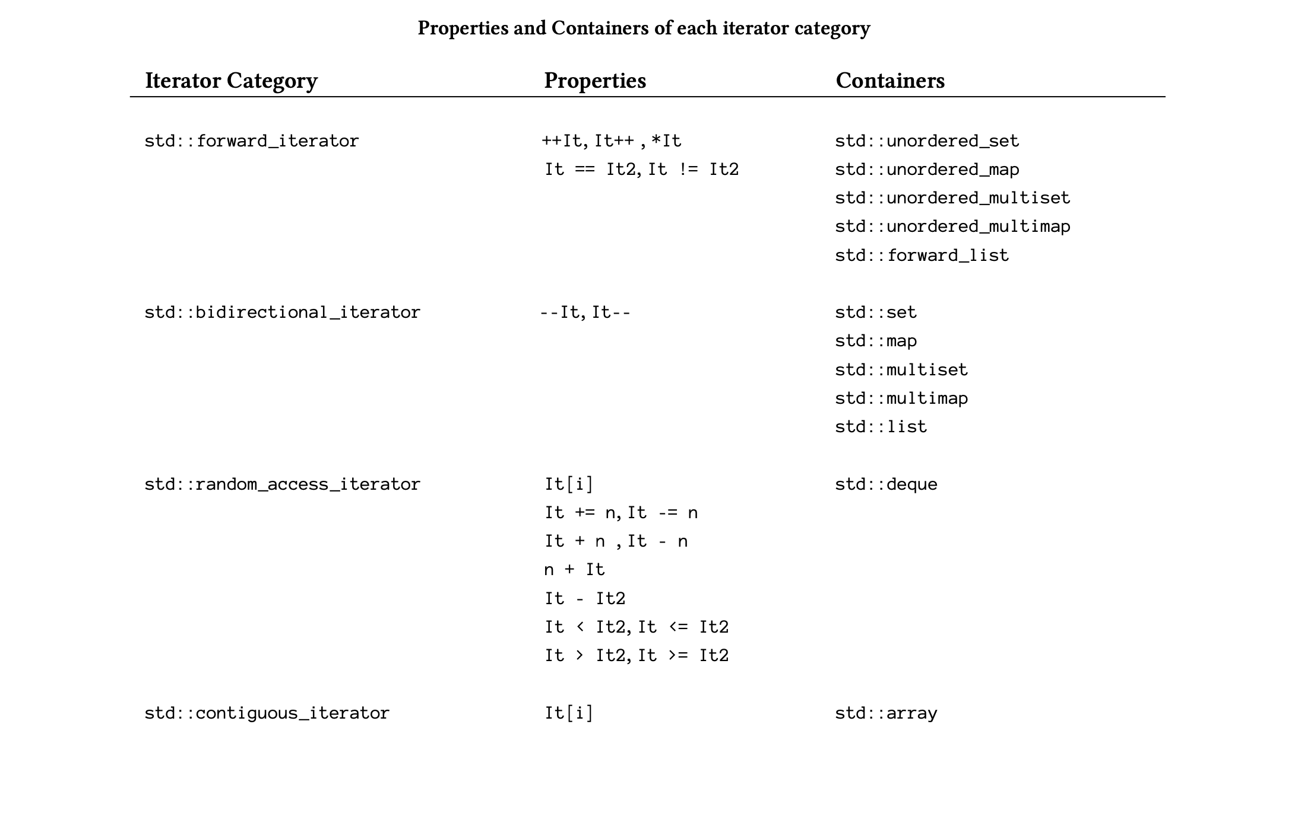
Const
/

Slide 317
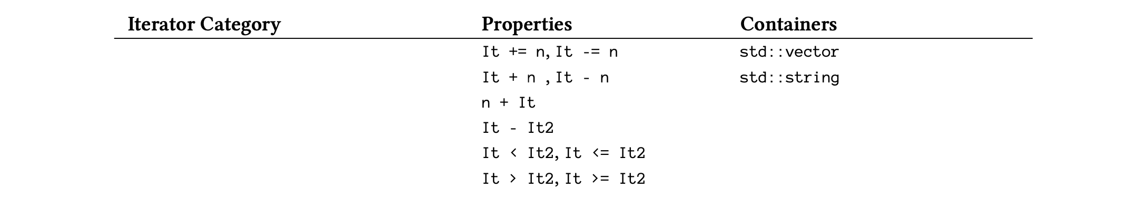
Const
/

Slide 318
Const
/

Slide 319
Const
/

Slide 320
Const
/

Slide 321
Const
/

Slide 322
Const
/

Slide 323
Functional programming
https://docplayer.net/61220863-Functional-programming-in-c-rainer-grimm.html
First class function
Lazy eveluation
Higher order functions
Pure functions
Recursion
Immutable data
Manipulation of list

Slide 324
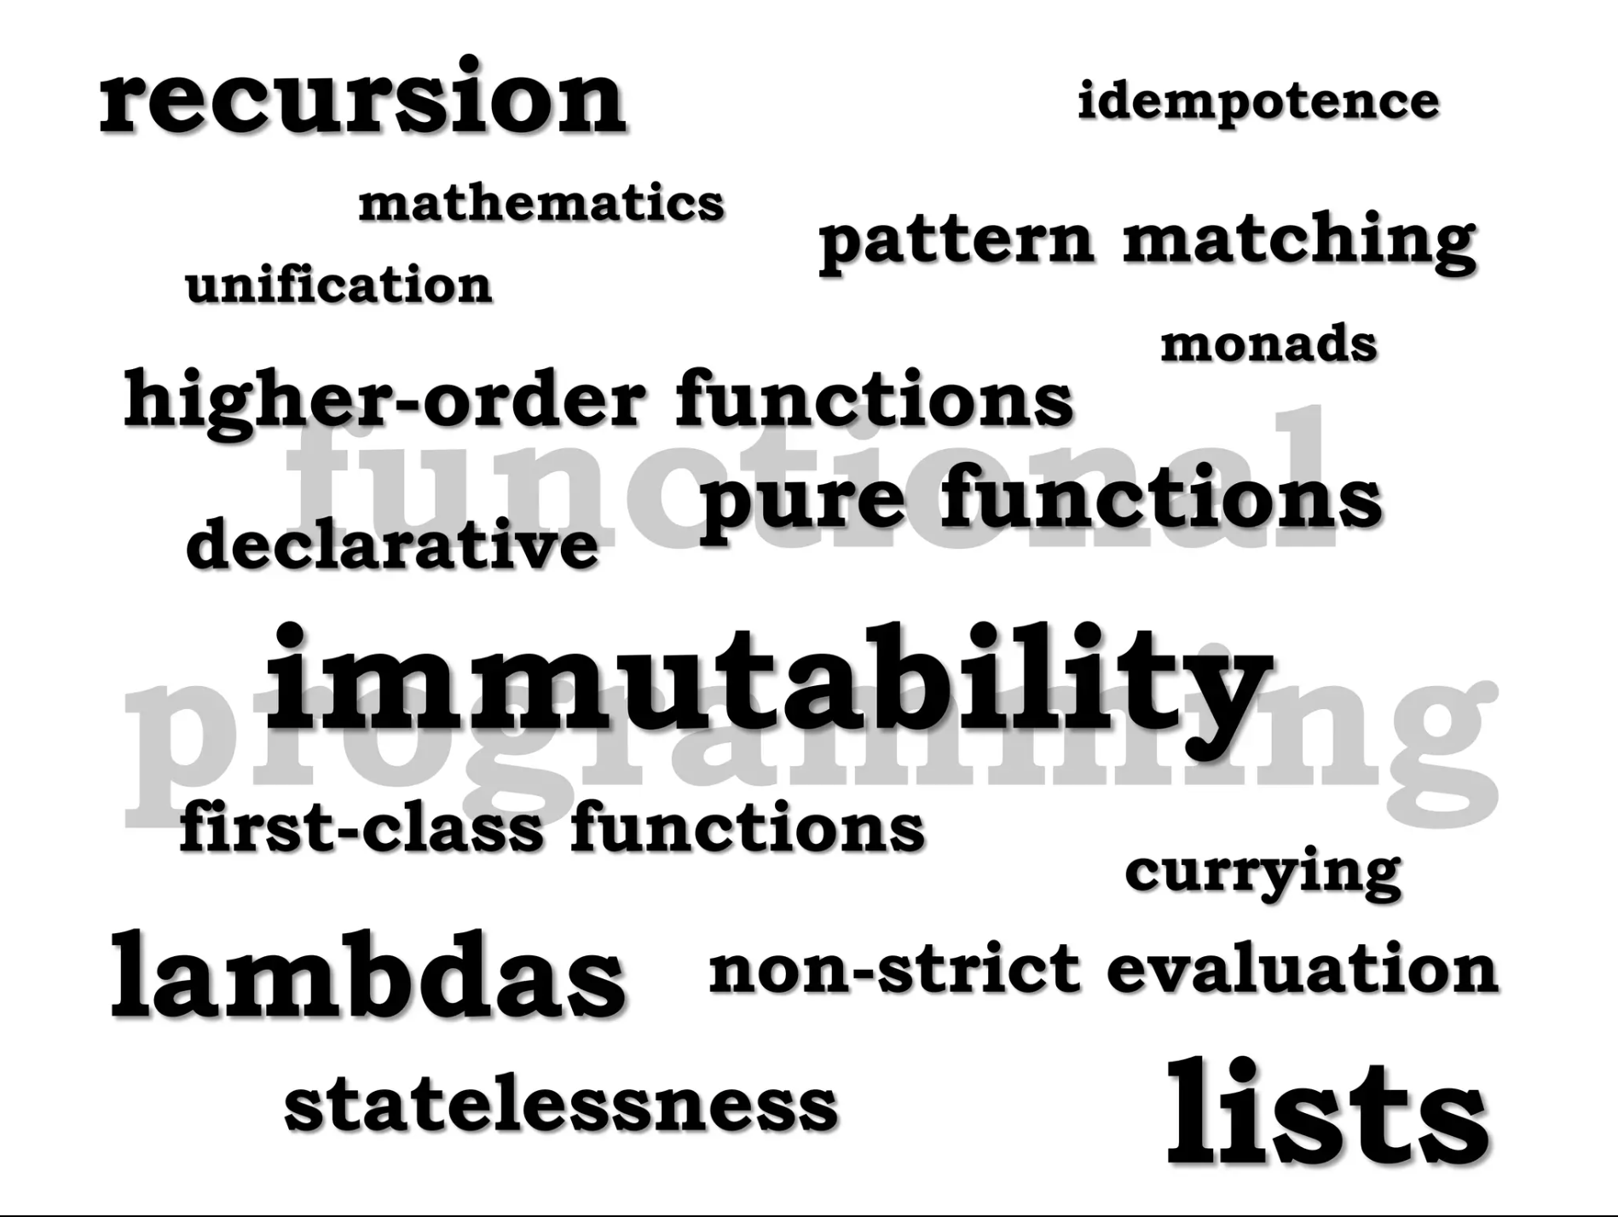
Functional programming
/

Slide 325
H
/

Slide 326
H
/

Slide 327
H
/

Slide 328
/

Slide 329
Coroutine Future-Promise
struct Future2 {
struct promise_type {
Future2 get_return_object() {
return {
// Uses C++20 designated initializer syntax
// following is a static method.. returns the coroutine state!!!
.h_ = std::experimental::coroutine_handle<promise_type>::from_promise(*this)
};
}
std::experimental::suspend_never initial_suspend() { return {}; }
std::experimental::suspend_never final_suspend() noexcept { return {}; }
void unhandled_exception() {}
// void return_void() {} // required only while using co_return ;
};
std::experimental::coroutine_handle<promise_type> h_;
operator std::experimental::coroutine_handle<promise_type>() const { return h_; }
// A coroutine_handle<promise_type> converts to coroutine_handle<>
operator std::experimental::coroutine_handle<>() const { return h_; }
};

Slide 330
Coroutine Future-Promise
struct Future2 {
struct promise_type {
Future2 get_return_object() {
return {
// Uses C++20 designated initializer syntax
// following is a static method.. returns the coroutine state!!!
.h_ = std::experimental::coroutine_handle<promise_type>::from_promise(*this)
};
}
std::experimental::suspend_never initial_suspend() { return {}; }
std::experimental::suspend_never final_suspend() noexcept { return {}; }
void unhandled_exception() {}
// void return_void() {} // required only while using co_return ;
};
std::experimental::coroutine_handle<promise_type> h_;
operator std::experimental::coroutine_handle<promise_type>() const { return h_; }
// A coroutine_handle<promise_type> converts to coroutine_handle<>
operator std::experimental::coroutine_handle<>() const { return h_; }
};

Slide 331
Coroutine Future-Promise
struct Future2 {
struct promise_type {
Future2 get_return_object() {
return {
// Uses C++20 designated initializer syntax
// following is a static method.. returns the coroutine state!!!
.h_ = std::experimental::coroutine_handle<promise_type>::from_promise(*this)
};
}
std::experimental::suspend_never initial_suspend() { return {}; }
std::experimental::suspend_never final_suspend() noexcept { return {}; }
void unhandled_exception() {}
// void return_void() {} // required only while using co_return ;
};
std::experimental::coroutine_handle<promise_type> h_;
operator std::experimental::coroutine_handle<promise_type>() const { return h_; }
// A coroutine_handle<promise_type> converts to coroutine_handle<>
operator std::experimental::coroutine_handle<>() const { return h_; }
};

Slide 332
Coroutine Future-Promise
struct Future2 {
struct promise_type {
Future2 get_return_object() {
return {
// Uses C++20 designated initializer syntax
// following is a static method.. returns the coroutine state!!!
.h_ = std::experimental::coroutine_handle<promise_type>::from_promise(*this)
};
}
std::experimental::suspend_never initial_suspend() { return {}; }
std::experimental::suspend_never final_suspend() noexcept { return {}; }
void unhandled_exception() {}
// void return_void() {} // required only while using co_return ;
};
std::experimental::coroutine_handle<promise_type> h_;
operator std::experimental::coroutine_handle<promise_type>() const { return h_; }
// A coroutine_handle<promise_type> converts to coroutine_handle<>
operator std::experimental::coroutine_handle<>() const { return h_; }
};

Slide 333
Coroutine Future-Promise
struct Future2 {
struct promise_type {
Future2 get_return_object() {
return {
// Uses C++20 designated initializer syntax
// following is a static method.. returns the coroutine state!!!
.h_ = std::experimental::coroutine_handle<promise_type>::from_promise(*this)
};
}
std::experimental::suspend_never initial_suspend() { return {}; }
std::experimental::suspend_never final_suspend() noexcept { return {}; }
void unhandled_exception() {}
// void return_void() {} // required only while using co_return ;
};
std::experimental::coroutine_handle<promise_type> h_;
operator std::experimental::coroutine_handle<promise_type>() const { return h_; }
// A coroutine_handle<promise_type> converts to coroutine_handle<>
operator std::experimental::coroutine_handle<>() const { return h_; }
};

Slide 334
H
/
The promise object should contain the following methods:
get_return_object — returns the coroutine object (Task)
initial_suspend — returns an awaiter that defines the behavior of the coroutine during the first run (In our case, it returns std::suspend_never, an awaiter from the standard library that forbids suspending coroutine execution during the first run.)
final_suspend — returns an awaiter that determines coroutine execution upon completion (We return std::suspend_never, which forbids suspending coroutine execution when exiting.)
unhandled_exception — called when an exception occurs and is responsible for handling all sorts of exceptions (In our case, we suppress any exceptions we encounter.)
One of three functions that can be called when the value is returned from the coroutine
There are three functions that can be called when the coroutine returns a value:
The return_void function returns nothing.
The return_value function returns a specific value.
The yield_value function suspends the coroutine and returns a value. Note that this function is called when we use the co_yield operator.
If the promise_type misses one of those return methods, we’re faced with undefined behavior when exiting the coroutine.
The counter function represents the body of the coroutine. It creates an awaitable object that controls the behavior of the coroutine on co_await calls. Awaitable should have the following mandatory methods:

Slide 335
H
await_ready — determines whether to make progress on coroutine execution
await_suspend — called when coroutine execution is terminated after the await_ready method returns false
await_resume — called when the coroutine continues its execution after the await_ready method returns true
After the coroutine has finished its work, we call std::coroutine_handle::destroy to free resources.
/

Slide 336
H
/

Slide 337
H
/

Slide 338
Coroutine
co_await a;
co_yield 123;
co_return
co_await a;
co_await std::suspend_always{}; does the following:
1 Ensures all local variables in the current function—which must be a coroutine—are saved as a state to a heap-allocated object. Creates a callable object that, when invoked,
will resume execution of the coroutine at the point
2 immediately following evaluation of the co_await expression.
Calls (or more accurately jumps to) a method of co_await’s target object a, passing that method
the callable object from step 2

Slide 339
Coroutine
Coroutine handles
co_await operator ensures the current state of a function is bundled up somewhere on the heap
and creates a callable object whose invocation continues
execution of the current function. The callable object is of type std::coroutine_handle<>.
Now let’s look more specifically at what co_await does.
When you evaluate the expression co_await a,
the compiler creates a coroutine handle and passes it to the method a.await_suspend(coroutine_handle).
1 The type of a must support certain methods, and is sometimes referred to as an “awaitable” object or an “awaiter.”

Slide 340
Coroutine
we call counter with a std::coroutine_handle<>*,
which we stick into our Awaiter type.
In its await_suspend method, this type stores the coroutine handle produced by co_await
into main’s coroutine handle.
Each time main invokes the coroutine handle,
it triggers one more iteration of the loop in counter, which then suspends execution again at the
co_await statement.
we store the coroutine handle every time await_suspend is called,
but the handle does not change across invocations.
The <coroutine> header provides two pre-defined awaiters, std::suspend_always and std::suspend_never.
As their names imply,
suspend_always::await_ready always returns false,
while suspend_never::await_ready always returns true.

Slide 341
H
co_await std::suspend_always{};
Coroutine_Awaiter_never_1
struct suspend_never {
constexpr bool await_ready() const noexcept { return true; }
constexpr void await_suspend(coroutine_handle<>) const noexcept {}
constexpr void await_resume() const noexcept {}
};
Coroutine_Awaiter_Core_1
struct suspend_always {
constexpr bool await_ready() const noexcept { return false; }
constexpr void await_suspend(coroutine_handle<>) const noexcept {}
constexpr void await_resume() const noexcept {}
};
/

Slide 342
Coroutine
/struct Awaiter {
std::experimental::coroutine_handle<> *hp_;
//await_ready is an optimization. If it returns true, then co_await does not suspend the function.
return true ( check with it!! )
// coroutine isn’t actually suspended unless first await_ready returns false
constexpr bool await_ready() const noexcept { return false; }// 3 always returns false.
// you could achieve the same effect in await_suspend, by resuming (or not suspending) the current coroutine,
but before calling await_suspend, the compiler must bundle all state into the heap object
referenced by the coroutine handle, which is potentially expensive.
we store the coroutine handle every time await_suspend is called,
void await_suspend(std::experimental::coroutine_handle<> h)
{
std::cout << "Await suspended :" << std::endl; // 4
*hp_ = h;
}
// await_resume here returns void, but if instead it returned a value, this value would be the value of the co_await expression.
constexpr void await_resume() const noexcept { } // 5
};

Slide 343
Coroutine code starts
/
struct ReturnObject {
struct promise_type {
ReturnObject get_return_object() { return {}; } //1
std::experimental::suspend_never initial_suspend() { return {}; } // 2
std::experimental::suspend_never final_suspend() noexcept { return {}; } // last
void unhandled_exception() {}
};
};

Slide 344
Coroutine
i is held by a state in Awaiter
ReturnObject
Await_counter(std::experimental::coroutine_handle<> *continuation_out)
{
Awaiter a{continuation_out};
for (unsigned i = 0; ; ++i) {
co_await a; // calls await_resume() step 5
std::cout << "Await_ counter :" << i << std::endl;
}
}

Slide 345
Coroutine Code ends.
int main()
{
std::experimental::coroutine_handle<> h;
Await_counter( &h ); // calls 1 2 3 4 suspends the avaiter at 4th step controll comes here
for (int i = 0; i < 3; ++i) {
std::cout << "In main1 function\n”;
h(); // calls await_resume() -> later we shall use () overload concept.
// void operator()() { resume(); } will be called on suspended co routines
}
h.destroy(); // destroy the coroutine call back
return 1 ;
}

Slide 346
Coroutine
/

Slide 347
Coroutine
The coroutine return object
R::promise_type must include a method R get_return_object()
ReturnObject get_return_object()
that returns an instance of the outer type R.

Slide 348
Coroutine Code 2
we no longer need our awaiter to save the coroutine handle (as we’ve already put the handle into the
return object), we just run co_await std::suspend_always{}.
struct ReturnObject2 {
struct promise_type {
ReturnObject2 get_return_object() {
return {
// // because we’ve copied the pointer into .h_
.h_ = std::coroutine_handle<promise_type>::from_promise(*this)
};
}
std::suspend_never initial_suspend() { return {}; }
std::suspend_never final_suspend() noexcept { return {}; }
void unhandled_exception() {}
};
std::coroutine_handle<promise_type> h_;
operator std::coroutine_handle<promise_type>() const { return h_; }
// A coroutine_handle<promise_type> converts to coroutine_handle<>
operator std::coroutine_handle<>() const { return h_; }
};
/

Slide 349
Coroutine
we no longer need our awaiter to save the coroutine handle (as we’ve already put the handle into the
return object), we just run co_await std::suspend_always{}.
ReturnObject2
counter2() {
for (unsigned i = 0;; ++i) {
co_await std::suspend_always{};
std::cout << "counter2: " << i << std::endl;
}
}
void main2() {
// note that the return object goes out of scope and is destroyed
// because we’ve copied the pointer into h
std::coroutine_handle<> h = counter2();
for (int i = 0; i < 3; ++i) {
std::cout << "In main2 function\n";
h();
}
h.destroy();
}
/

Slide 350
Coroutine
we no longer need our awaiter to save the coroutine handle
(as we’ve already put the handle into the return object),
we just run co_await std::suspend_always{}.

Slide 351
Coroutine
/

Slide 352
Coroutine code 3
std::coroutine_handle<ReturnObject3::promise_type>.
The method promise() on this coroutine handle will return the promise_type& that we need.
Define a new awaiter type GetPromise that contains a field promise_type *p_.
We have its await_suspend method store the address of the promise object in p_, but then return false to avoid actually suspending the coroutine. Until now, we have only seen co_await expressions of type void.
This time, we want our co_await to return the address of the promise object, so we also add an await_resume function returning p_.

Slide 353
Coroutine
/

Slide 354
Coroutine Not a good practice
template<typename PromiseType>
struct GetPromise {
PromiseType *p_;
bool await_ready() { return false; } // says yes call await_suspend
bool await_suspend(std::coroutine_handle<PromiseType> h) {
p_ = &h.promise();
return false; // says no don't suspend coroutine after all
}
PromiseType *await_resume() { return p_; }
};
In addition to void and bool, await_suspend may also return a coroutine_handle, in which case the returned handle is immediately resumed. Instead of returning false, GetPromise::await_suspend could alternatively have returned the handle h to resume the coroutine immediately, but presumably this would be less efficient.

Slide 355
Coroutine code 3
struct ReturnObject3 {
struct promise_type {
unsigned value_;
ReturnObject3 get_return_object() {
return ReturnObject3 {
.h_ = std::coroutine_handle<promise_type>::from_promise(*this)
};
}
std::suspend_never initial_suspend() { return {}; }
std::suspend_never final_suspend() noexcept { return {}; }
void unhandled_exception() {}
};
std::coroutine_handle<promise_type> h_;
operator std::coroutine_handle<promise_type>() const { return h_; }
};
/

Slide 356
Coroutine
/

Slide 357
Coroutine
ReturnObject3
counter3()
{
auto pp = co_await GetPromise<ReturnObject3::promise_type>{};
for (unsigned i = 0;; ++i) {
pp->value_ = i;
co_await std::suspend_always{};
}
}
void
main3()
{
std::coroutine_handle<ReturnObject3::promise_type> h = counter3();
ReturnObject3::promise_type &promise = h.promise();
for (int i = 0; i < 3; ++i) {
std::cout << "counter3: " << promise.value_ << std::endl;
h();
}
h.destroy();
}
/

Slide 358
Coroutine
/

Slide 359
Coroutine
Since yield_value is a method on promise_type, we no longer need to jump through hoops to get our hands on
the promise object, it’s just this. Here’s what the new code looks like:
struct ReturnObject4 {
struct promise_type {
unsigned value_;
ReturnObject4 get_return_object() {
return {
.h_ = std::coroutine_handle<promise_type>::from_promise(*this)
};
}
std::suspend_never initial_suspend() { return {}; }
std::suspend_never final_suspend() noexcept { return {}; }
void unhandled_exception() {}
std::suspend_always yield_value(unsigned value) {
value_ = value;
return {};
}
};
std::coroutine_handle<promise_type> h_;
};
/

Slide 360
Coroutine
ReturnObject4
counter4()
{
for (unsigned i = 0;; ++i)
co_yield i; // co yield i => co_await promise.yield_value(i)
}
void
main4()
{
auto h = counter4().h_;
auto &promise = h.promise(); // we can access value_ since we have the access to promise
for (int i = 0; i < 3; ++i) {
std::cout << "counter4: " << promise.value_ << std::endl;
h();
}
h.destroy();
}

Slide 361
Coroutine
/

Slide 362
The co_return operator
code on next slide
The co_return operator
So far our coroutines have produced an infinite stream of integers, and our main function has simply destroyed the coroutine state after reading the first three integers. What if instead our coroutine only wants to produce a finite number of values before signaling an end-of-coroutine condition?
To signal the end of a coroutine, C++ adds a new co_return operator. There are three ways for a coroutine to signal that it is complete:
The coroutine can use “co_return e;” to return a final value e.
The coroutine can use “co_return;” with no value (or with a void expression) to end the coroutine without a final value.
The coroutine can let execution fall off the end of the function, which is similar to the previous case.

Slide 363
Coroutine - The co_return operator
struct ReturnObject2 {
struct promise_type {
ReturnObject2 get_return_object() {
return {
// Uses C++20 designated initializer syntax
.h_ = std::coroutine_handle<promise_type>::from_promise(*this)
};
}
std::suspend_never initial_suspend() { return {}; }
std::suspend_never final_suspend() noexcept { return {}; }
void unhandled_exception() {}
void return_void() {} // required only while using co_return ;
};
std::coroutine_handle<promise_type> h_;
operator std::coroutine_handle<promise_type>() const { return h_; }
// A coroutine_handle<promise_type> converts to coroutine_handle<>
operator std::coroutine_handle<>() const { return h_; }
};
/

Slide 364
Coroutine
ReturnObject2
counter2()
{
for (unsigned i = 0;; ++i) {
co_await std::suspend_always{};
std::cout << "counter2: " << i << std::endl;
}
co_return ; // should have void return_void() {}
}
void
main2()
{
std::coroutine_handle<> h = counter2();
for (int i = 0; i < 3; ++i) {
std::cout << "In main2 function\n";
h();
}
// h.destroy(); not required since co_return in place
}
/

Slide 365
Coroutine
/

Slide 366
Coroutine
/
// The promise object -
// It would be great if our counter function, instead of writing to standard output,
just returned values to main,
//Since we know the coroutine state includes an instance of promise_type, we can add a field value_
to this type and use that field to transmit values from the coroutine to our main function. How do
we get access to the promise type? In the main function, this isn’t too hard. Instead of converting
our coroutine handle to a std::coroutine_handle<>, we can keep it
as a std::coroutine_handle<ReturnObject3::promise_type>.
The method promise() on this coroutine handle will return the promise_type& that we need.
// struct GetPromise -> explained in detail below :
// We thus define a new awaiter type GetPromise that contains a field promise_type *p_.
We have its await_suspend method store the address of the promise object in p_, but then return false
to avoid actually suspending the coroutine. Until now, we have only seen co_await expressions of type void.
This time, we want our co_await to return the address of the promise object, so we also add an
await_resume function returning p_.

Slide 367
Coroutine
template<typename PromiseType>
struct GetPromise {
PromiseType *p_;
bool await_ready() { return false; } // says yes call await_suspend
bool await_suspend(std::experimental::coroutine_handle<PromiseType> h) {
p_ = &h.promise();
return false; // says no don't suspend coroutine after all
}
PromiseType *await_resume() { return p_; }
};
struct ReturnObject3 {
struct promise_type {
unsigned value_;
ReturnObject3 get_return_object() {
return ReturnObject3 {
.h_ = std::experimental::coroutine_handle<promise_type>::from_promise(*this)
};
}
std::experimental::suspend_never initial_suspend() { return {}; }
std::experimental::suspend_never final_suspend() noexcept { return {}; }
void unhandled_exception() {}
};
std::experimental::coroutine_handle<promise_type> h_;
operator std::experimental::coroutine_handle<promise_type>() const { return h_; }
};
/

Slide 368
Coroutine
ReturnObject3
counter3()
{
// get the handle
auto pp = co_await GetPromise<ReturnObject3::promise_type>{};
for (unsigned i = 0;; ++i) {
// set the handle pp with value = i ( It's getting messy here
pp->value_ = i; // use co_yield i; instead!! as demonstrated below
co_await std::experimental::suspend_always{};
}
}
void
coRoutineReturnHandleGetPromise()
{
// auto hh = counter3().h_;
// auto &promise = hh.promise(); // long way compared down below..
std::experimental::coroutine_handle<ReturnObject3::promise_type> h = counter3();
ReturnObject3::promise_type &promise = h.promise();
for (int i = 0; i < 3; ++i) {
std::cout << "counter3: " << promise.value_ << std::endl;
h();
}
h.destroy();
}
/

Slide 369
Coroutine
/

Slide 370
Coroutine
// ************************* Phase IV co_yeild *************************
struct ReturnObject4 {
struct promise_type {
unsigned value_;
ReturnObject4 get_return_object() {
return {
.h_ = std::experimental::coroutine_handle<promise_type>::from_promise(*this)
};
}
std::experimental::suspend_never initial_suspend() { return {}; }
std::experimental::suspend_never final_suspend() noexcept { return {}; }
void unhandled_exception() {}
std::experimental::suspend_always yield_value(unsigned value) {
value_ = value;
return {};
}
};
std::experimental::coroutine_handle<promise_type> h_;
};
/

Slide 371
Coroutine
ReturnObject4
counter4()
{
for (unsigned i = 0;; ++i)
co_yield i; // co yield i => co_await promise.yield_value(i)
}
void
Coroutine_co_yeild()
{
auto h = counter4().h_;
auto &promise = h.promise();
for (int i = 0; i < 3; ++i) {
std::cout << "counter4: " << promise.value_ << std::endl;
h();
}
h.destroy();
}
/

Slide 372
Coroutine
/

Slide 373
Coroutine
// ************************* Phase IV co_return_Operator *************************
struct ReturnObject5 {
struct promise_type {
unsigned value_;
~promise_type() {
std::cout << "promise_type destroyed" << std::endl;
}
ReturnObject5 get_return_object() {
return {
.h_ = std::experimental::coroutine_handle<promise_type>::from_promise(*this)
};
}
std::experimental::suspend_never initial_suspend() { return {}; }
std::experimental::suspend_always final_suspend() noexcept { return {}; }
void unhandled_exception() {}
std::experimental::suspend_always yield_value(unsigned value) {
value_ = value;
return {};
}
void return_void() {}
};
std::experimental::coroutine_handle<promise_type> h_;
};
/

Slide 374
Coroutine
ReturnObject5
counter5()
{
for (unsigned i = 0; i < 3; ++i)
co_yield i;
// falling off end of function or co_return; => promise.return_void();
// (co_return value; => promise.return_value(value);)
}
void
CoReturn_Operator()
{
auto h = counter5().h_;
auto &promise = h.promise();
while (!h.done()) { // Do NOT use while(h) (which checks h non-NULL)
std::cout << "counter5 Co return Object : " << promise.value_ << std::endl;
h();
}
h.destroy();
}
/

Slide 375
Coroutine
A birds eye view.
/

Slide 376
Coroutine
A birds eye view.
/
there’s an important question about what to do at the end of a coroutine.
Should the compiler update the coroutine state and suspend the coroutine one
final time, so that even after evaluating co_return, code in the main function
can access the promise object and make sane use of the coroutine_handle?
Or should returning from a coroutine automatically destroy the coroutine state,
like an implicit call to coroutine_handle::destroy()?
This question is resolved by the final_suspend method on the promise_type.
The C++ spec says says that a coroutine’s function-body is effectively wrapped
in the following pseudo-code:

Slide 377
Coroutine
A birds eye view.
{
promise-type promise promise-constructor-arguments ;
try {
co_await promise.initial_suspend() ;
function-body
} catch ( ... ) {
if (!initial-await-resume-called)
throw ;
promise.unhandled_exception() ;
}
final-suspend :
co_await promise.final_suspend() ;
}
// "The coroutine state is destroyed when control flows
// off the end of the coroutine"
/

Slide 378
Coroutine
A birds eye view.
/
When a coroutine returns, you implicitly co_await the result of promise.final_suspend(). If final_suspend actually suspends the coroutine,
then the coroutine state will be updated one last time and remain valid, and code outside of the coroutine will be responsible for freeing the coroutine
object by calling the coroutine handle’s destroy() method. If final_suspend does not suspend the coroutine, then the coroutine state will be
automatically destroyed.
If you never plan to touch the coroutine state again (maybe because the coroutine just updated some global variable and/or released a semaphore
before co_return, and that’s all you care about), then there’s no reason to pay for saving state one last time and worry about manually freeing the
coroutine state, so you can have final_suspend() return std::suspend_never. On the other hand, if you need to access the coroutine handle
or promise object after a coroutine returns, you will need final_suspend() to return std::suspend_always (or some other awaitable object that
suspends the coroutine).
To make the point more concrete, here’s what happens if we change ReturnObject5::promise_type::final_suspend()
to return std::suspend_never instead of std::suspend_always:

Slide 379
Coroutine
A birds eye view.
/

Slide 380
Coroutine
A birds eye view.
/

Slide 381
Coroutine
Let’s go by code.
there’s an important question about what to do at the end of a coroutine.
Should the compiler update the coroutine state and suspend the coroutine
one final time, so that even after evaluating co_return, code in the main
function can access the promise object and make sane use of the
coroutine_handle? Or should returning from a coroutine automatically
destroy the coroutine state, like an implicit call to
coroutine_handle::destroy()?
This question is resolved by the final_suspend method on the promise_type.
The C++ spec says says that a coroutine’s function-body is effectively wrapped
in the following pseudo-code:

Slide 382
Coroutine
A birds eye view.
Coroutine_CoAwait_done_resume_Init_Suspend_3
The simpleCoroutine now includes a loop with three iterations.
The main thread and the coroutine take turns executing, and you can see how the execution
interleaves between the main thread and the coroutine. The done status of the coroutine is
checked before and after resuming, and you can observe how the coroutine's execution
progresses.
In this example, the coroutine state is managed internally by the promise and coroutine
handle. When co_await is encountered, the coroutine's state is suspended, and the control
returns to the caller. The co_await expression's associated promise captures the state of the coroutine, allowing it to be resumed later.
When coro.resume() is called, it resumes the suspended coroutine from where it left off.
The coroutine state transitions between active and suspended states, and the done() function
indicates whether the coroutine has completed.
Please note that this example is for demonstration purposes, and the actual implementation
details might vary depending on the compiler and platform.

Slide 383
Coroutine
A birds eye view.
/n the provided code, the coroHandle variable is of type std::coroutine_handle, which represents a
coroutine handle. Coroutine handles are used to manage the lifecycle of a coroutine and control
its execution. Here's the purpose of the mentioned lines:
coroHandle.destroy();: This line is used in the destructor of the MyCoroutine class. When the
MyCoroutine object is destroyed (which happens when it goes out of scope or explicitly),
the destroy method is called on the coroutine handle. This is essential to ensure proper cleanup
and deallocation of any resources associated with the coroutine, as well as unwinding any
suspended stack frames.
coroHandle.resume();: This line is used to resume the execution of the coroutine associated with the
coroHandle. In the main function's loop, the coro.resume() call is made, which causes the coroutine
to continue executing from where it was suspended. This is how the coroutine's execution is
interleaved with the main thread's execution.
return coroHandle.done();: This line is used to check whether the coroutine has completed its
execution. The done method of the coroutine handle returns true if the coroutine has completed or
been destroyed, and false otherwise. This is used to determine whether the coroutine is still active
and needs further execution or has completed.
Overall, these lines of code are crucial for managing the lifecycle and execution of the coroutine
in a controlled manner, ensuring proper cleanup, execution, and status checking.

Slide 384
Coroutine
A birds eye view.
/
struct MyCoroutine {
struct promise_type {
int var ;
MyCoroutine get_return_object() {
//Note we are returning the promise_type address.. as a handle
return MyCoroutine{std::experimental::coroutine_handle<promise_type>::from_promise(*this)};
}
std::experimental::suspend_never initial_suspend() {
data = 123 ;
std::cout << "Initializing coroutine data Var - initial_suspend() .... " << data << std::endl;
std::this_thread::sleep_for(std::chrono::seconds(2)); // Simulating initialization
return {}; // Coroutine starts immediately
}
std::experimental::suspend_always final_suspend() noexcept {
std::cout << "Cleaning up coroutine data Var - final_suspend() ..." << std::endl;
data = 0 ;
std::this_thread::sleep_for(std::chrono::seconds(1)); // Simulating cleanup
return {}; // Coroutine completes immediately
}
void return_void() {std::cout << "return_void called CoRoutine terminated...- Dont fall out of the stack!!!. " << std::endl;} //
void unhandled_exception() { std::cout << "Landed at unHandledException ..." << std::endl;}
// Phase III
int data = 0 ; // Variable within promise_type
};

Slide 385
Coroutine
A birds eye view.
// std::experimental::coroutine_handle<promise_type> coroHandle;
explicit MyCoroutine(std::experimental::coroutine_handle<promise_type> handle) : coroHandle( handle ) {}
~MyCoroutine() {
if (coroHandle)
coroHandle.destroy();
// coroHandle.promise().get_return_object()
// coroHandle.promise().return_void()
// coroHandle.promise().initial_suspend()
// coroHandle.promise().final_suspend()
// coroHandle.promise.SAME AS ABOVE
}
void resume() {
// state changes
if (coroHandle)
// coroHandle.promise.var += 10 ;
incData();
coroHandle.resume();
}
bool done() const {
return coroHandle.done();
}
// Phase III access the data
int getData() const {
return coroHandle.promise().data;
}
void incData() {
coroHandle.promise().data += 10;
}
void resetData() {
coroHandle.promise().data = 0;
}
private:
using handle_type = std::experimental::coroutine_handle<promise_type>;
handle_type coroHandle;
};
/

Slide 386
Coroutine
A birds eye view.
// Phase IV
MyCoroutine simpleCoroutine() {
MyCoroutine::promise_type p;
MyCoroutine coroObject = p.get_return_object();
try{
co_await p.initial_suspend();
int count = 0;
std::cout << "Start coroutine" << std::endl;
for (int i = 1; i <= 3; ++i) {
// Support for std::experimental::coroutine_traits will be removed in LLVM 15; use std::coroutine_traits instead
co_await std::experimental::suspend_always{};
// state changestill coro.resume(); is called..
std::cout << "Coroutine iteration " << i << std::endl;
++count;
}
std::cout << "Coroutine completed with " << count << " iterations" << std::endl;
} catch(...){
p.unhandled_exception();
}
//final-suspend :
co_await p.final_suspend();
// Phase III
co_return; // Coroutine completion calls void return_void()
}
//final-suspend :
object by calling the coroutine handle’s destroy() method. If final_suspend does not suspend the coroutine,
then the coroutine state will be automatically destroyed.
/

Slide 387
Coroutine
A birds eye view.
int main() {
MyCoroutine coro = simpleCoroutine();
std::cout << "Coroutine done: Not yet started.." << coro.done() << std::endl;
for (int i = 1; i <= 3; ++i) {
std::cout << "Main thread iteration " << i << std::endl;
coro.resume(); // we can wrap this up by try{ }catch(){ }
// Phase III
std::cout << "Data from coroutine: " << coro.getData() << std::endl;
}
std::cout << "Coroutine done: Completed.. " << coro.done() << std::endl;
// Phase III
std::cout << "Data from coroutine: " << coro.getData() << std::endl;
return 0;
}
/

Slide 388
Coroutine
A birds eye view.
/*
Initializing coroutine data Var - initial_suspend() .... 123
Initializing coroutine data Var - initial_suspend() .... 123
Start coroutine
Coroutine done: Not yet started..0
Main thread iteration 1
Coroutine iteration 1
Data from coroutine: 133
Main thread iteration 2
Coroutine iteration 2
Data from coroutine: 143
Main thread iteration 3
Coroutine iteration 3
Coroutine completed with 3 iterations
Cleaning up coroutine data Var - final_suspend() ...
Data from coroutine: 153
Coroutine done: Completed.. 0
Data from coroutine: 153
(lldb)
*/
/

Slide 389
Coroutine
A birds eye view.
/

Slide 390
Coroutine
A birds eye view.
/

Slide 391
Coroutine
A birds eye view.
/

Slide 392
Coroutine
Let’s go by code.
{
promise-type promise promise-constructor-arguments ;
try {
co_await promise.initial_suspend() ;
function-body
} catch ( ... ) {
if (!initial-await-resume-called)
throw ;
promise.unhandled_exception() ;
}
final-suspend :
co_await promise.final_suspend() ;
}
/

Slide 393
Coroutine Here you go…
/

Slide 394
Coroutine
/

Slide 395
Coroutine Generator
/vvoid
f()
{
std::vector<std::coroutine_handle<>> coros =
{ mkCoroutineA(), mkCoroutineB() };
try {
for (int i = 0; i < 3; ++i)
for (auto &c : coros)
if (!c.done())
c();
}
catch (...) {
for (auto &c : coros)
c.destroy();
throw;
}
for (auto &c : coros)
c.destroy();
}

Slide 396
Coroutine
In the example above, suppose mkCoroutineA() returns a coroutine handle while
mkCoroutineB() throws an exception before its first co_await. In that case, the coroutine
created by mkCoroutineA() will never be destroyed. Of course, you could restructure the code
to wrap mkCoroutineB in it’s own try-catch block, but you can see this would quickly get unwieldy
when creating many coroutines.
To address these issues, the method promise_type::initial_suspend() can return
std::suspend_always, thereby suspending mkCoroutineB immediately on entry, before
any code in the coroutine has executed (and hence before said code may throw an exception).
We use this technique in our example generator below. It simply means we have to resume the
coroutine once before returning the first value from our generator.
So here is our generic generator. A generator producing type T must return a Generator<T>.
The main function uses operator bool to determine if the Generator still has an output value,
and operator() to obtain the next value
/

Slide 397
Coroutine generator code
template<typename T>
struct Generator {
struct promise_type;
using handle_type = std::experimental::coroutine_handle<promise_type>;
struct promise_type {
T value_;
std::exception_ptr exception_;
Generator get_return_object() {
return Generator(handle_type::from_promise(*this));
}
std::experimental::suspend_always initial_suspend() { return {}; }
std::experimental::suspend_always final_suspend() noexcept { return {}; }
// Exception_ReThrow_1
//
void unhandled_exception() { exception_ = std::current_exception(); }
// https://stackoverflow.com/questions/68886164/why-can-the-type-constraint-stdconvertible-to-be-used-with-only-one-template
template<std::convertible_to<T> From> // C++20 concept
std::experimental::suspend_always yield_value(From &&from) {
value_ = std::forward<From>(from);
return {};
}
void return_void() {}
};

Slide 398
Coroutine
handle_type h_;
Generator(handle_type h) : h_(h) {}
~Generator() { h_.destroy(); }
explicit operator bool() {
fill();
return !h_.done();
}
T operator()() {
fill();
full_ = false;
return std::move(h_.promise().value_);
}
private:
bool full_ = false;
void fill() {
if (!full_) {
h_();
if (h_.promise().exception_)
std::rethrow_exception(h_.promise().exception_);
full_ = true;
}
}
};
/

Slide 399
Coroutine
Generator<unsigned>
counter6()
{
for (unsigned i = 0; i < 3;)
co_yield i++;
}
void
Generic_Generator()
{
auto gen = counter6();
while (gen)
{
// gen.h_.destroy(); created delebratly to check the following error
// "resume() has undefined behavior when the coroutine is done");
std::cout << "counter6: Generic_Generator " << gen() << std::endl;
}
}
/*
counter6: Generic_Generator 0
counter6: Generic_Generator 1
counter6: Generic_Generator 2
Program ended with exit code: 0
*/

Slide 400
Coroutine
/

Slide 401
Coroutine
/

Slide 402
Coroutine
/

Slide 403
Coroutine
/struct Task {
struct promise_type {
std::experimental::suspend_always initial_suspend() noexcept { std::cout << "\n Init Task \n"; return {}; }
std::experimental::suspend_always final_suspend() noexcept { std::cout << "\n Suspend Task \n"; return {}; }
Task get_return_object() { return std::experimental::coroutine_handle<promise_type>::from_promise(*this); }
void return_void() {} // final destructor for coroutine
void unhandled_exception() {}
};
Task(std::experimental::coroutine_handle<promise_type> handle): handle{handle} {}
auto get_handle() { return handle; }
std::experimental::coroutine_handle<promise_type> handle;
};
Task mkCoroutineA() {
std::cout << " Entered Coroutine A " << std::endl;
co_await std::experimental::suspend_always{};
std::cout << "Coroutine A executed" << std::endl;
}
Task mkCoroutineB() {
std::cout << " Entered Coroutine B " << std::endl;
co_await std::experimental::suspend_always{};
std::cout << "Coroutine B executed" << std::endl;
}

Slide 404
Coroutine generator
void f() {
/// std::vector<std::experimental::coroutine_handle<>> coros = { mkCoroutineA().get_handle(), mkCoroutineB().get_handle() };
std::vector<std::experimental::coroutine_handle<>> coros ;
coros.emplace_back( mkCoroutineA().get_handle());
coros.emplace_back( mkCoroutineB().get_handle());
try {
for (int i = 0; i < 3; ++i) {
for (auto &c : coros) {
// dosent work
// if (!c.done()) continue; // if coroutine created!
// c();
// works by setting all std::experimental::suspend_never{} to _never c.resume() is not required
if (c.done()) continue; // if coroutine created!
c.resume();
}
}
} catch (...) {
for (auto &c : coros) {
// if (c.done()) continue; // if coroutine created!
c.destroy();
}
throw;
}
for (auto &c : coros) {
if (c.done()) continue; // if coroutine created!
c.destroy();
}
}

Slide 405
Coroutine
/
int main() {
f();
return 0;
}
/*
Init Task
Init Task
Coroutine A executed
Suspend Task
Coroutine B executed
Suspend Task
Program ended with exit code: 0
*/

Slide 406
Coroutine
/

Slide 407
Coroutine - Generic generator example
/

Slide 408
Coroutine presentation
Basic code
Coroutine_CoAwait_done_resume_1
Coroutine_CoAwait_done_resume_Init_Suspend_3 Has state block as well as exception
explainstinit_suspend final_suspend etc great code..
without the state block as we have seemn above
Coroutine_CoAwait_done_resume_Init_Suspend_2
Basic understanding resume done destroy
Coroutine_CoAwait_done_resume_1
will not suspend but we can have our own logic
Coroutine_Awaiter_never_1
co_await std::suspend_never{};
Coroutine_Awaiter_Core_1
co_await std::suspend_always{};

Slide 409
H
/
co_await std::suspend_always{};
Coroutine_Awaiter_Core_1
struct suspend_never {
bool await_ready() const _NOEXCEPT { return true; }
void await_suspend(coroutine_handle<>) const _NOEXCEPT {}
void await_resume() const _NOEXCEPT {}
};
Coroutine_Awaiter_never_1
struct suspend_always {
bool await_ready() const _NOEXCEPT { return false; }
void await_suspend(coroutine_handle<>) const _NOEXCEPT {}
void await_resume() const _NOEXCEPT {}
};

Slide 410
Coroutine
co_wait is indirectly related to Awaitable
Coroutine_Awaiter_Counter_2
struct Awaitable
{
public:
explicit Awaitable(std::coroutine_handle<>* coroutineHandle): coroutineHandle(coroutineHandle){}
~Awaitable()
{
if(this->coroutineHandle)
this->coroutineHandle->destroy();
}
// required
bool await_ready() const noexcept { return false; }
void await_suspend(std::coroutine_handle<> h) { *coroutineHandle = h; }
void await_resume() const noexcept {}
private:
std::coroutine_handle<>* coroutineHandle;
};

Slide 411
Coroutine
co_await std::suspend_always{};
// compiler transform
auto&& awaiter = std::suspend_always{};
if(awaiter.await_ready()) {
awaiter.await_suspend(std::coroutine_handle<>..);
//<suspend/resume>
}
awaiter.await_resume();

Slide 412
H
/

Slide 413
H
/

Slide 414
H
/

Slide 415
H
/

Slide 416
H
/

Slide 417
H
/

Slide 418
H
/

Slide 419
H
/

Slide 420
H
/

Slide 421
H
/

Slide 422
H
/

Slide 423
H
/

Slide 424
H
/

Slide 425
H
/

Slide 426
H
/

Slide 427
H
/

Slide 428
H
/

Slide 429
H
/

Slide 430
H
/

Slide 431
H
/

Slide 432
H
/

Slide 433
H
/

Slide 434
H
/

Slide 435
H
/

Slide 436
H
/

Slide 437
H
/

Slide 438
H
/

Slide 439
H
/

Slide 440
H
/

Slide 441
H
/

Slide 442
H
/

Slide 443
H
/

Slide 444
H
/

Slide 445
H
/

Slide 446
H
/

Slide 447
H
/

Slide 448
H
/

Slide 449
H
/

Slide 450
H
/

Slide 451
H
/

Slide 452
H
/

Slide 453
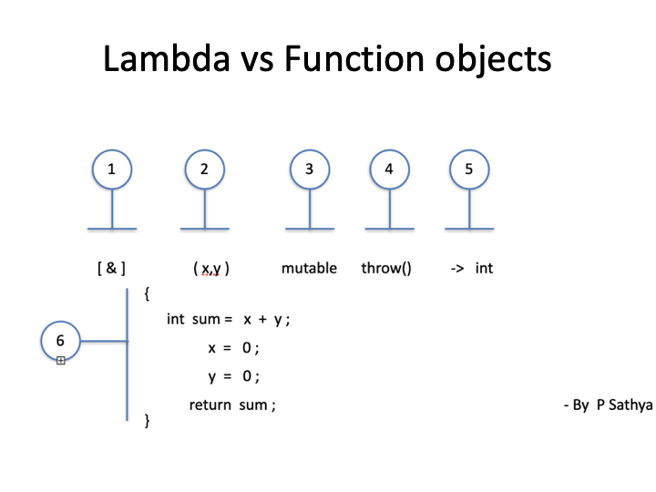
Lambda
/

